Slide 2
2N® Clip
The 2N® Clip is a new 4″ video IP indoor station designed to meet the rising demand for more affordable housing.

Slide 3
Perfect for mid-range projects
The 2N® Clip was designed with the mid-range sector in mind. You’ll get IP video, good design, and the reliability of 2N's products without the premium price tag

Slide 4
Increase security. Upgrade to IP video
Forget blurry videos from outdated analog units - high-quality IP video is the new norm in modern living and is much more secure. Meet the market’s standards with the 2N® Clip!

Slide 5
Fits seamlessly into the 2N ecosystem
The 2N® Clip runs on the powerful, reliable 2N OS – the same as the most premium of products from our workshop. Plus, it can be remotely managed and configured via the My2N Management Platform

Slide 6
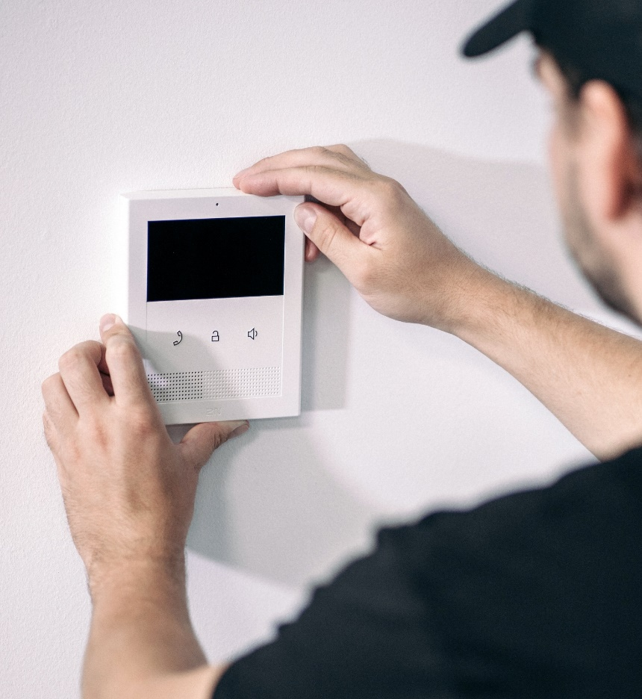
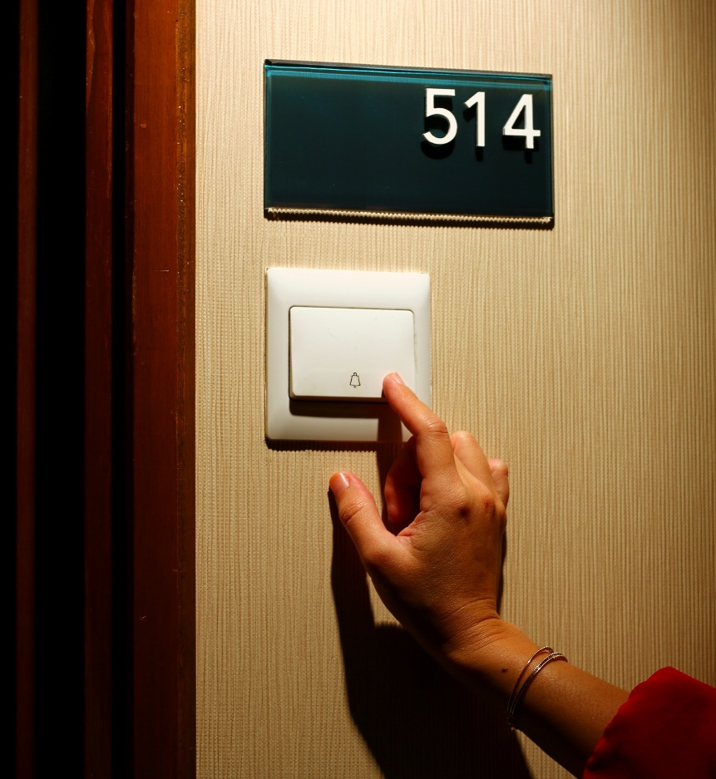
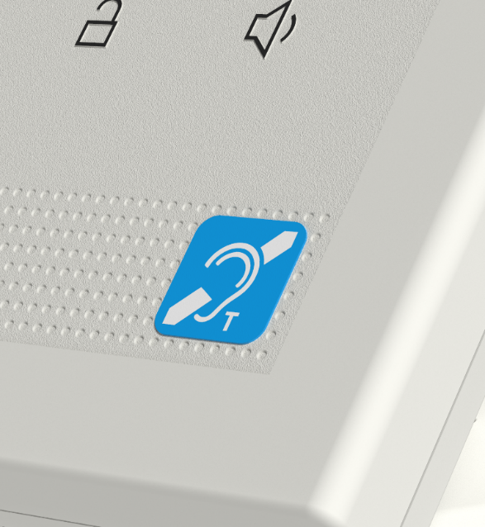
Install it in 3 minutes!
Doorbell button support
Help the hearing-impaired
Drill in two screws and ‘clip’ the 2N® Clip to the wall! This is the fastest indoor station installation
Save money on a traditional doorbell. Simply connect the doorbell button to the 2N® Clip directly
Choose a variant with a built-in induction loop for projects where accessibility is a priority

Slide 7
Technical parameters
Power supply
Type | PoE
PoE | 802.3af Class 0, 48 V DC, 200 mA
User interface
Controls | 3 capacitive buttons
Operation | press and hold the RESET button to restore factory settings
Audio
Microphone | integrated
Speaker | integrated, 2W
Integrated induction loop | optional
Codecs | G.711a/u, G.722, G.729, L16/16 kHz
Video
Display | 4.3” display
Resolution | 480x272 pixels
Codecs | H.264
Interface
LAN | 10/100BaseT, RJ-45
Recommended cabling | Cat5e or higher
Doorbell input
Input type | switching contact (button/relay)
Contact type | normally open (NO)
Contact parameters | 12V/20mA, DC
Mechanical properties
Operating temperature | 32 to 122°F
Storage temperature | -4 to 158°F
Relative operating humidity | 10 to 90 % (non-condensing)
Recommended altitude | 0 to 6,500 ft
Dimensions | 4.88 (W) x 5.91 (H) x 1.10 (D) in
Weight | 0.52 lb

Slide 8
E2E mid-range solution
Bring premium quality to mid-priced residential projects
With the 2N® Clip in your portfolio, you can easily offer comprehensive 2N solution even to the price sensitive projects

Slide 9
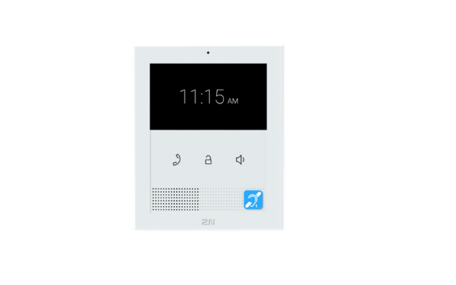
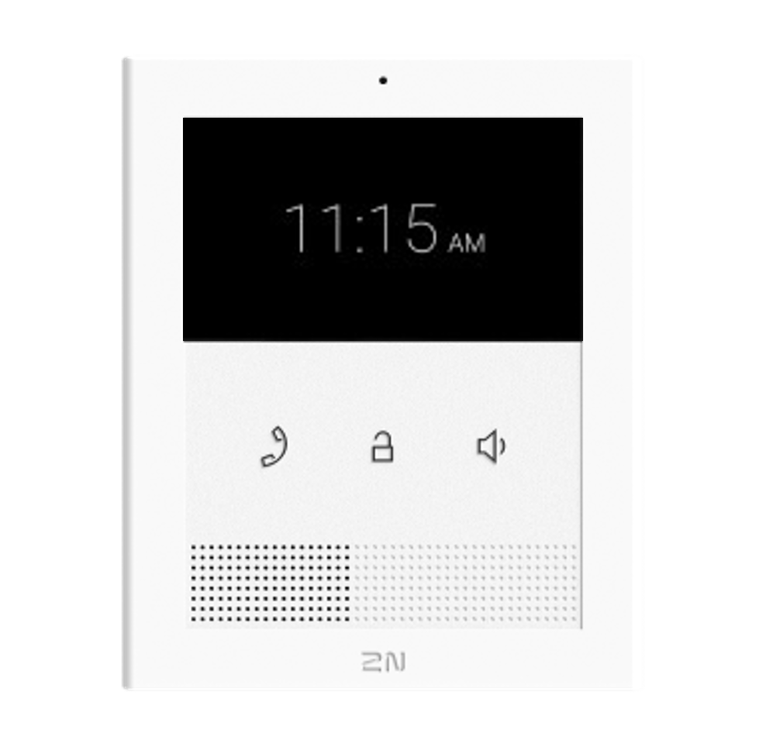
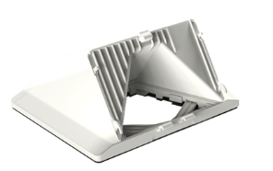
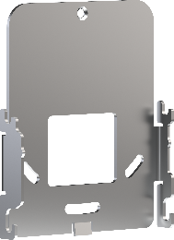
Order Numbers
2N® Clip, Ethernet
2N® Clip, Ethernet, Induction Loop
2N Clip Desk Stand
2N Clip Single-Gang Box installation plate
02892-001
02893-001
02905-001
02906-001

Slide 10
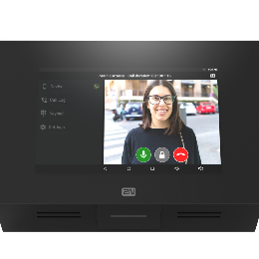
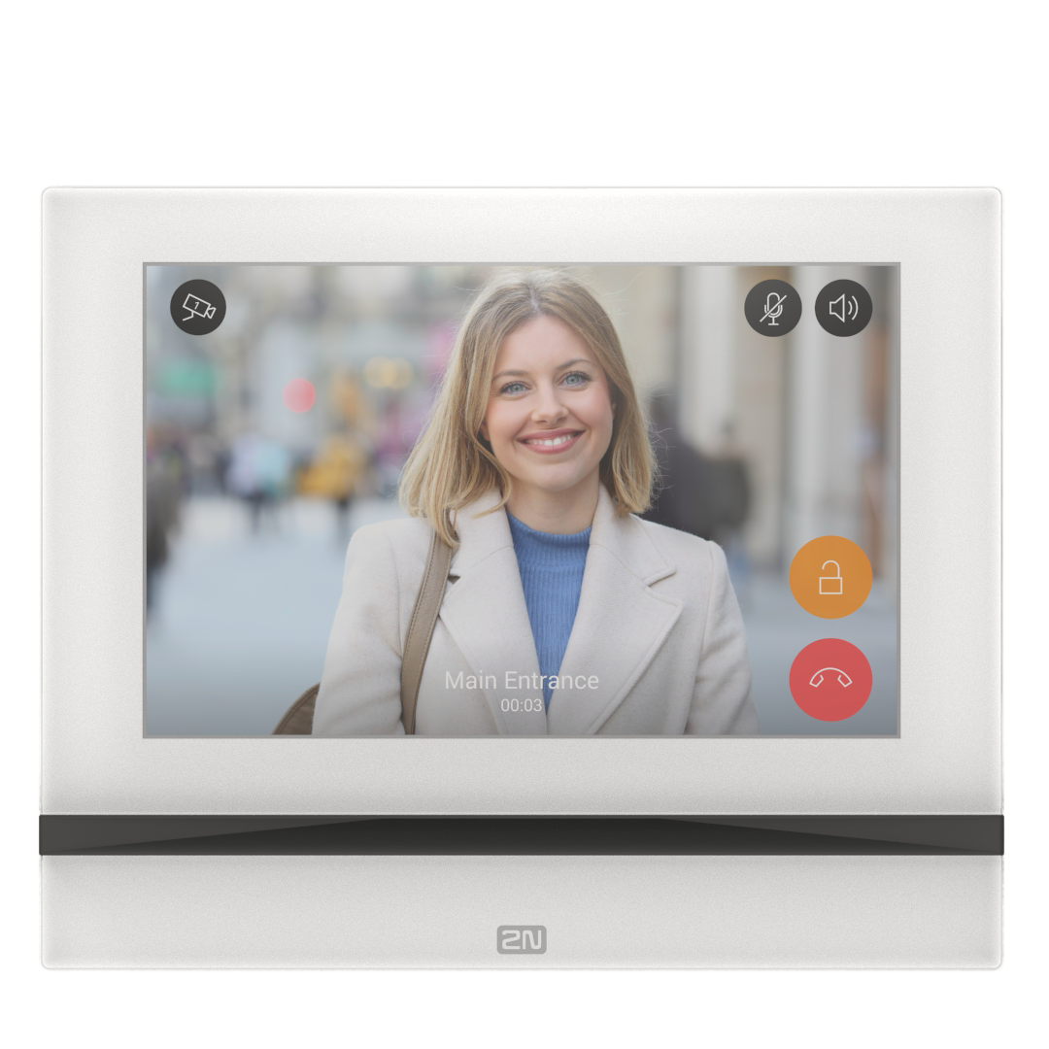
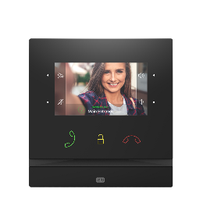
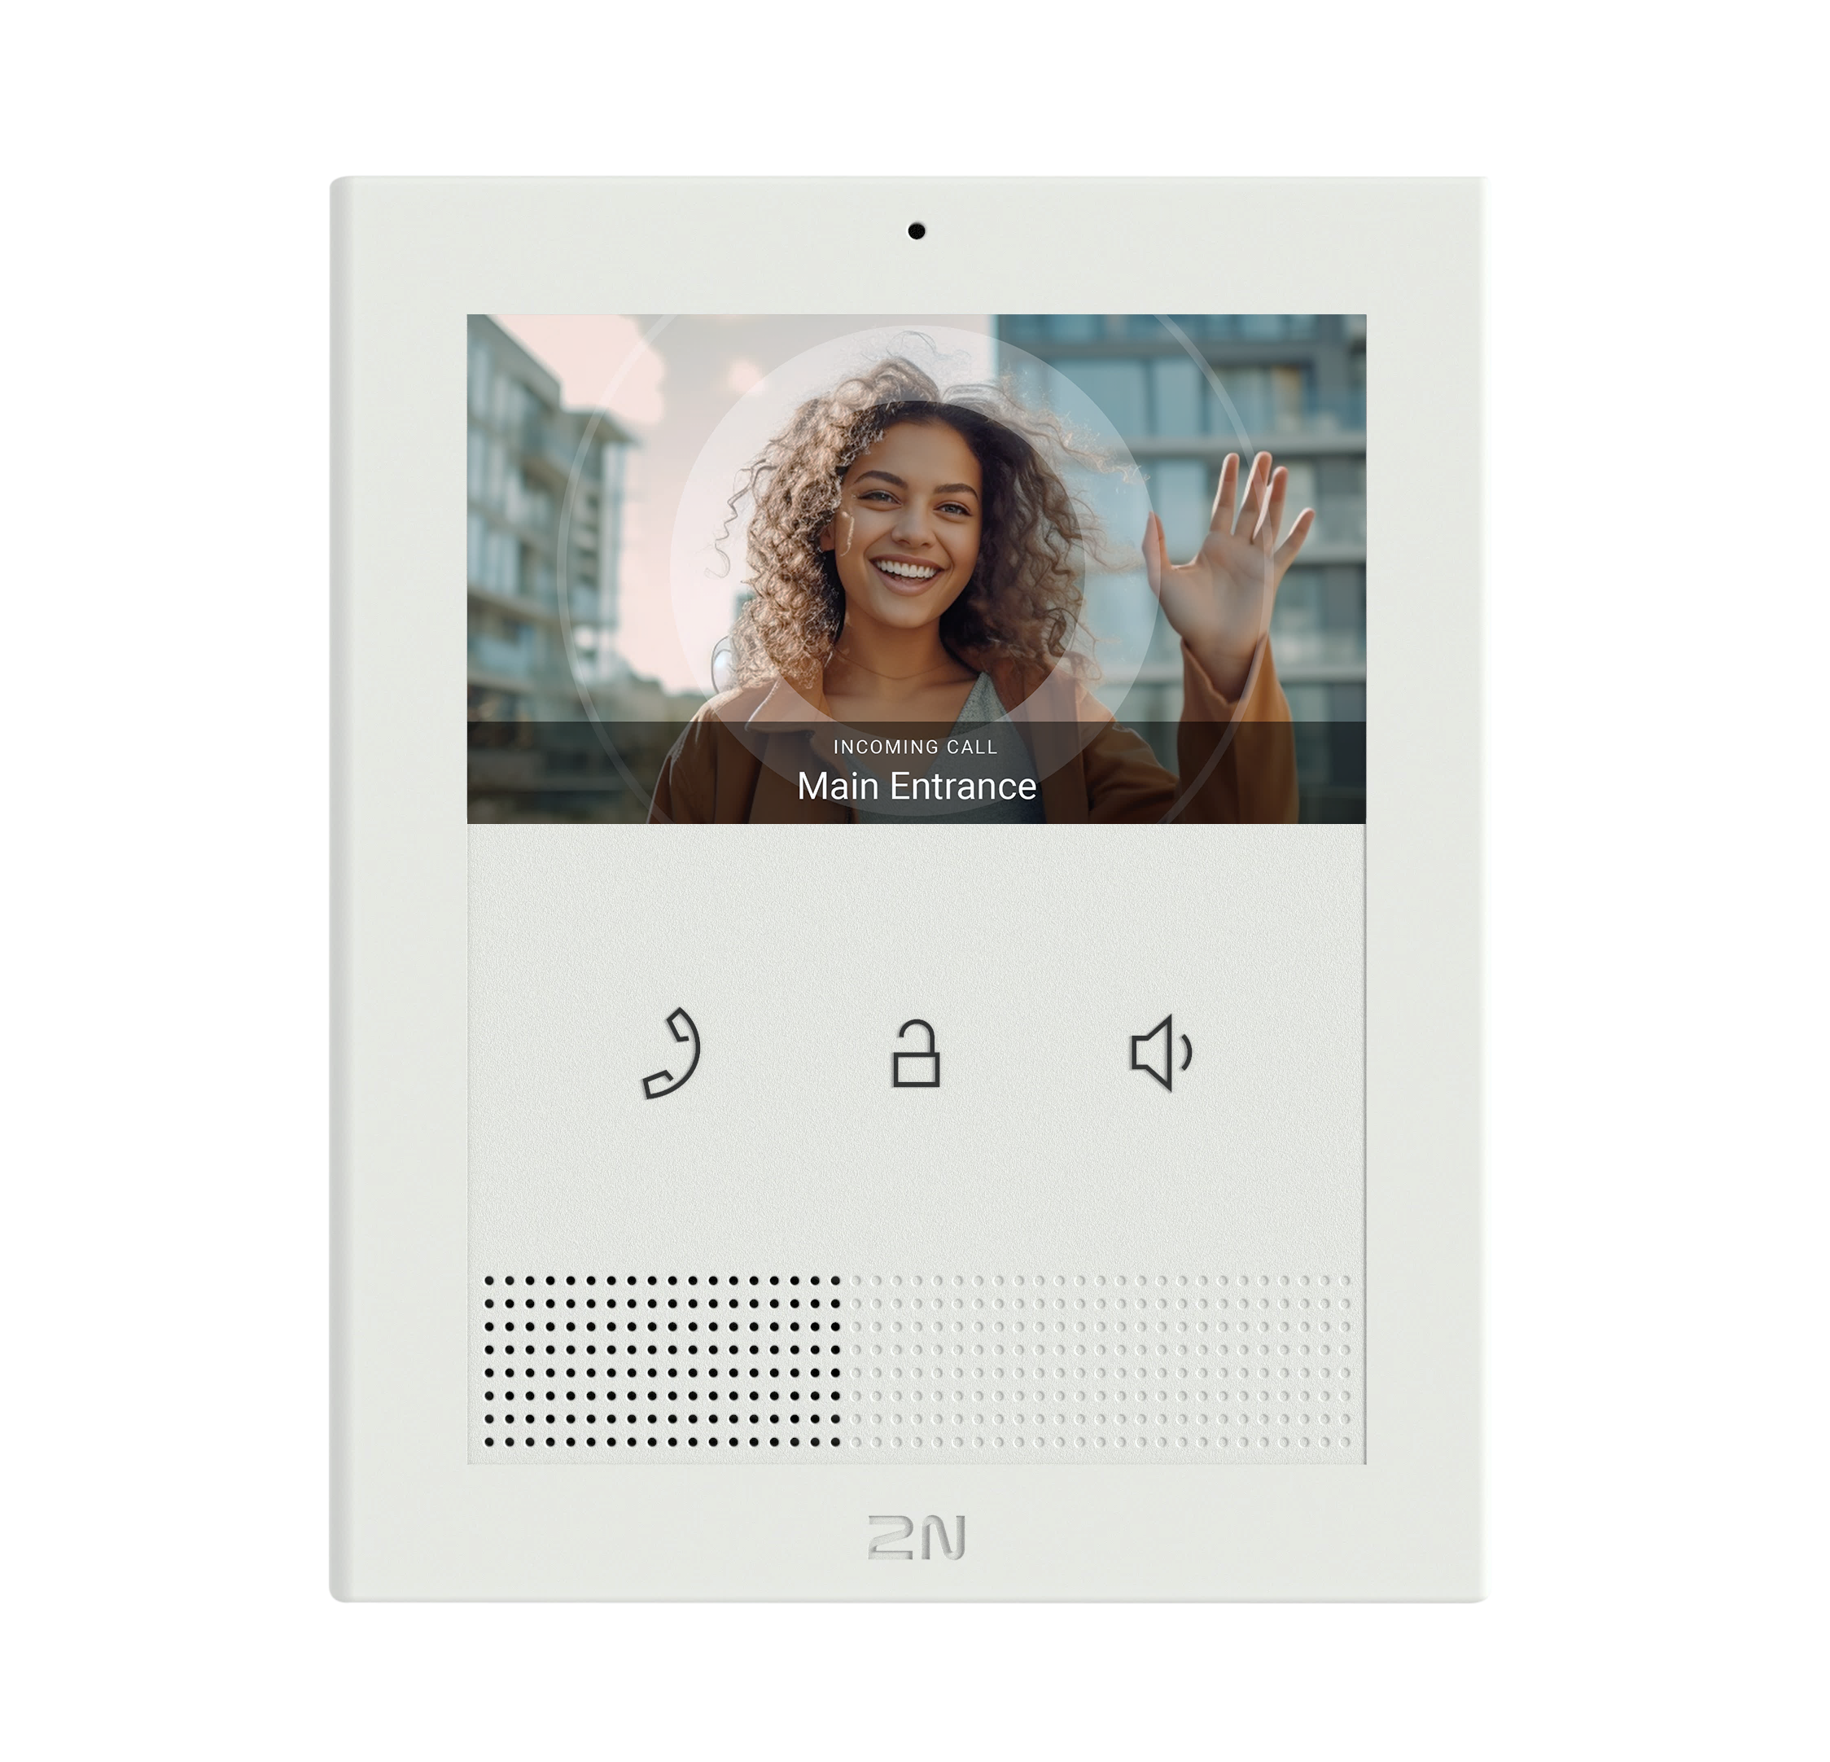
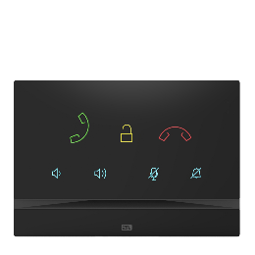
Answering unit portfolio
Home Automation
High-end 7” full screen
High-end 4” video
Cost effective video
Premium audio only
Mobile

Slide 11
Bring the power of IP to every home

