Slide 1
2N Access Commander
Capability without complexity!

Slide 2
Software for efficient access management
2N® Access Commander allows site admins to configure and manage 2N IP intercoms, access readers and other devices in a user-friendly, centralized interface.
Notes:
Well, I’m talking about the decentralized nature of our solution, built on edge devices which combine controller and reader into Component. That;’s the only component type needed in the 2N system – no additional door controllers or system controllers
~That makes it simple and quick and cheap to install, because you drop all of that extra cabling for connecting and powering readers and controllers.
~Despite the simplicity, it’s an incredibly robust system – decentralized means there’s no single point of failure, each and every reader
~ can make access decisions autonomously..
Access Commander protects that system strength, maintaining the autonomy of the devices, whilst offering a single interface through which to manage them all.
So how do we get it up and running?

Slide 3
Cater to SMB & SME needs
Highly robust and flexible system designed for dozens of devices and hundreds of users
Harness the power of a decentralized solution with autonomous hardware (no additional door controllers needed)
Support multiple companies in a single installation
Minimise set-up time, maximise profits
Notes:
Well, I’m talking about the decentralized nature of our solution, built on edge devices which combine controller and reader into Component. That;’s the only component type needed in the 2N system – no additional door controllers or system controllers
~That makes it simple and quick and cheap to install, because you drop all of that extra cabling for connecting and powering readers and controllers.
~Despite the simplicity, it’s an incredibly robust system – decentralized means there’s no single point of failure, each and every reader
~ can make access decisions autonomously..
Access Commander protects that system strength, maintaining the autonomy of the devices, whilst offering a single interface through which to manage them all.
So how do we get it up and running?

Slide 4
Two options of distribution
Virtual machine
Box (embedded PC)
Fully scalable for larger installations
Quick import to dedicated virtual server
Common virtualization platforms supported (VMware, Microsoft Hyper-V, Oracle Virtual Box)
Plug & play solution installed in a few minutes
Intended for SMB/SME installations
Optimized for up to 2.000 connected 2N devices
Configuration via a web browser (PC/MAC in the LAN)
2N Access Commander can be downloaded for free as a virtual appliance or you can buy it already installed on a mini-PC
Notes:
Software is distributed as a complete image file that has to be imported to dedicated virtual server. It already includes web server, database server and all other applications.
It takes an advantage of an IT-friendly language which means that average IT guy will install this software within few minutes.
This distribution is suitable especially for larger companies.
2N® Access Commander Box – plug and play access control solution that is tailored to be installed within a minute by any installer. There is no need for a dedicated server in the company. Intended mainly for SME market with up to 2000 connected 2N devices.

Slide 5
Key features
User Management
Assign user access credentials, access groups, and contact details in the system.
Set the required levels of management rights for users so they work with a more restricted 2N Access Commander if needed
Device Management
Update firmware in bulk and with a few clicks, ensuring optimal performance and security of devices.
See immediately if devices are all online and check their door states.
Access Rules Setup
Intuitive, lightning-fast settings enable users to go wherever they want, whenever thanks to our innovative graphical matrix – offering huge time savings and making audit a piece of cake.

Slide 6
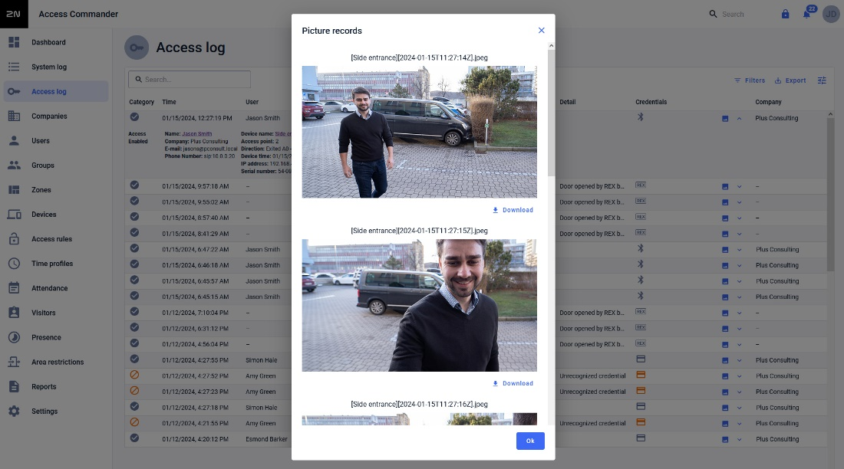
Logs & Notifications
Clear lists of all access events with powerful filtering and customization options (just display what is relevant for you)
CAM logs: complete the access logs with a sequence of images from the intercom camera
Work with different events: door forced open, door open too long, tamper alarm, user access granted/denied and more
Respond effectively to events thanks to instant alerts by email or in the notification channel.

Slide 7
Keep track of people
Time & Attendance
2N Access Commander offers native attendance monitoring features.
Track user attendance, view reports in the software, and export records to PDF or CSV.
Presence
See who’s in the building at a glance from our live Presence page - including when they entered and in which zone.
Area Restrictions
Tighten security and enforce access policy compliance with the Anti-passback function.
Restrict how many people are allowed in an area with Occupancy Management.

Slide 8
Features that improve workflow & make us stand out

Slide 9
Dashboard Widgets
Create a unique dashboard layout for every admin
Put door control - including live intercom camera feeds - right where it’s needed
Monitor recent Access and System log events easily
Enroll visitors quickly and see who’s still actively visiting the site
IT managers can see system resources, licensing information, the status of devices, and an installation overview

Slide 10
Visitor Credential Management
User access & visitor access rights in one
Easily onboard visitors
Grant time-limited access to the areas you choose
Issue credentials remotely for self-serve access (such as QR, PIN and LPR)
Maintain an audit trail for compliance
Simplified visitor management mode for mobile browser (QR/PIN only)

Slide 11
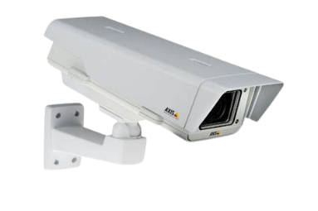
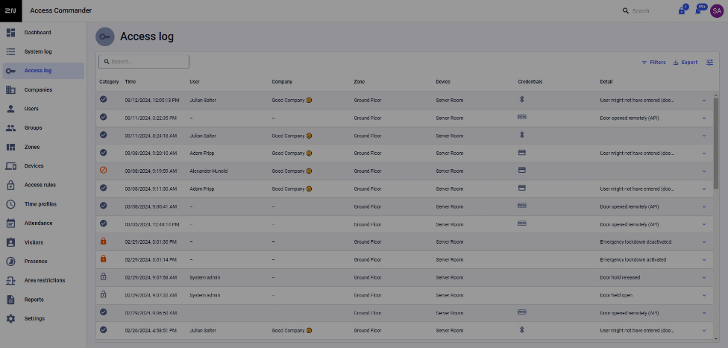
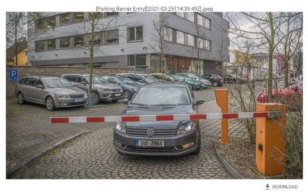
LPR Support
Enforce a secure access policy for car parks, garages and vehicle barriers
License plate as another credential
Integrates with Axis cameras running AXIS license plate verifier or Vaxtor VaxALPR software (ACAP)
Combine it with WaveKey for multi-factor auth.
Keep a log of images in Access Commander

Slide 12
Lift Access Control
Secure floors as well as doors
Access to selected floors only after successful authentication (different credentials)
Public floors available for everybody
2N Access Unit or IP intercom connected with Axis I/O module A9188 (control up to 64 floors)
Set configuration and access rights in 2N Access Commander

Slide 13
Open to Integration
Integration makes an admin’s life easier with one connected system
REST API offers endless integration possibilities
LDAP support and custom mappings streamline workflow with user directories
CSV sync provides low-level integration with simpler systems
Special plugin for Milestone Xprotect® Access
Notes:
Integration makes a life easier mostly to administrators and installers.
Therefore we’ve created 2N® Access Commander as a software that can be easily integrated with VMS, T&A, alarm and other 3rd party systems using the REST API web interface or special 2N plugin.
CRM ... customer relationship management
BMS ... building management systems (or property management or asset management solution)

Slide 14
Encrypted Credentials
Support for 2N® PICard Commander
2N’s unique cryptographic solution, providing Protected Identity Credentials (PIC)
Built on multi-application MIFARE® DESFire® technology (supports EV2 and EV3 cards)
2N Access Commander shares your encrypted reading keys with all 2N IP intercoms and access units in the installation

Slide 15
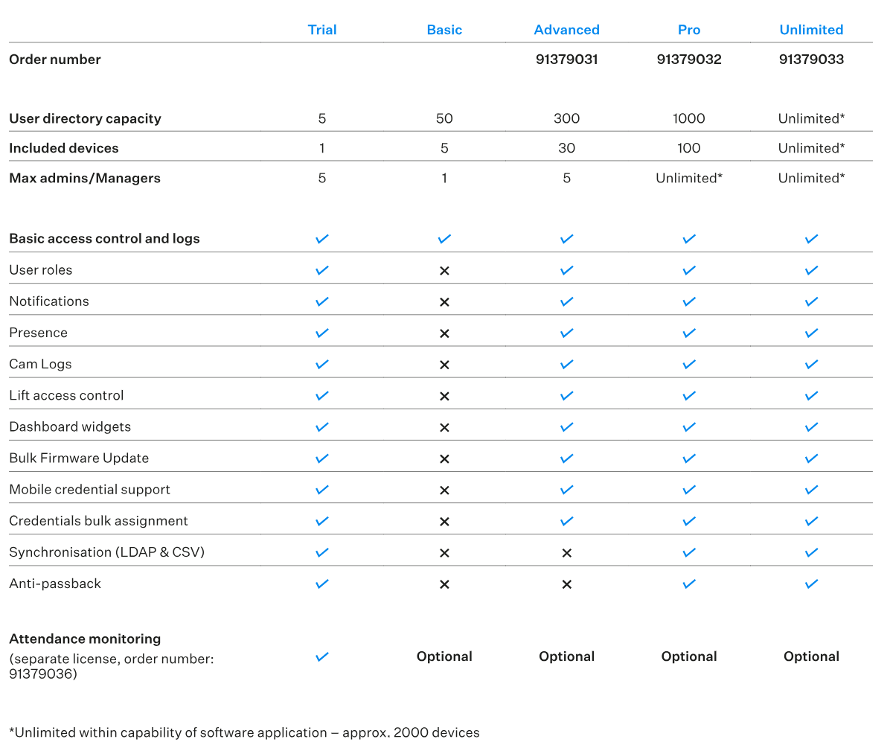
Licensing
2N® Access Commander
2N Access Commander Trial license enables you to test all the management functions with one device and five users.
Our free Basic license is ideal for small businesses where simple access control is needed.
Advanced is great for SMBs looking for extra value features.
Pro is perfect for larger businesses or office chains.
Need more scalability? Choose Unlimited.
One-time fee, no recurring charges or subscriptions.

Slide 16
2N Access Commander
Capability without complexity!

