Slide 1
2N® PICard
Manage secured RFID cards using our user-friendly solution

Slide 2

Why to use encrypted RFID cards?
To outmatch modern security threats
Outdated 125kHz cards are very easy to clone
  Their UID (CSN) can be read by any RFID reader
Growing demand from market for secured cards
  The most widespread technology is MIFARE® DESFire® with the perfect balance of speed, performance and cost-efficiency

Slide 3
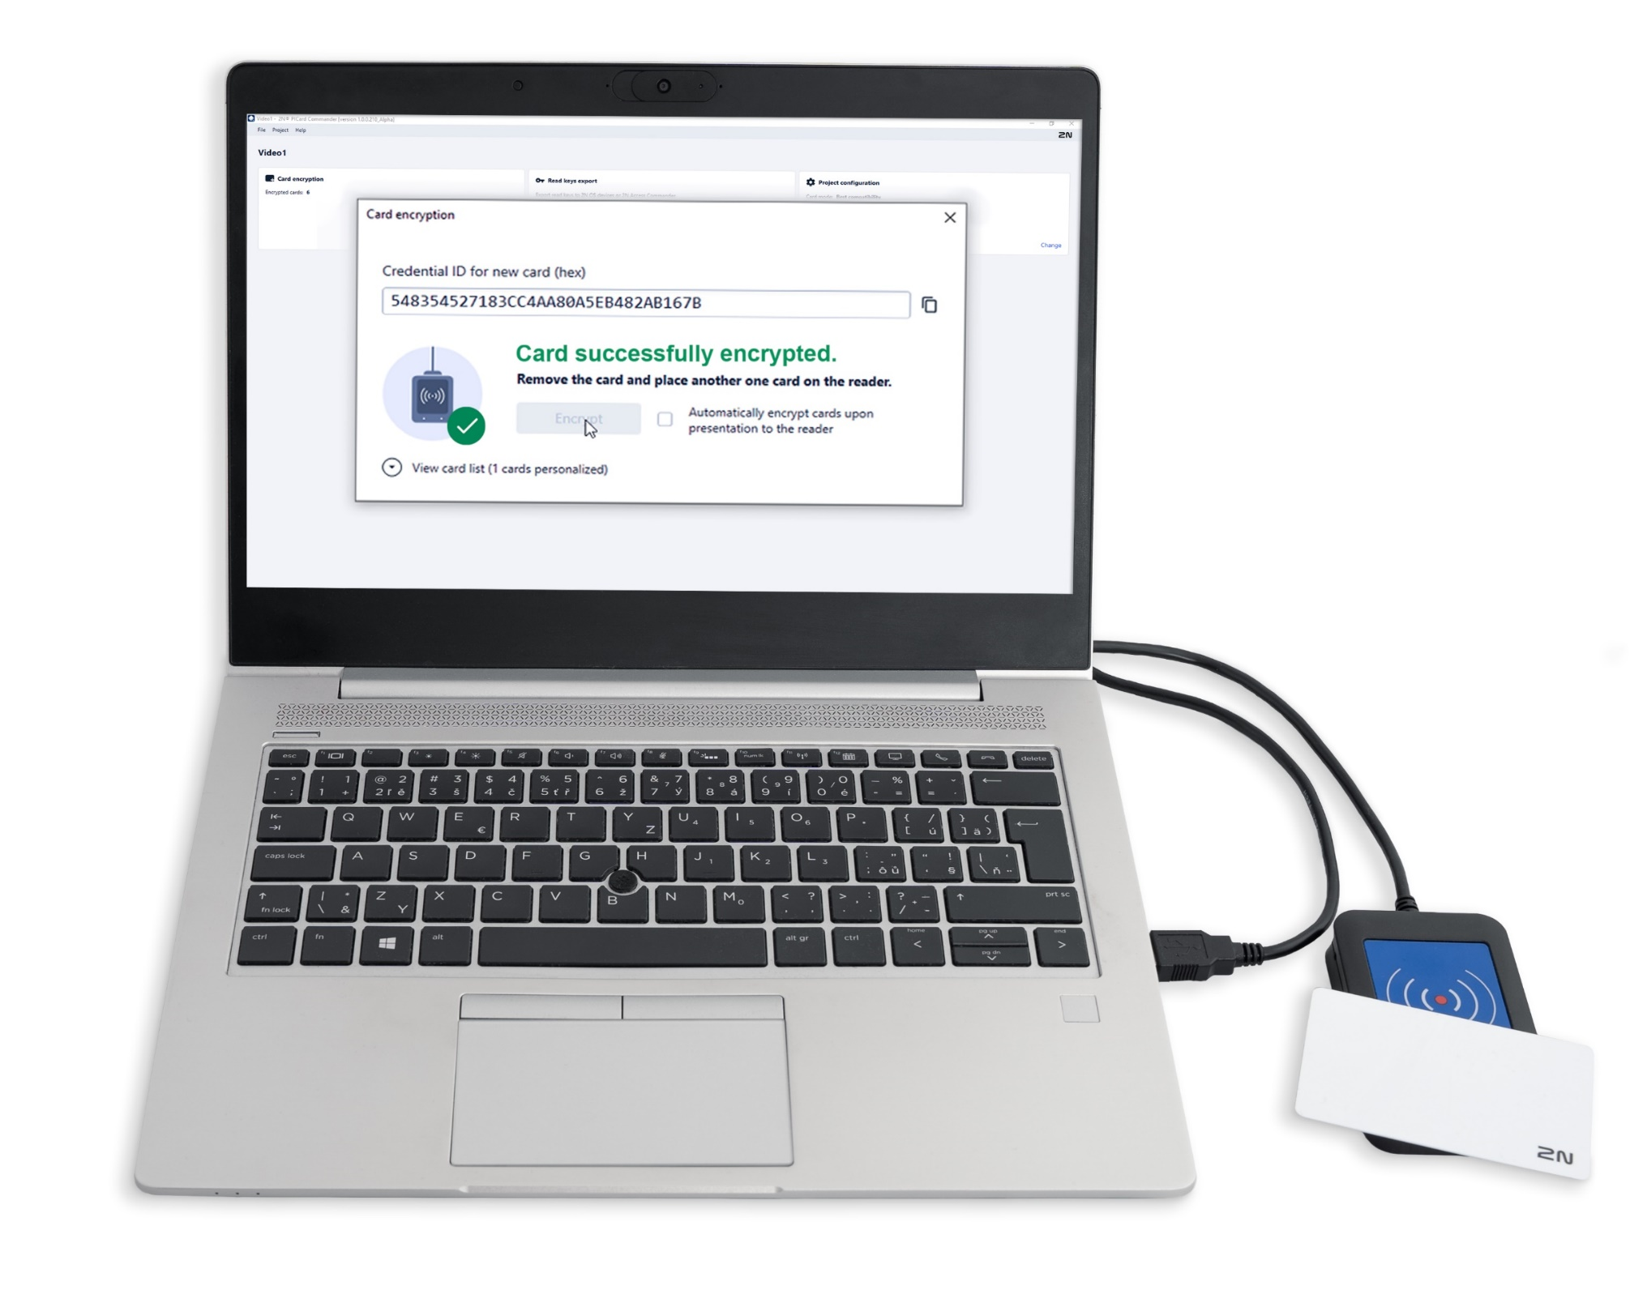
Provide safety & flexibility with 2N® PICard
2N’s unique cryptographic solution, providing Protected Identity Credentials (PIC) built on the multi-application MIFARE® DESFire® technology

Slide 4
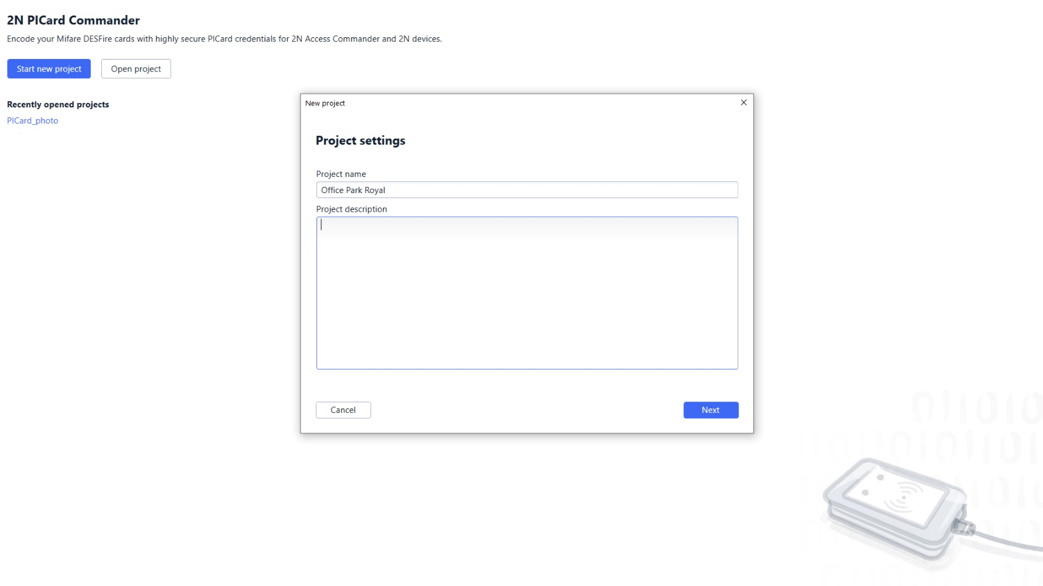


2N® PICard Commander
The heart of the entire solution
Software app that allows admins to create a unique cryptographic keyset for every site
Keysets are based on the main encryption key (MEK) from which other keys are derived:
Encryption keys
Reading keys
Used to encrypt new credentials on cards via a 2N USB reader
Exported and uploaded directly to the 2N devices or to 2N® Access Commander

Slide 5
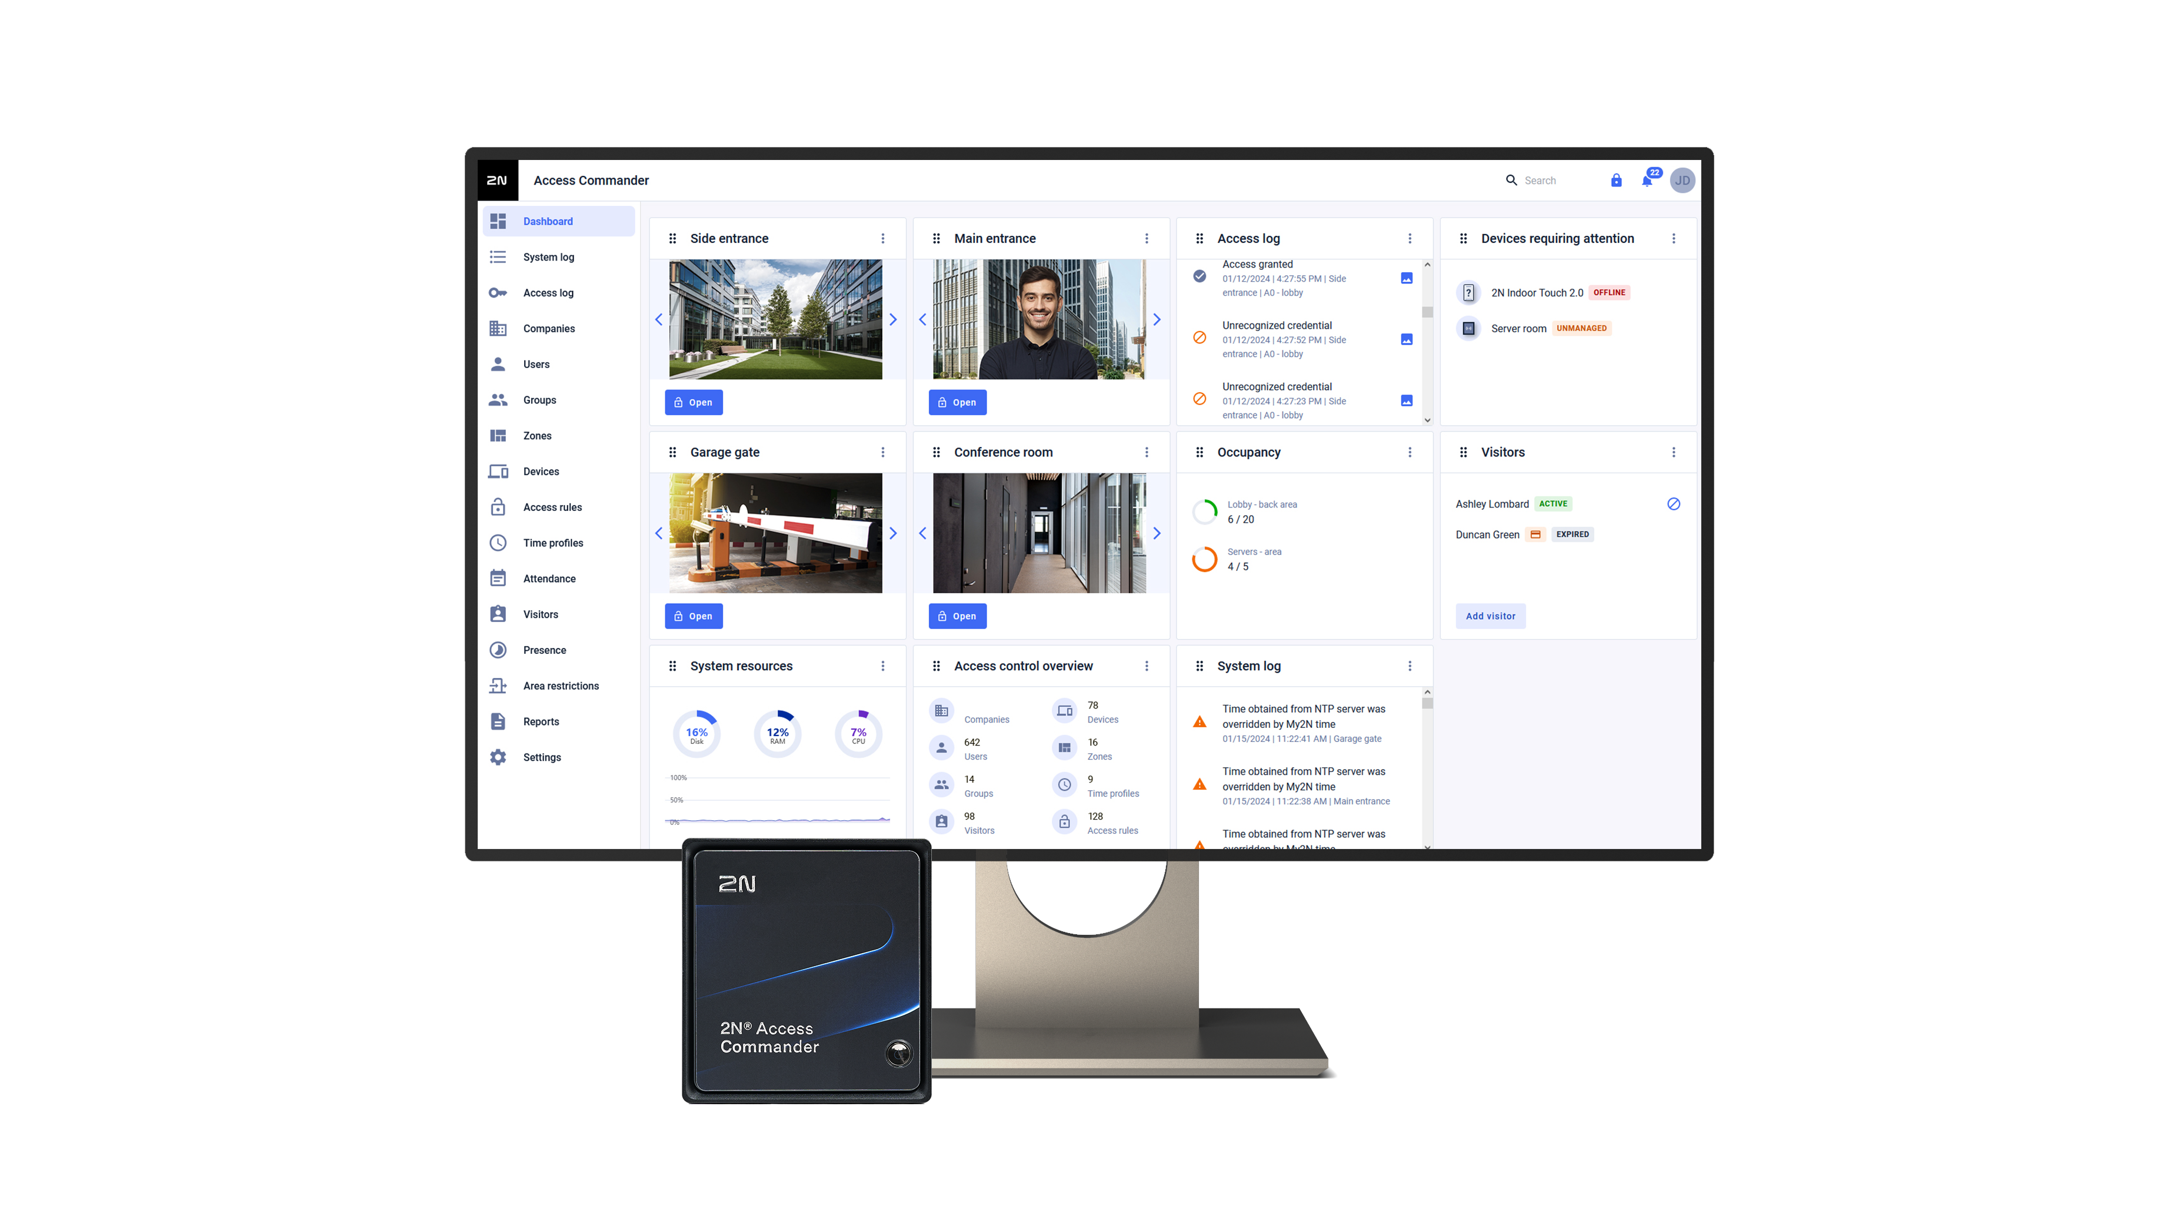
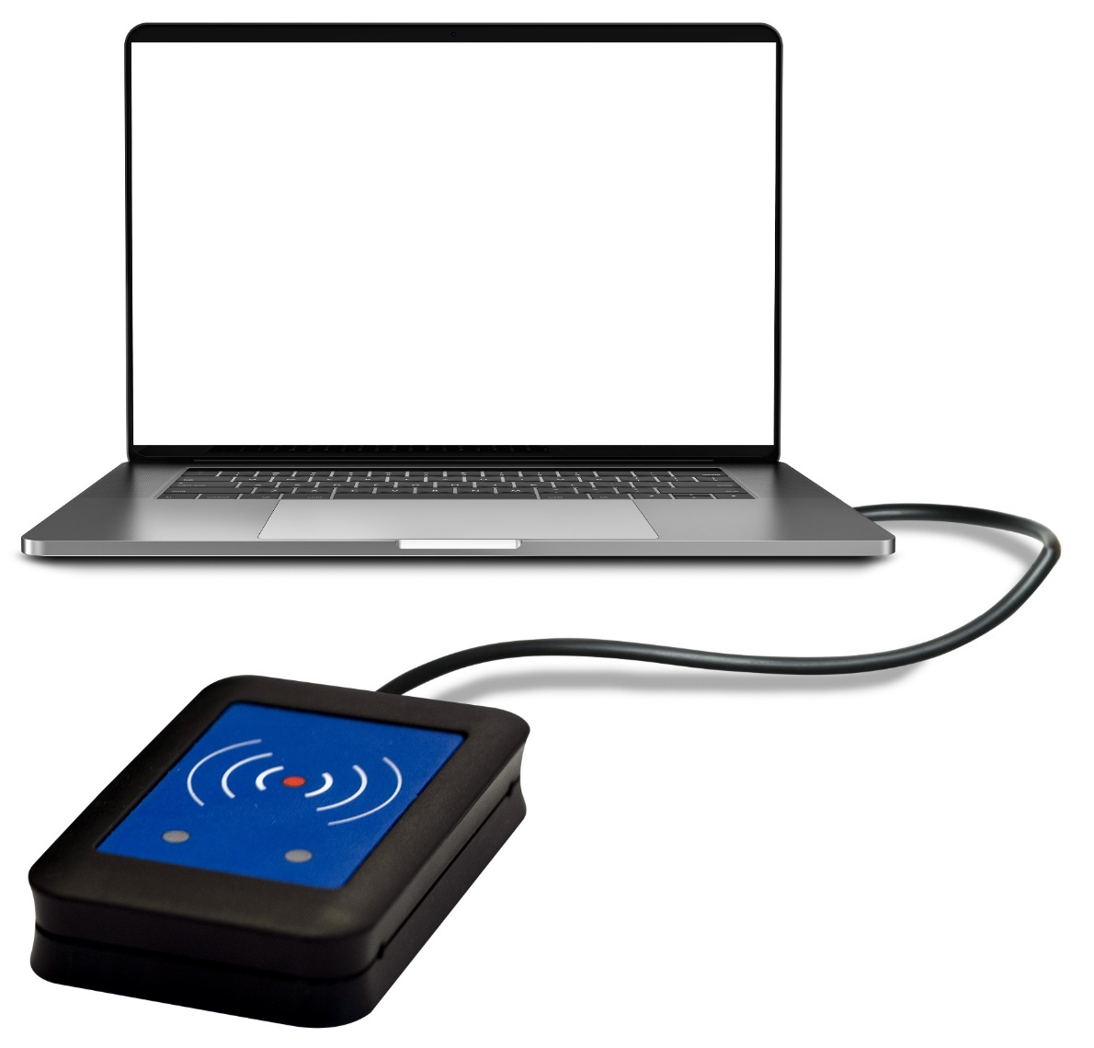
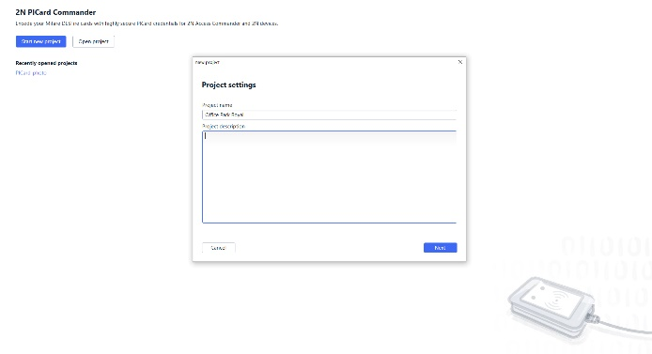
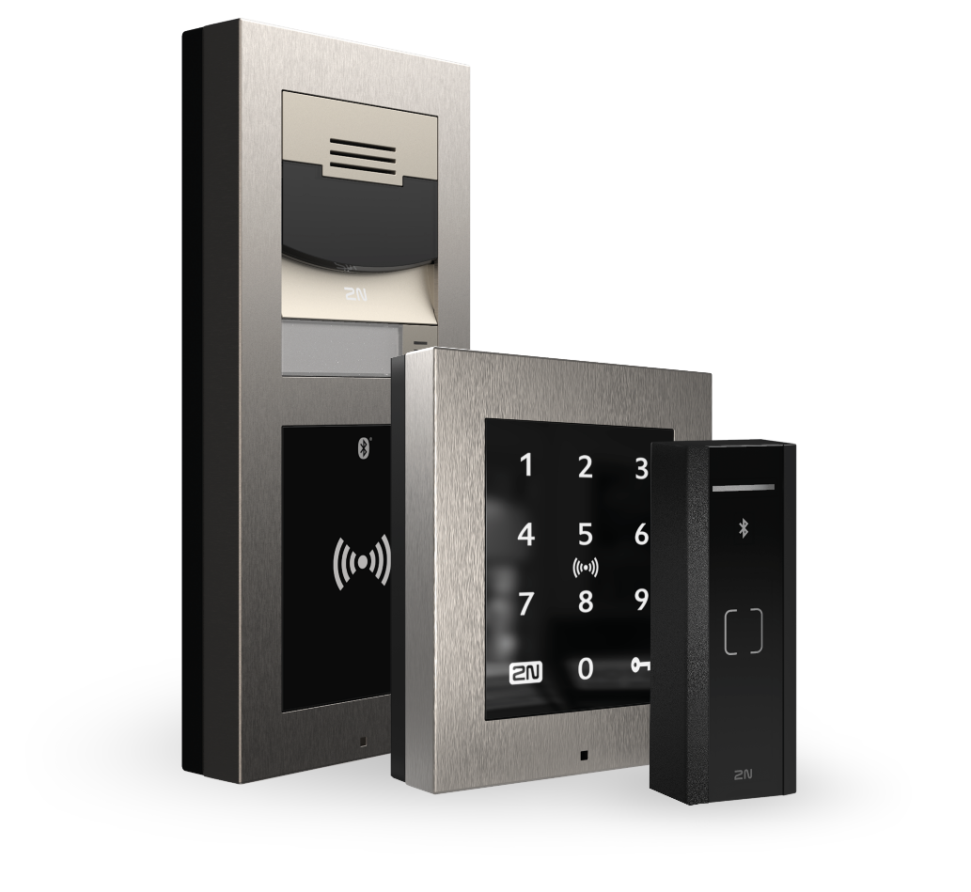


How 2N® PICard works
2N® PICard Commander
2N® Access Commander
2N USB reader
2N IP intercoms & readers (2N OS)

Slide 6
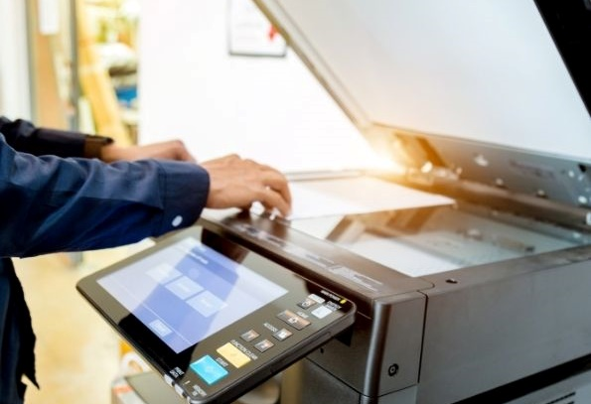


Three ways of card encryption
High compatibility
High security
Customizability
Card may be used not only for 2N access control (access credentials are encrypted by 2N® PICard), but also for other things such as the coffee machines or printers.
Card is used exclusively as an access credential for 2N devices. The original unencrypted card’s UID is then randomized (always different when read by a reader).
The customer already uses their own DESFire® cards with other third-party apps and they need to write encrypted 2N® PICard credentials on them.

Slide 7

Licensing policy
One-off license per USB reader
Encrypt secure MIFARE® DESFire® EV2/EV3 cards from any computer, but always with a licensed 2N USB reader
Part number of the license: 02722-001

Slide 8
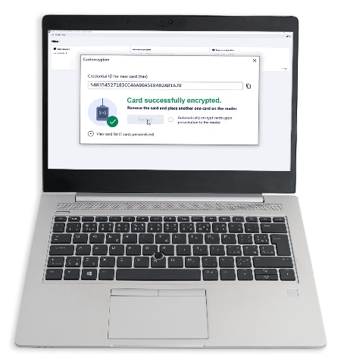
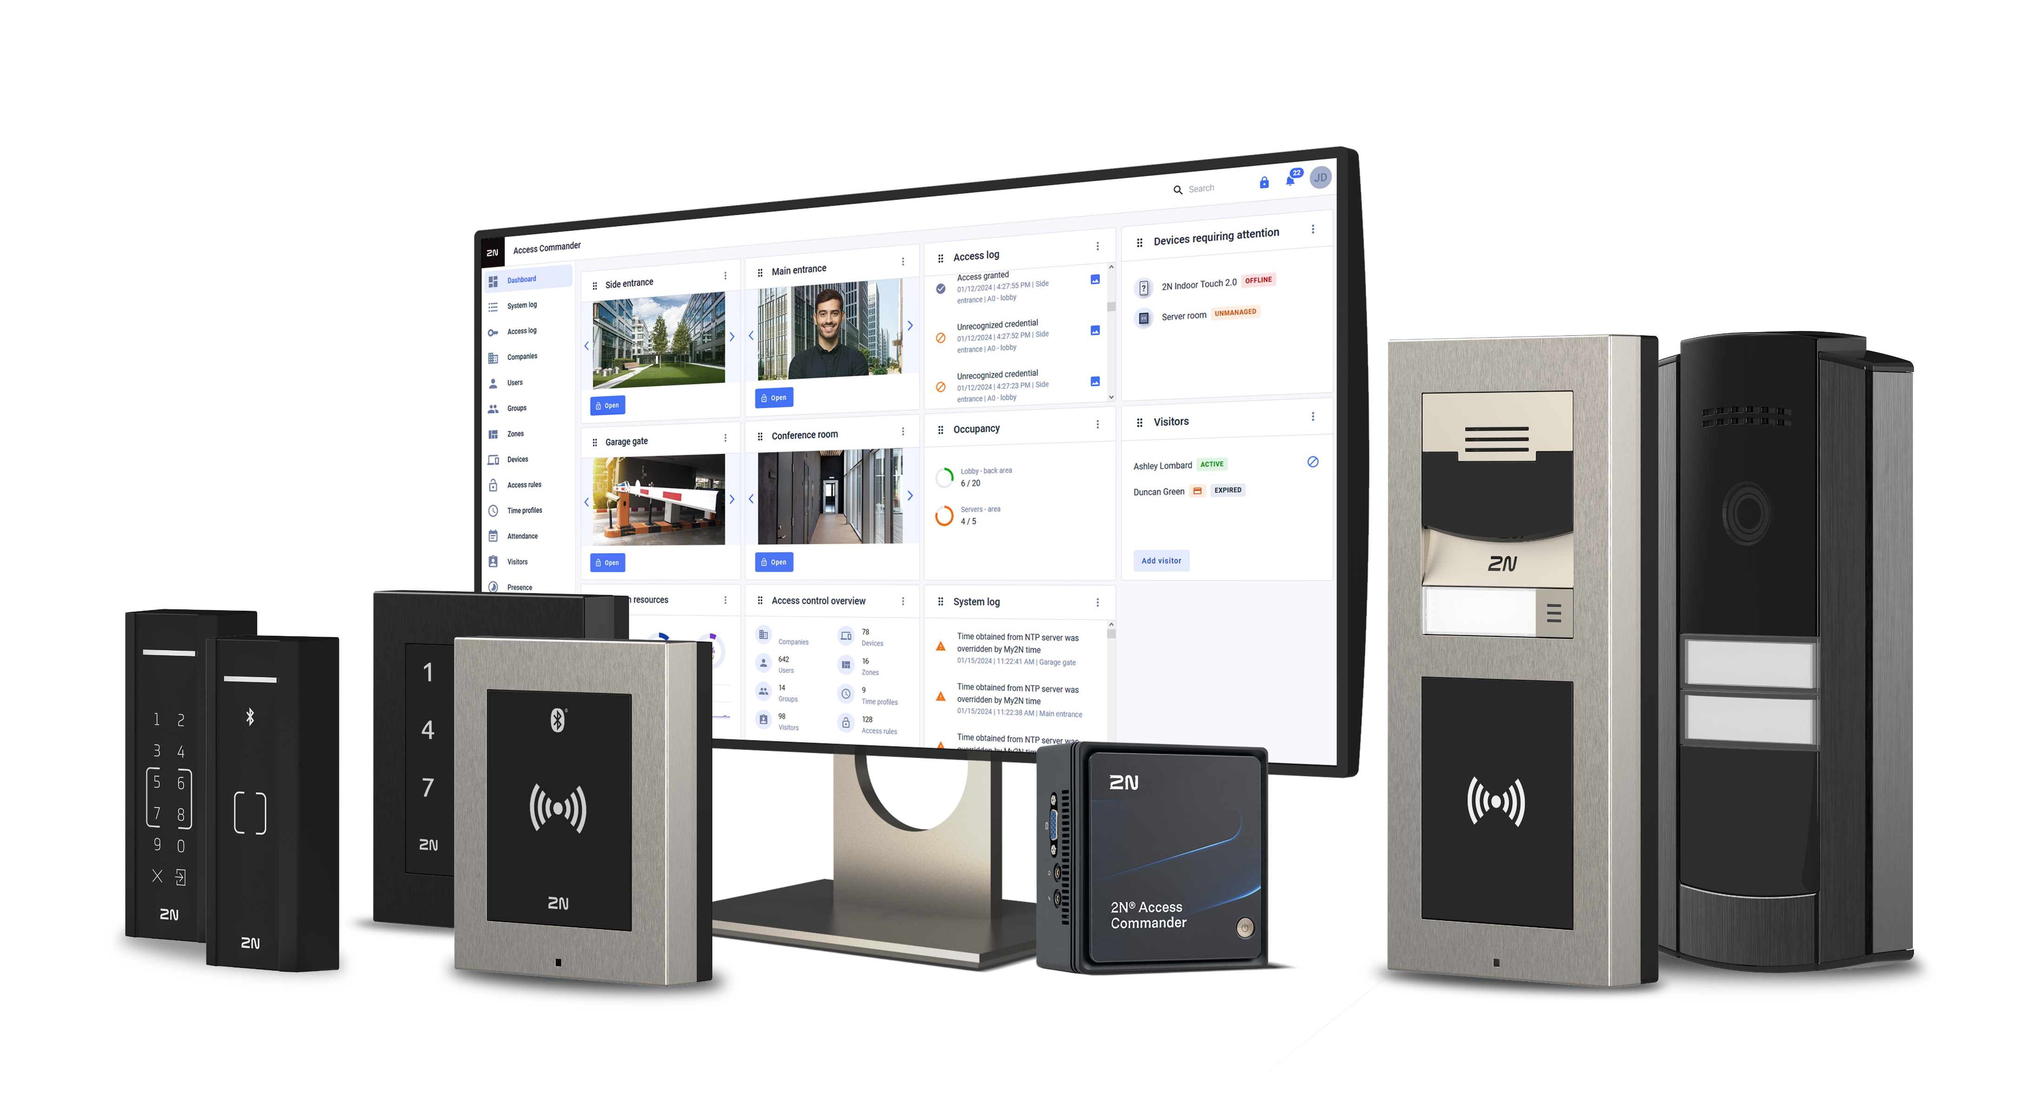

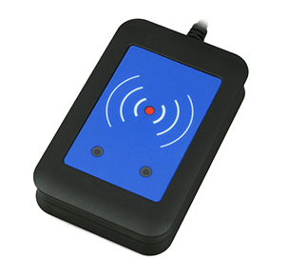
One-stop shop
Offer your customers a complete access control solution including secure card management. All from one manufacturer.
2N Access Control portfolio
2N® PICard Commander
Wide portfolio of IP intercoms and smart readers managed via 2N® Access Commander software
Software for management of secure cards
2N USB reader
Used for the encryption of secure cards
2N cards and fobs
MIFARE® DESFire® EV3 cards
Notes:
2N® PICard is a technology for the encryption of secure MIFARE® DESFire® EV2/EV3 cards and is part of a comprehensive & truly secure access control solution from 2N.
Multi-technology smart readers available in two versions
Slimline design – installation on door frames
Elegant design – installation in the wall and on the glass

Slide 9
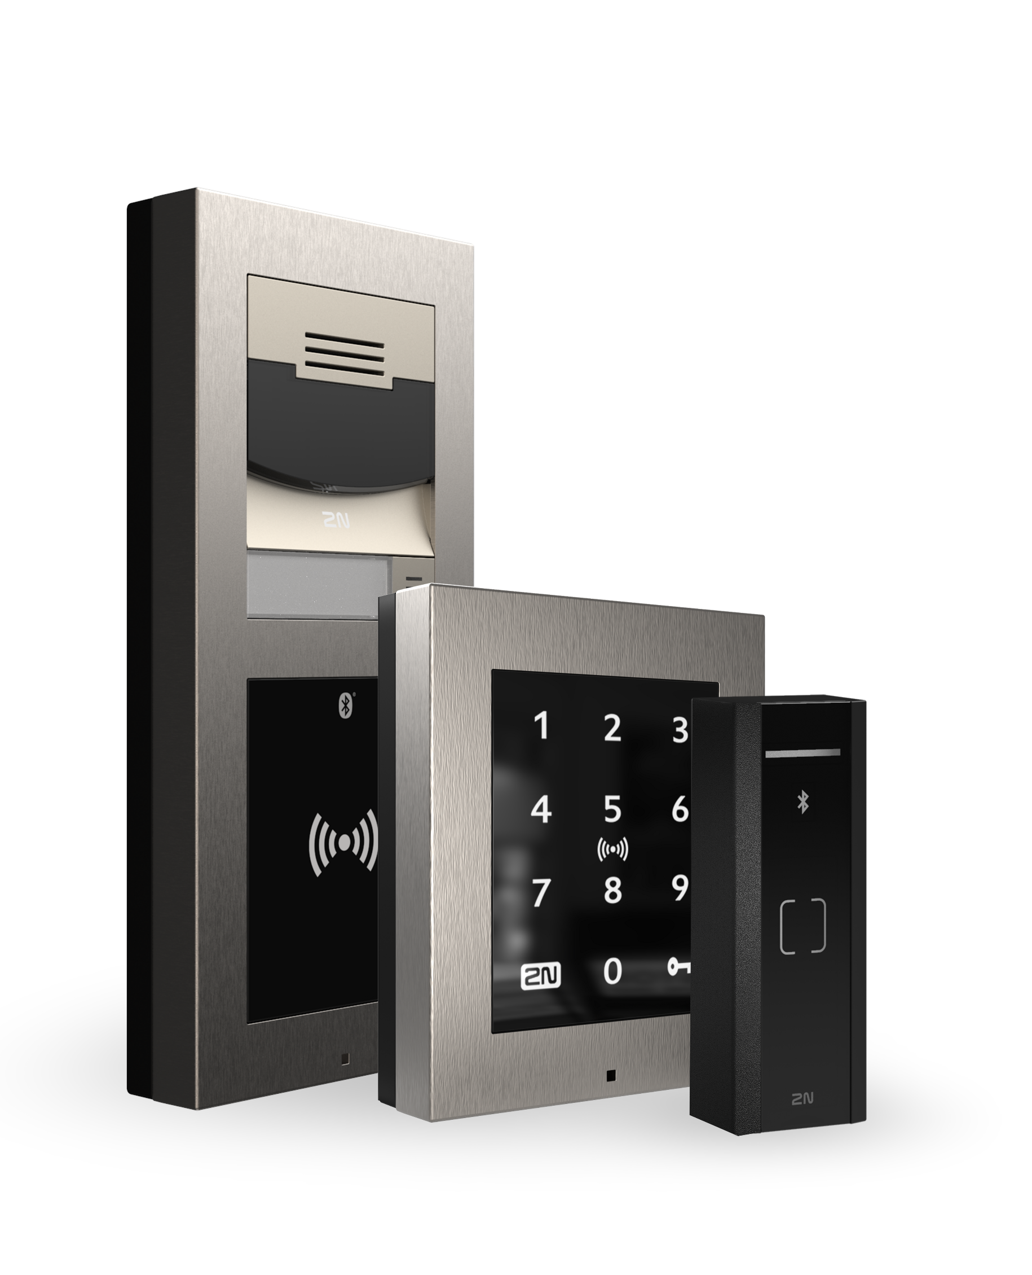
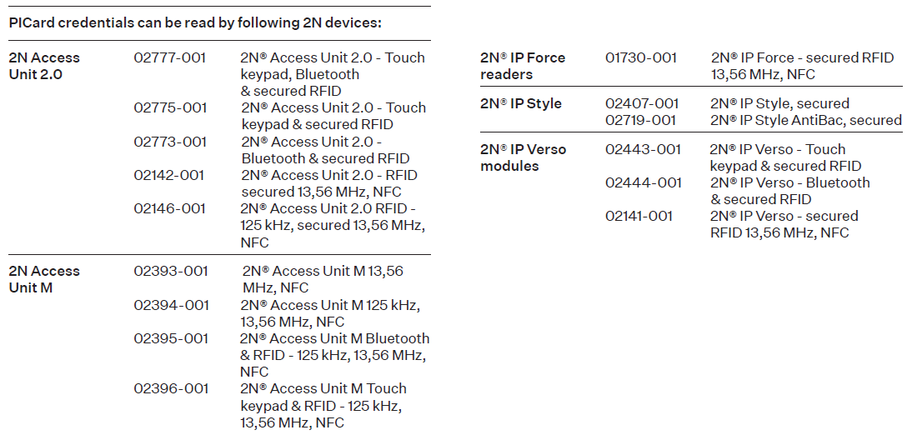
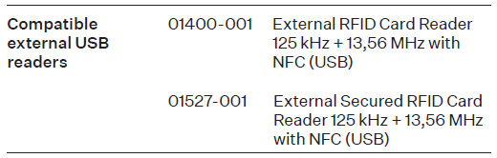

Compatibility with
2N devices

Slide 10



Why to choose 2N® PICard
2N® PICard is part of the complete 2N access control ecostytem
Multi-level security
Flexibility
Simple workflow
Minimizes the chance of access credentials copying and eavesdropping
Based on standards:
AES-128 encryption
ECDSA digital signature
MIFARE® DESFire®
For facility managers taking care of their own building
For system integrators managing more buildings
Management of secure card can be offered as a service
Capability without complexity: you don’t need to be a card format expert to manage secure cards and create keys
Three options of card encryption
Notes:
2N® PICard is a technology for the encryption of secure MIFARE® DESFire® EV2/EV3 cards and is part of a comprehensive & truly secure access control solution from 2N.

Slide 11
2N® PICard. Secure solution for your next access control project.

