Slide 1
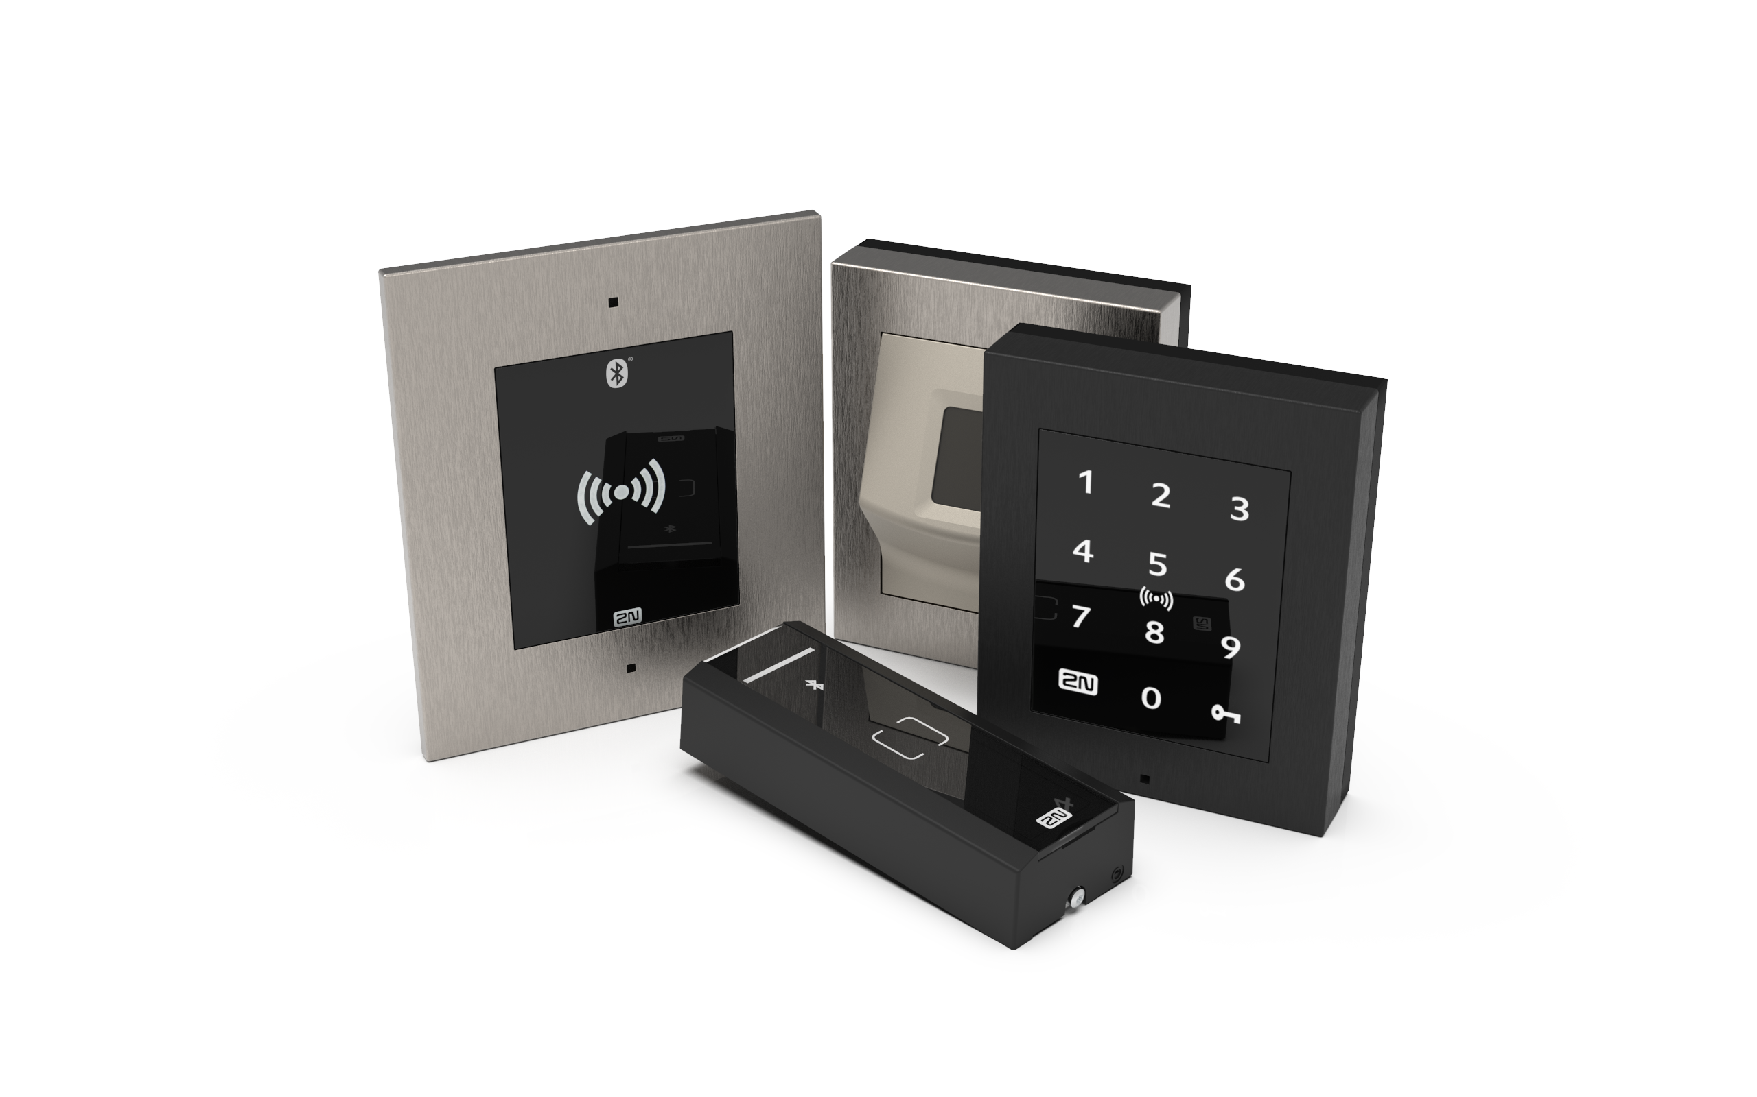
IP Access Control
Reconsider Access Control as you know it!

Slide 2
AGENDA
How is Access Control usually solved?
2N Access Commander – easy to use software
2N Access Unit portfolio – standalone IP device
2N IP intercoms – devices combining access control with audio-visual communication
Integration with 3rd party systems

Slide 3
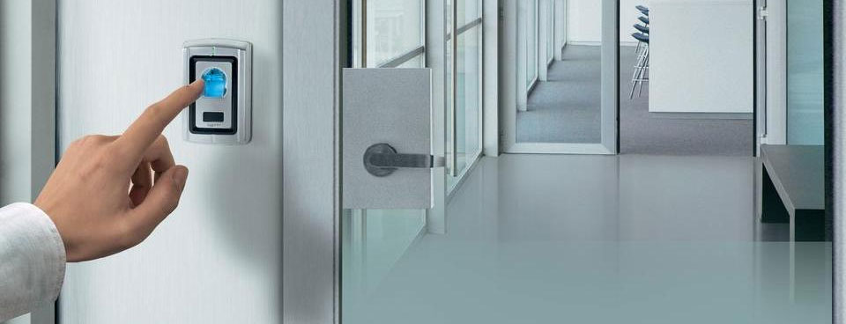
How is typically access control solved?

Slide 4
...but sometimes readers are not enough!
How would you allow the access to:
visitors
employees who lost / forgot their key or card
disabled people
You need something more than a “reader”...
... you need an INTERCOM!

Slide 5
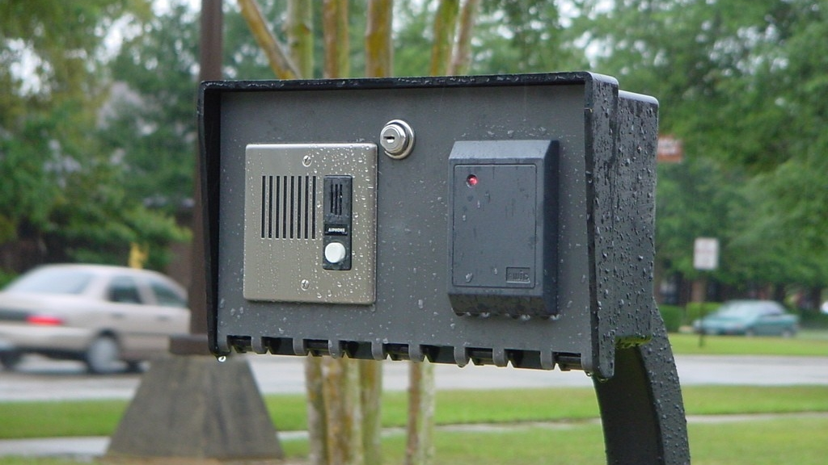
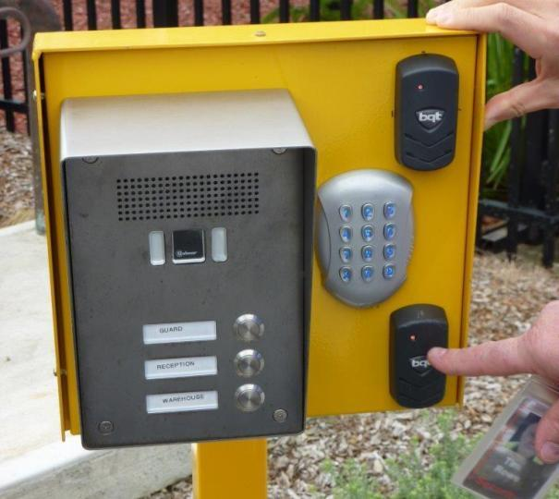
Try to prevent installations like...

Slide 6
think wisely and do it stylish!!

Slide 7
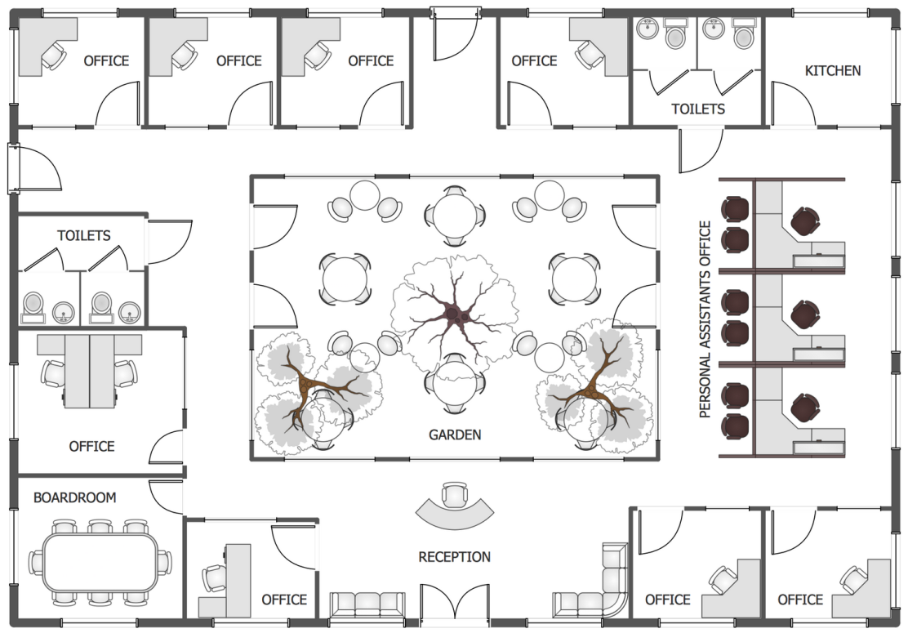
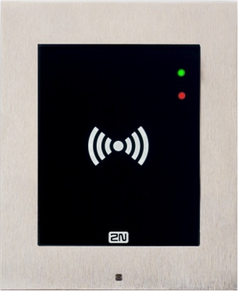
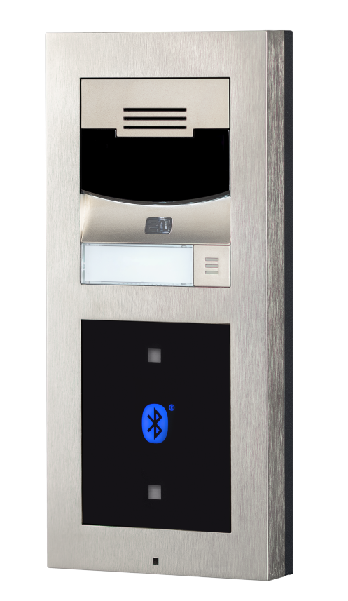
What if you have a lot of devices and users?

Slide 8
Configuration of the system is crucial
Access Control is not only about these devices,
it is mainly about the software,
which is the brain of the solution and allows admin to control all devices from one place
Software makes the differences!
Notes:
Such AC software should be easy to use and offer all functions requested from AC market

Slide 9
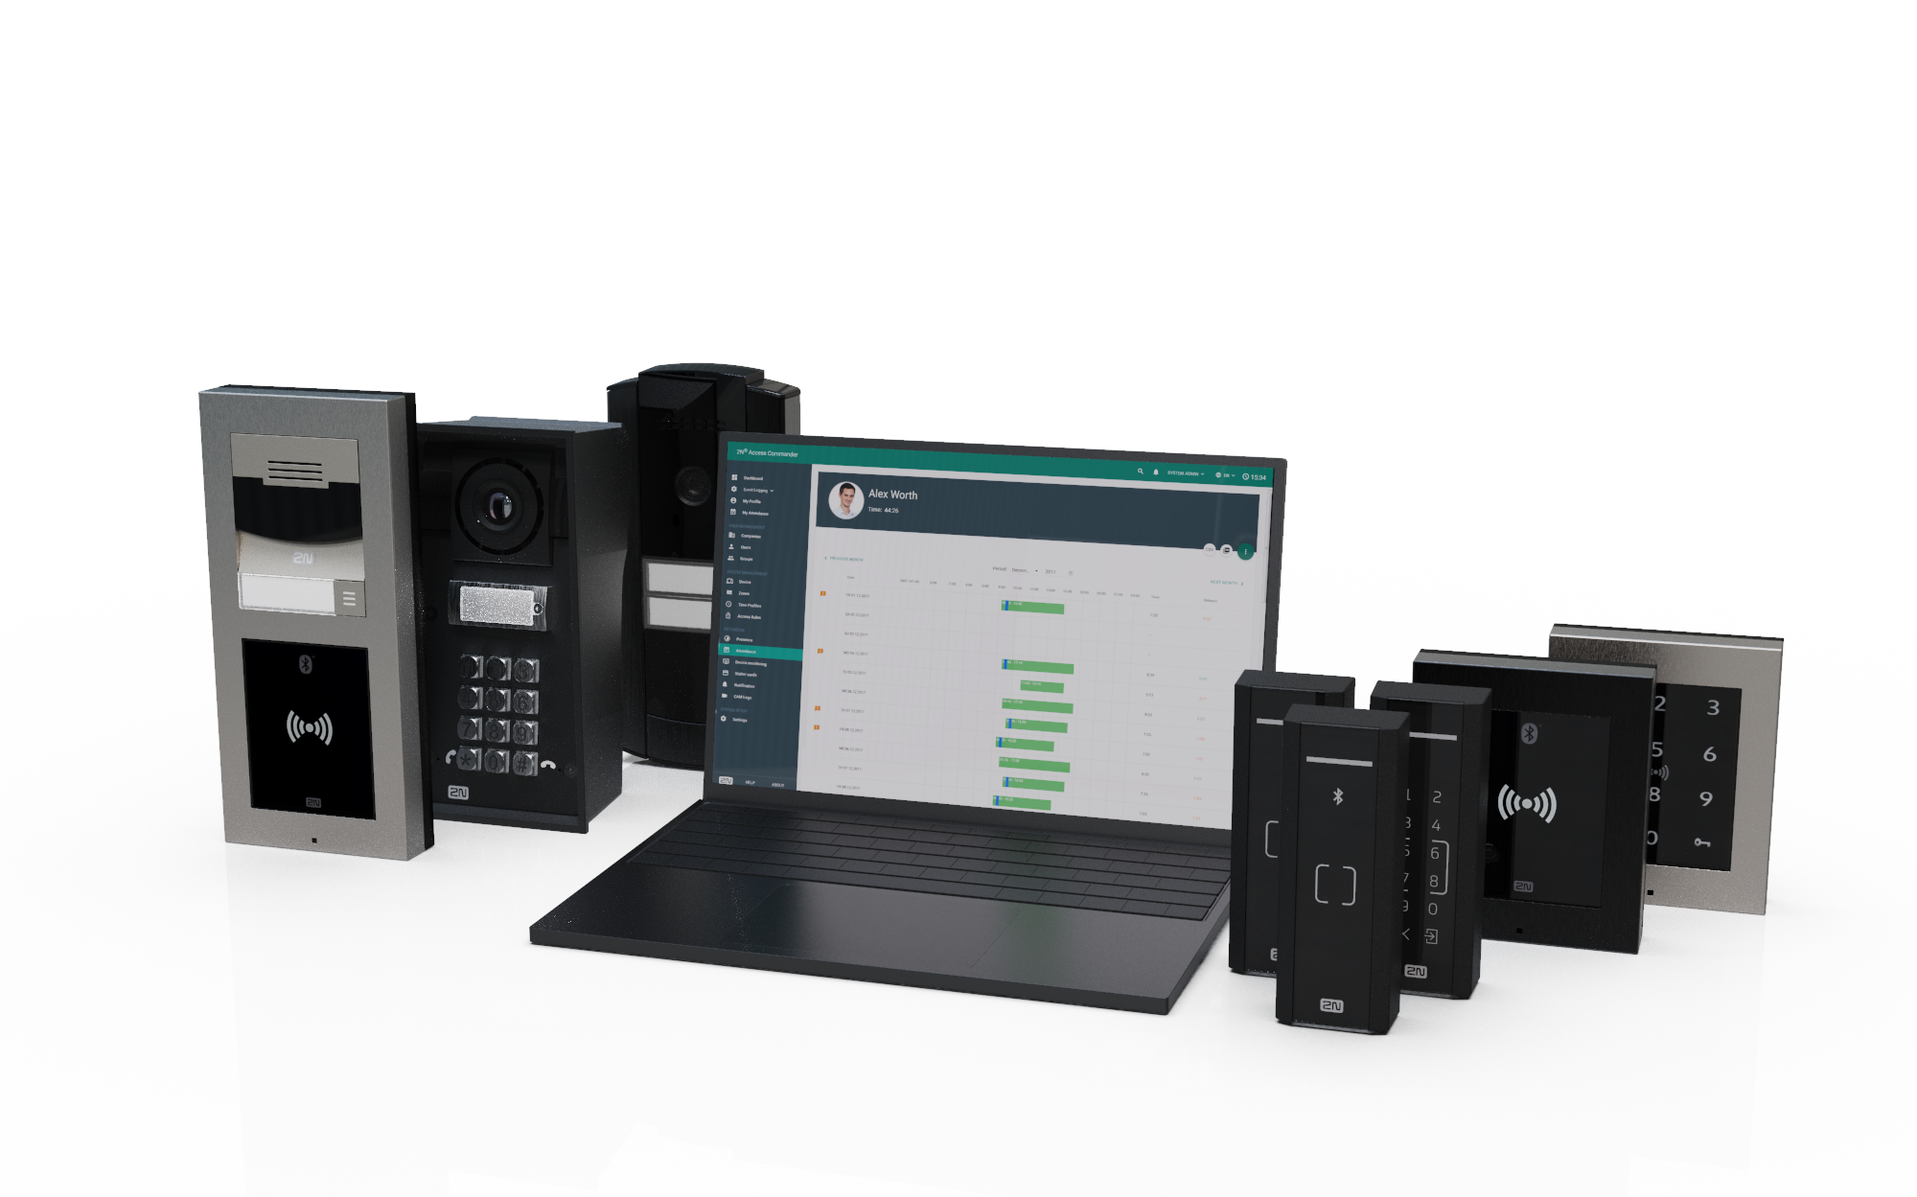
2N offers complete Access Control portfolio
Software
IP readers
IP intercoms

Slide 10
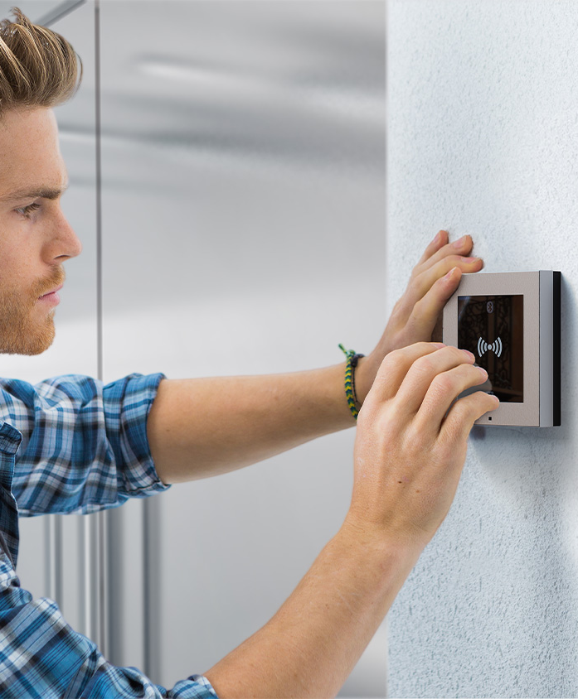
Cost savings installation
Intelligent readers with the controller already built-in
Support of PoE
Single UTP cable for connection and power
Save on cabling and time spent installing
Single point of failure (no controllers)
Notes:
Our intelligent readers come with the controller already built-in. Support of PoE means you need only a single UTP cable for connection and power in one. You won't need costly stand-alone controllers and you'll save on cabling and time spent installing.

Slide 11
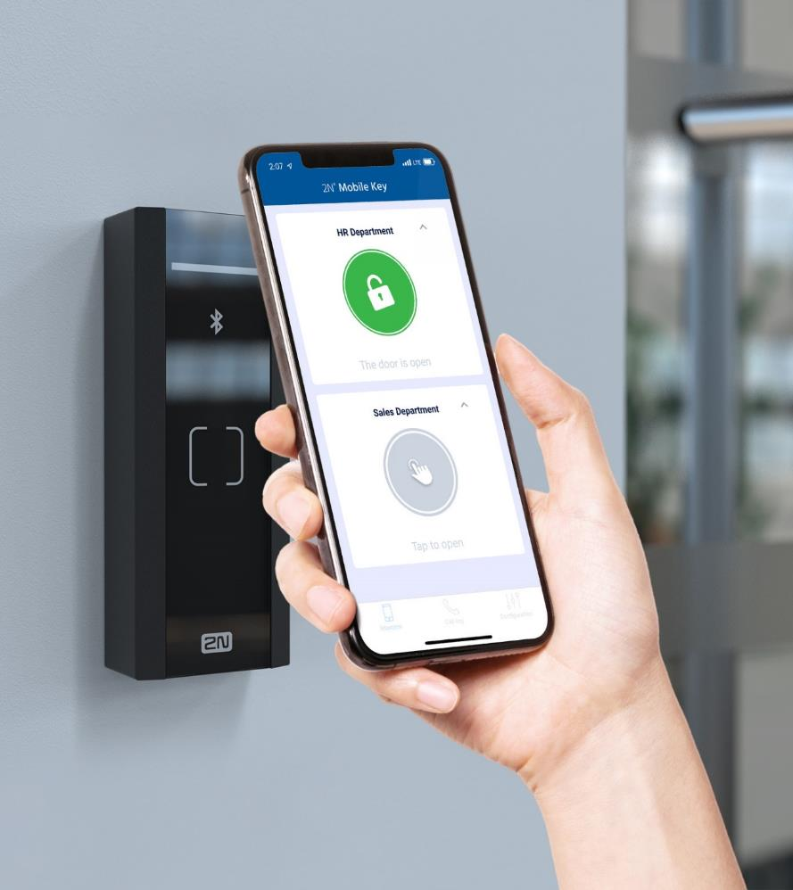
Mobile ready solution
Control the door from the smartphone
WaveKey – our own patented mobile access technology (Bluetooth based)
Combines the convenience with the security
Remote and frictionless issuing of credentials
Mobile credentials for free
Notes:
Use the power of smartphones to offer a modern approach to access control which is highly secure and convenient. Our leading technology means you no longer have to make compromises.

Slide 12
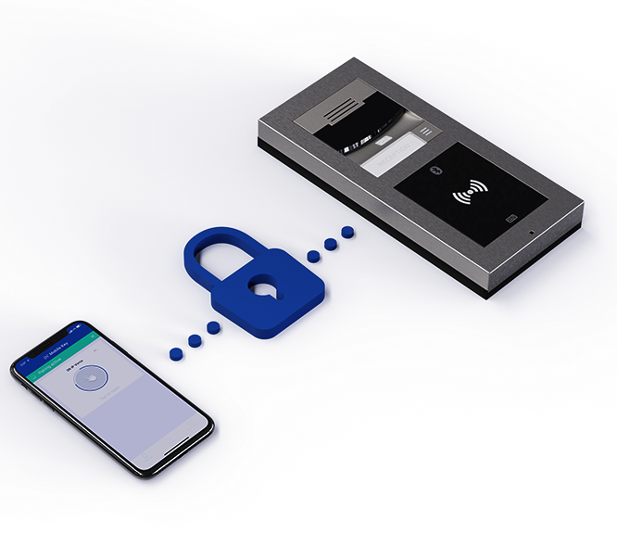
Truly secure system
High security is at the heart of our solutin
Encrypted communication (SIPs, HTTPs, SRTP)
802.1x (authenticated connection to LAN)
Intelligent password mechanisms
Authenticated access to API and RTSP stream
2N OS inside
Notes:
Our intelligent readers come with the controller already built-in. Support of PoE means you need only a single UTP cable for connection and power in one. You won't need costly stand-alone controllers and you'll save on cabling and time spent installing.

Slide 13
VERTICALS
Office
Residential
Education
Industry
Government
Healthcare

Slide 14
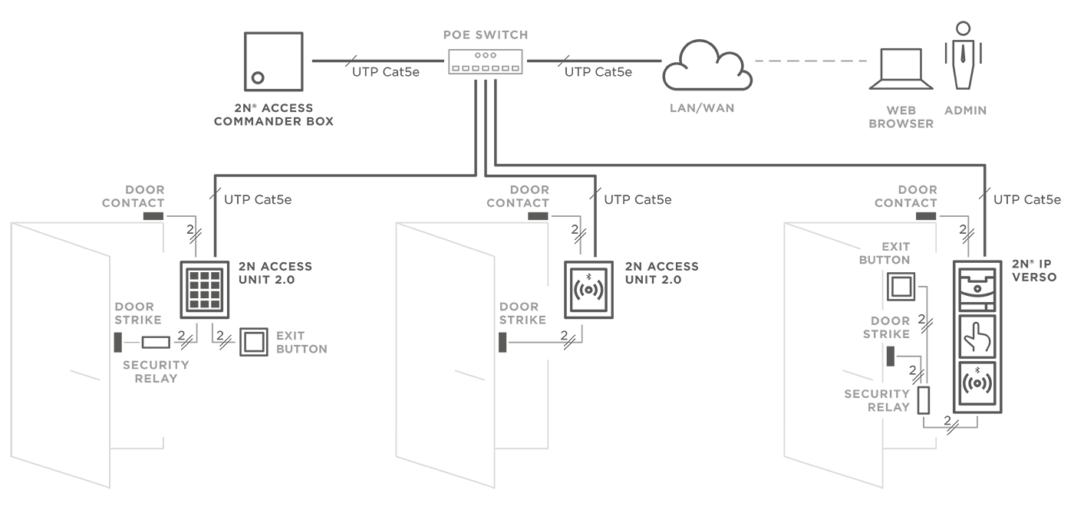
CONNECTION TOPOLOGY
Notes:
All you need is a network cable by the door for communication and PoE. Since most camera and security systems use network cables too, it's no problem in this age of smart buildings.
The door lock may be connected directly to and powered by the device, so there's really no need for any extra cabling. This offers dramatic savings in installation costs.
You can easily configure the whole system using the 2N® Access Commander software. For smaller installations, we offer this software pre-installed on a small PC. For larger installations, we have an application for virtual servers. Take a look at the diagram to see how easy it is!

Slide 15
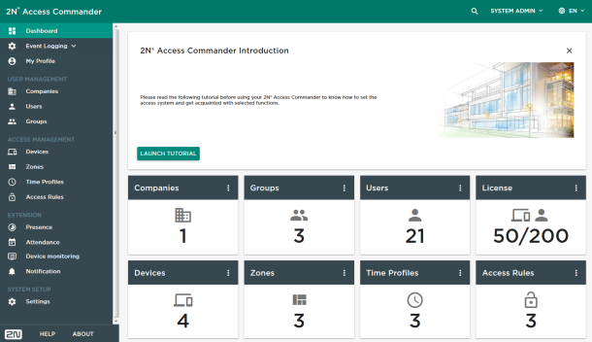
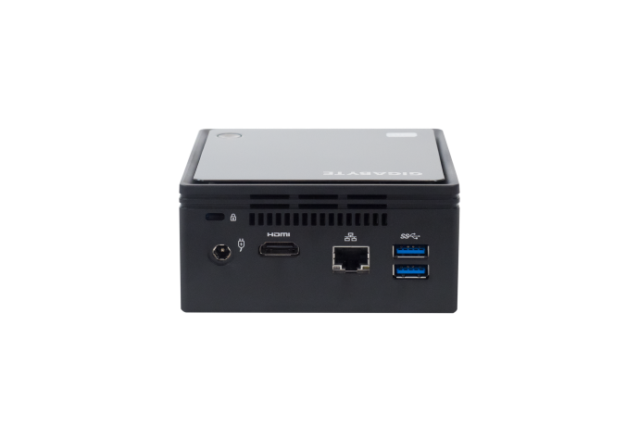
2N® Access commander
Easy to use software providing capability without complexity!
Notes:
Access Commander provides capability without the complexity. It brings powerful features to SMB’s without the resources needed by those costly, bloated and highly complex systems.

Slide 16
Cater to SMB/SME needs
Easy to access key functions in an intuivite platform
Quick deploy, simple to operate and learn
Highly robust and flexible system
Harness the power of decentralized system
Autonomous hardware
Notes:
Well, I’m talking about the decentralized nature of our solution, built on edge devices which combine controller and reader into Component. That;’s the only component type needed in the 2N system – no additional door controllers or system controllers
~That makes it simple and quick and cheap to install, because you drop all of that extra cabling for connecting and powering readers and controllers.
~Despite the simplicity, it’s an incredibly robust system – decentralized means there’s no single point of failure, each and every reader
~ can make access decisions autonomously..
Access Commander protects that system strength, maintaining the autonomy of the devices, whilst offering a single interface through which to manage them all.
So how do we get it up and running?

Slide 17
2N® Access Commander
Virtual machine distribution
Independent of server OS
Import to dedicated virtual server
Fully scalable for larger installations
Common virtualization platforms supported
Oracle VM Virtual Box
VMware
Microsoft Hyper-V
Notes:
Software is distributed as a complete image file that has to be imported to dedicated virtual server. It already includes web server, database server and all other applications.
It takes an advantage of an IT-friendly language which means that average IT guy will install this software within few minutes.
This distribution is suitable especially for larger companies.

Slide 18
2N® Access Commander Box
Distribution on embedded PC
Plug and play solution
Installed within a minute by any installer
No need for a dedicated server
Intended for SMB/SME installations
Optimized for up to 50 connected 2N devices
Notes:
2N® Access Commander Box – plug and play access control solution that is tailored to be installed within a minute by any installer. There is no need for a dedicated server in the company.
Intended mainly for SME market with up to 50 connected 2N devices.

Slide 19
User Management
Firmware Management
Logs & Notifications
Time & Attendance
Anti-Passback
Presence / Mustering

Slide 20
Lift Access Control
Secure your floors as well as your doors
Access only to selected floors after successful authentication (different credentials)
Public floors available for everybody
2N Access Unit together with Axis I/O module A9188 (control up to 40 floors)
Configuration from 2N® Access Commander

Slide 21
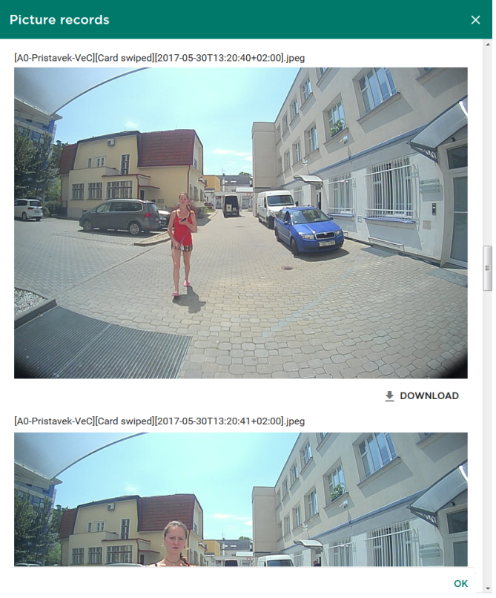
Camera Logs
Helpful in case of any incident
Puts access logs together with the sequence of pictures in a single and powerful interface
Works only with 2N IP intercoms with camera
Sequence of 8 pictures (5 before, 1 at the moment, 2 after the action)
Actions: door forced open, door open too long, tamper alarm, wrong PIN code, etc.

Slide 22
LPR support
Enforce a secure access policy
Unified parking security
License plate as another credential
Flexible authentication options (support of shared cars)
Integrates with Axis camera and Vaxtor VaxALPR software (ACAP)
Notes:
30 sec: Access control doesn’t start just at the front door, but even before we get there.
~ Unified support of LicencePR in our platform lets you enforce a secure access policy in the parking spaces too, safeguarding the whole facility through a single interface
~ Integration with a range of Axis cameras means flexibility built on a trusted, secure brand
~ And that flexibility applies to the ways that a license plate can allow access; on its own or combined with traditional credentials
This feature is fresh from development, so customers will be able to enjoy the benefits from April this year.

Slide 23
Anti-passback
Next level of the building protection
Prevents access to an area a second time without leaving it first (re-entering misuse)
Forces usage of the in-out-in-out access
Applies restrictions if the rule is broken (in-in-in) … Hard or Soft Anti-passback
Notes:
Applies restrictions if rule is broken (in-in-in)
Hard – access restricted
Soft – violation only logged

Slide 24
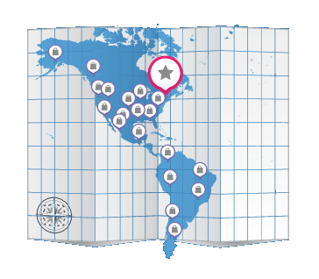
Multiple sites control
Control all sites from a single location
Aimed to companies with branch offices
Admin sits in the headquarter and oversees the access control system in all locations
This is impossible with traditional AC systems (using serial cables, RS-485, Wiegand)
Notes:
Multiple sites control from a single location is a huge benefit for companies having branch offices in different locations that are interconnected via VPN. Admin sits in one city and oversees the access control system in other cities through the LAN...something that’s impossible with serial cable systems!

Slide 25
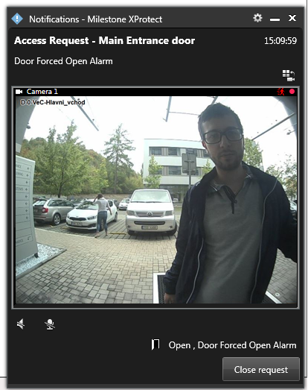
Open for the integration
Integration makes an admin’s life easier with one „robust solution”
Special plugin – for Milestone Xprotect® Access
REST API – Time & Attendance (Advent, Onfit), HR, billing, booking systems and many others
Active Directory – users data import from Microsoft Active Directory via LDAP protocol
CSV sync – regular synchronization with 3rd party CRM and BMS systems (e.g. Yardi Voyager)
Notes:
Integration makes a life easier mostly to administrators and installers.
Therefore we’ve created 2N® Access Commander as a software that can be easily integrated with VMS, T&A, alarm and other 3rd party systems using the REST API web interface or special 2N plugin.
CRM ... customer relationship management
BMS ... building management systems (or property management or asset management solution)

Slide 26
2N access unit
Multi-technology access control readers with various form factor
Notes:
Edge device = standalone IP Access Control device

Slide 27
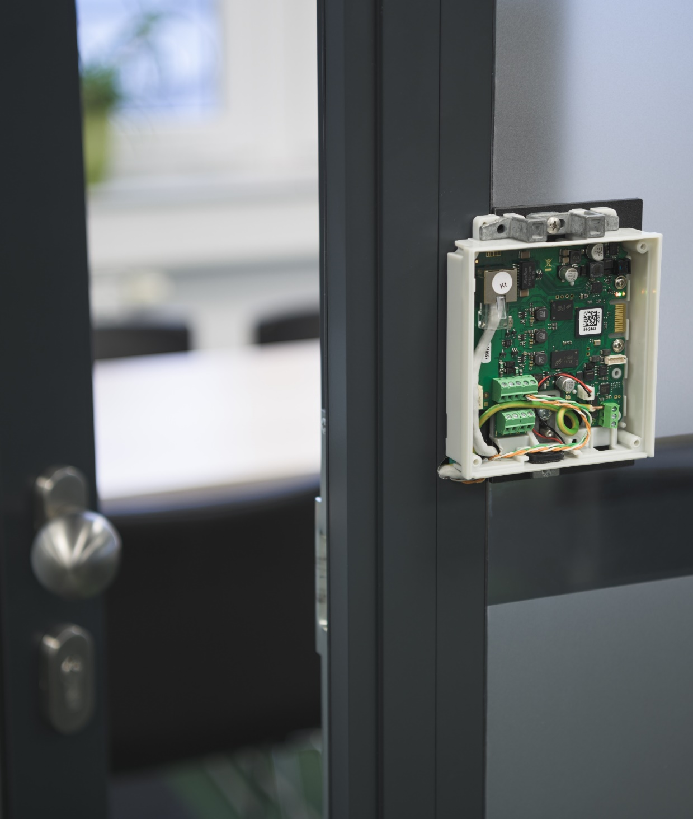
Reader with built-in controller
2N Access Unit = IP edge device
All the decision-making intelligence at the door
Only a single network cable for connection and power (PoE)
Onboard input and output relays
30% faster installation compared to traditional systems saving material and labor cost
Notes:
2N Access Unit combines traditional door controller and reader (Bluetooth, biometry, RFID, keypad) in one standalone device!
Compared to the traditional access control systems which require more equipment, installation labor and maintenance, the total cost of ownership (TCO) is far less!

Slide 28
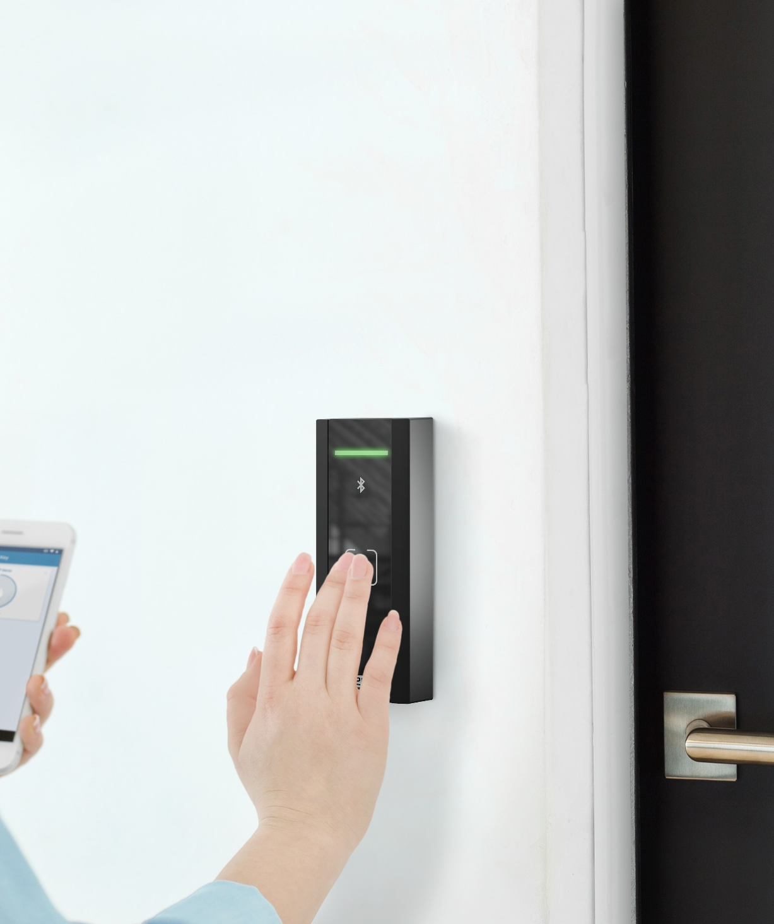
2N OS inside
We make smart & secure readers
Smart means integrated – open protocols for integration with 3rd party systems
„Automation“ section to set up advanced scenarios
„Hack-resistant“ system – encrypted communication, multi-factor authentication, 802.1x, anti-passback
Notes:
The Access Unit can be easily installed and configured by people without any previous experience with access control devices.
Only an Ethernet cable is needed and can be connected directly to the unit (using wires of the Ethernet cable) or to RJ-45 pigtail
All accessories such as REX button, door contact, electrical strike or lock are connected to Inputs and OUTputs (relays) inbuilt in the access unit
Configuration is done via intuitive and tuned web interface

Slide 29
Variety of access credentials
RFID reader (125kHz or/and 13.56MHz)
Supports secured iCLASS Seos cards (except „ AU M“)
Bluetooth reader (and NFC)
WaveKey = 2N mobile access made reliable
Touch, tap in app, motion and card mode
PIN keypad
Allows two-factor authentication or of one-time PIN
Fingerprint reader (only in 2N Access Unit 2.0)

Slide 30
Quality meets design
Proudly made in the European Union
Innovative look of readers matching the intercoms’ makes the installation stand out
First-class and durable (scratch-free) materials
IP and IK certified as they are dust, water and impact resistant – outdoor installation
Notes:
The Access Unit can be easily installed and configured by people without any previous experience with access control devices.
Only an Ethernet cable is needed and can be connected directly to the unit (using wires of the Ethernet cable) or to RJ-45 pigtail
All accessories such as REX button, door contact, electrical strike or lock are connected to Inputs and OUTputs (relays) inbuilt in the access unit
Configuration is done via intuitive and tuned web interface

Slide 31
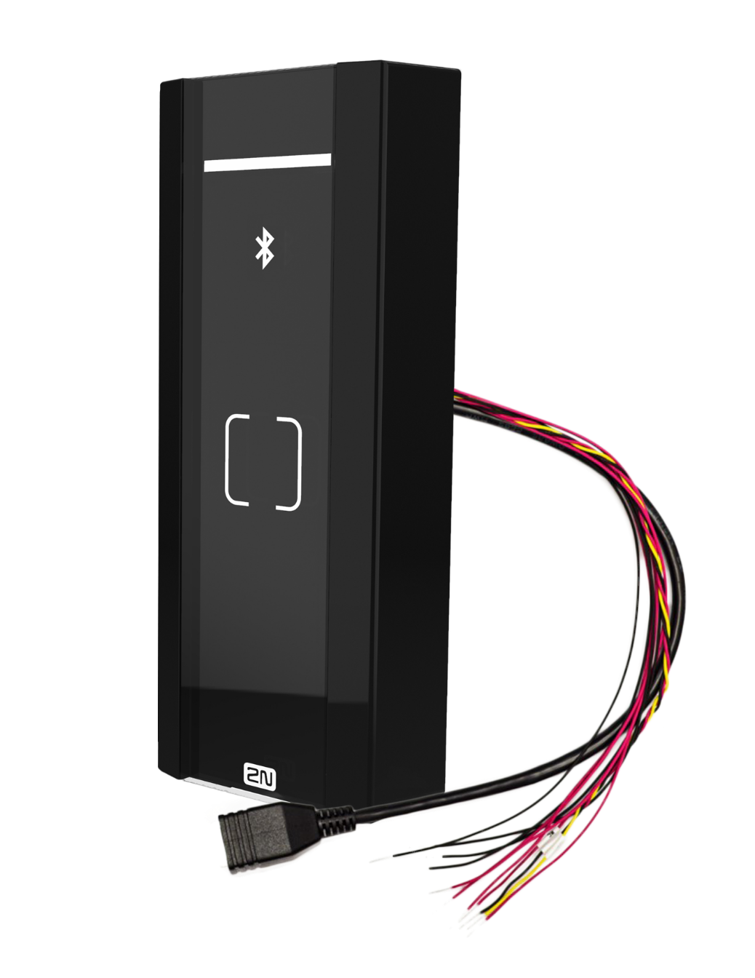
Simple quotation
Do you need to propose the access control solution for a project with 40 doors?
Typical questions…How many controllers do I need, how many extension boards, what type of interfaces, cabling?
Stop thinking in this way! Simply offer 40pcs of 2N Access Unit

Slide 32
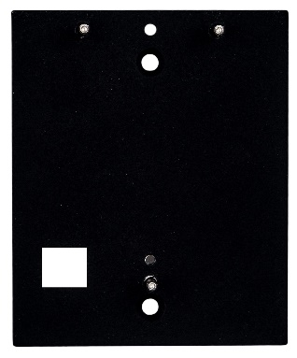
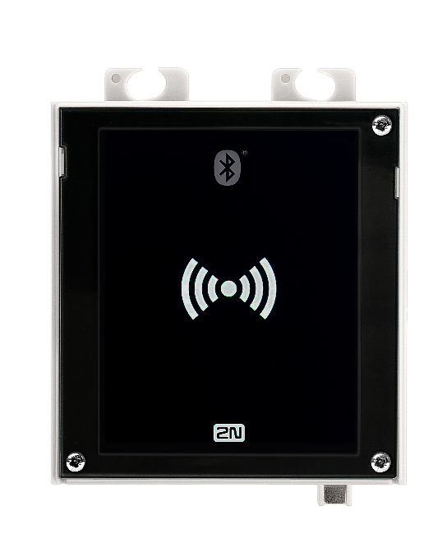
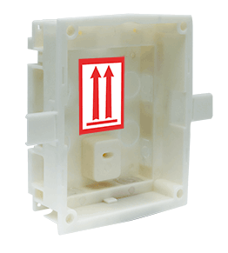
2N Access Unit 2.0
Frame for surface installation
No other accessories are needed for surface installation of the intercom/access control reader.
Backplacte for glass mount
Enables installation on glass or uneven surfaces.
SURFACE
Frame for recessed installation
The wider frame covers the uneven edges of a drilled hole, it is 5mm above the surface.
Box for recessed installation
Flush mounted box for walls or plasterboard
RECESSED

Slide 33
2N Access Unit M
No mounting accessory available
The installation anchor is part of the package
Only surface type of the installation
on the door frame or on the wall
RJ-45 pigtail (female connector)
11-wires (IN1, IN2, Active OUT, Relay, External power)

Slide 34
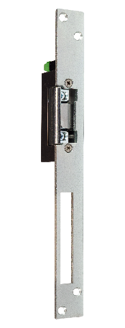
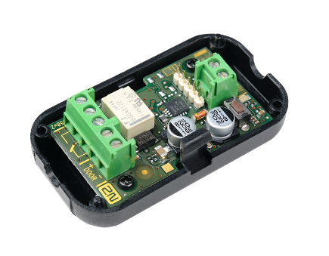
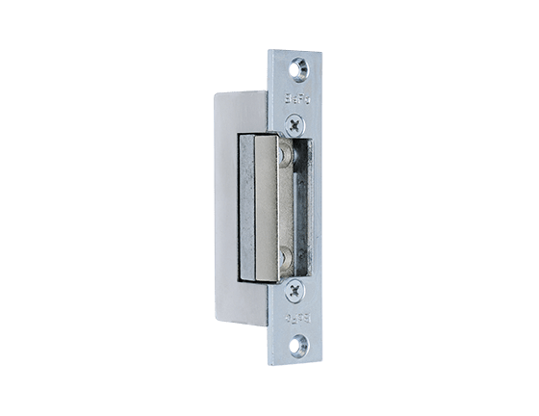
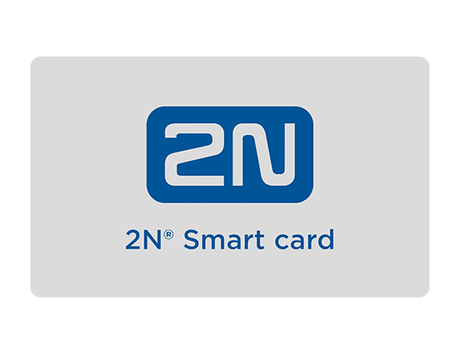
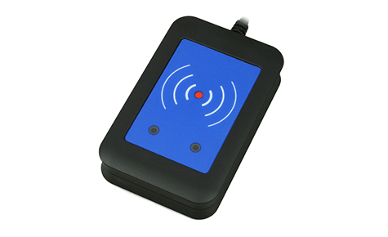
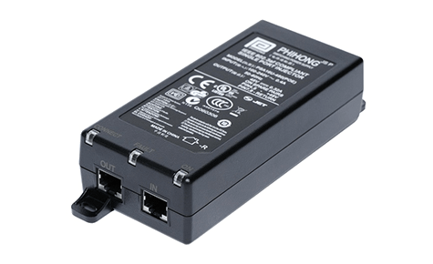
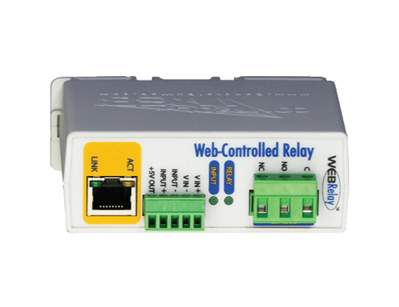
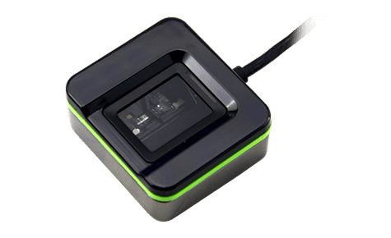
Additional accessories (common)
2N® Security Relay
Door strikes
RFID cards and fobs
External USB readers
PoE injector
External IP relay

Slide 35
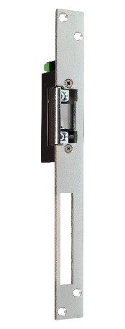
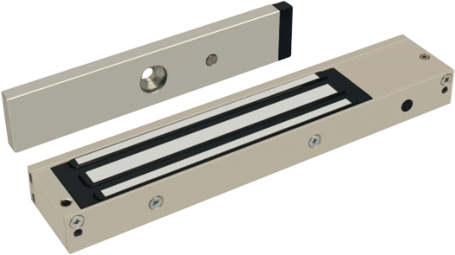
Recommended installation
Door strikes
DOOR
OUT1
Relay
2N® Security Relay
12V
2N Access Unit
Magnetic lock, electromechanical lock
For security reasons we strictly recommend you to:
always use an active OUT1 for any door strike / lock connection
always connect 2N® Security Relay between the 2N Access Unit and door lock

Slide 36
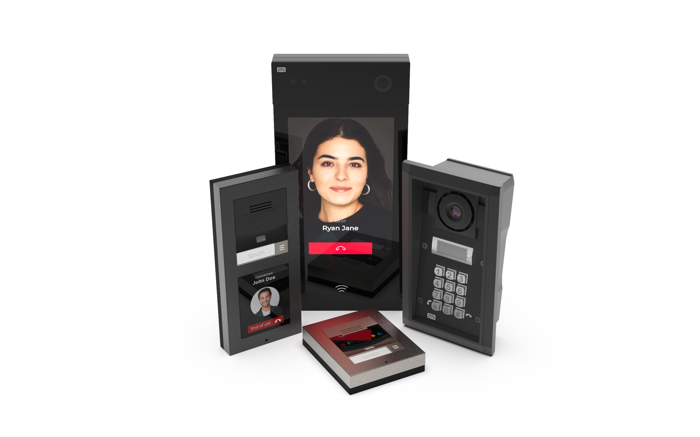
2N IP intercoms
IP access control devices with audio-visual communication
Notes:
Intercoms combine 3 different types of devices to one, that is compact

Slide 37
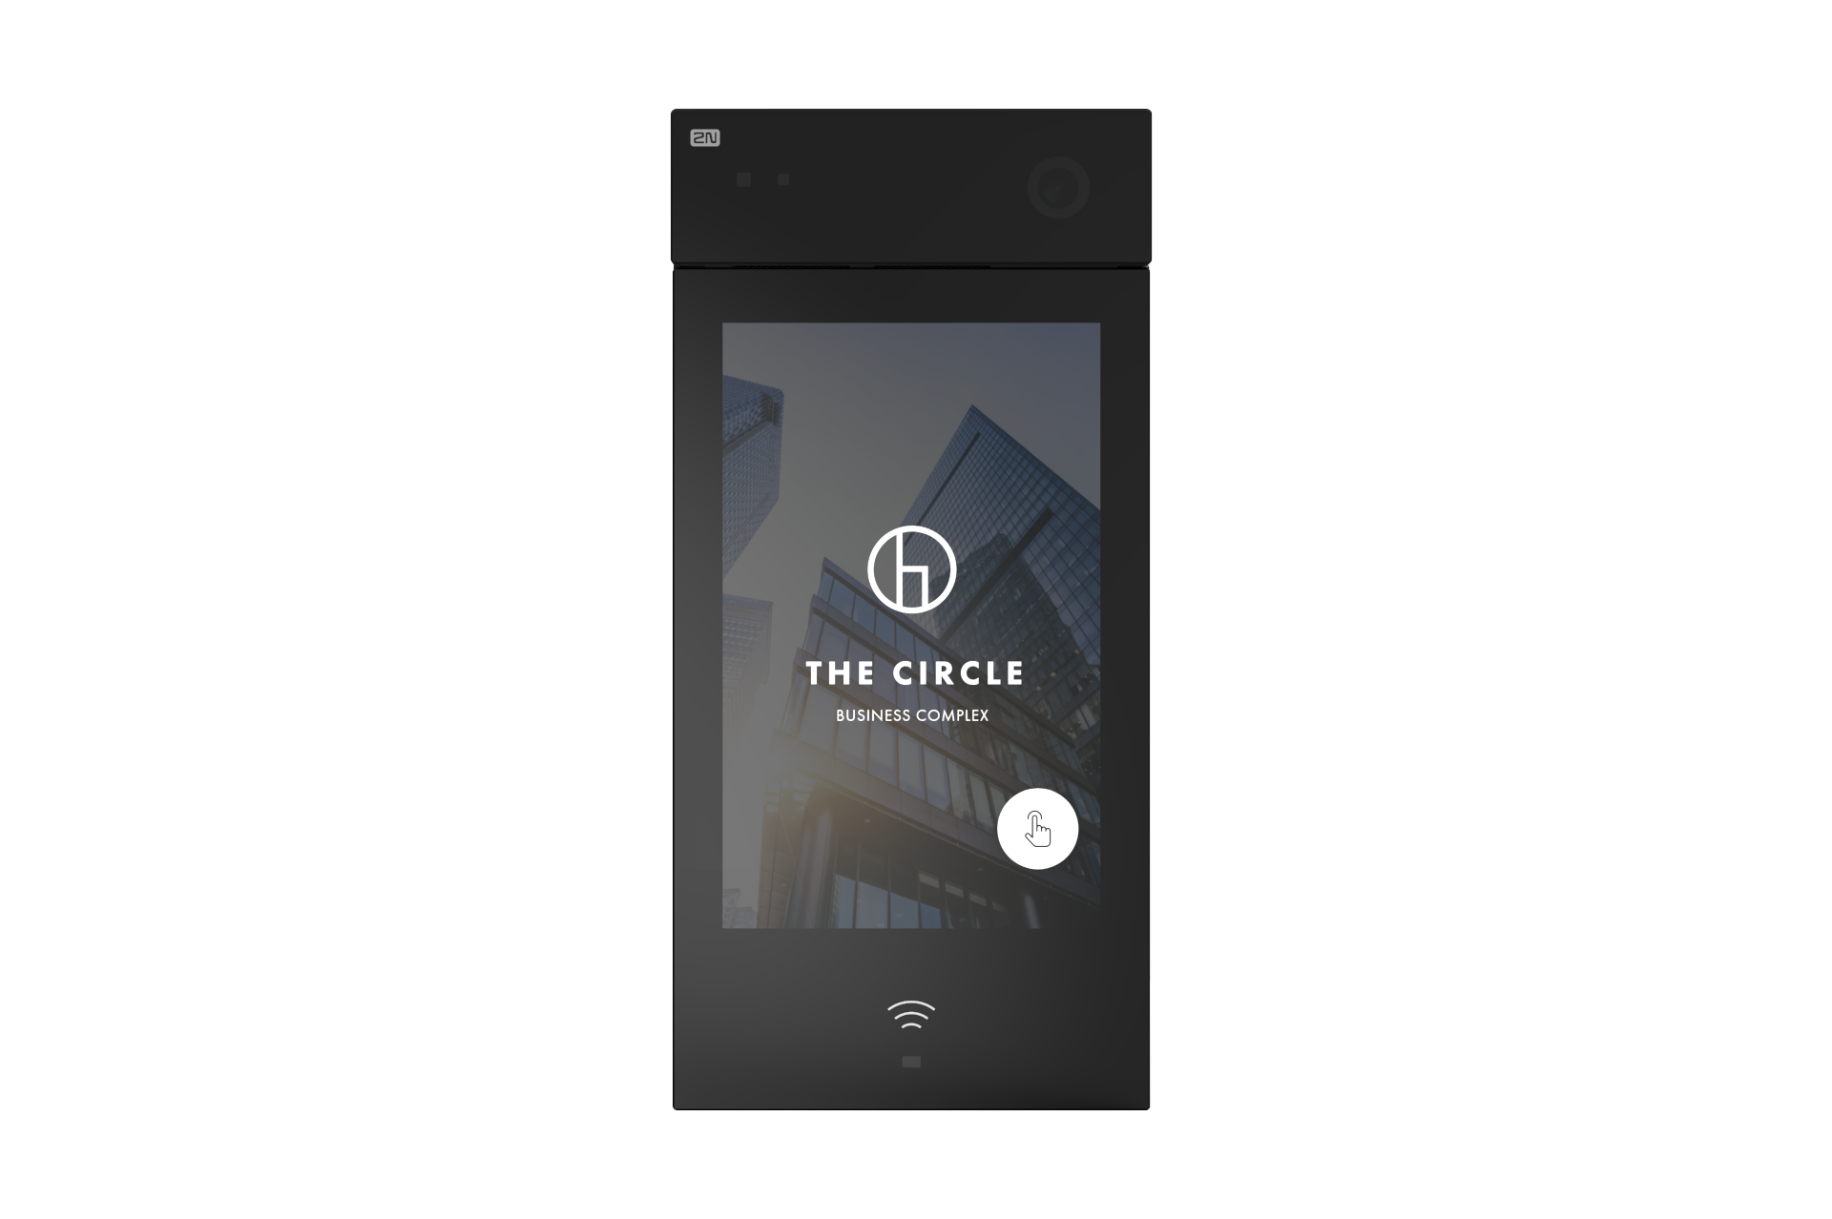
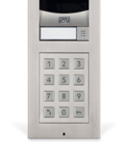
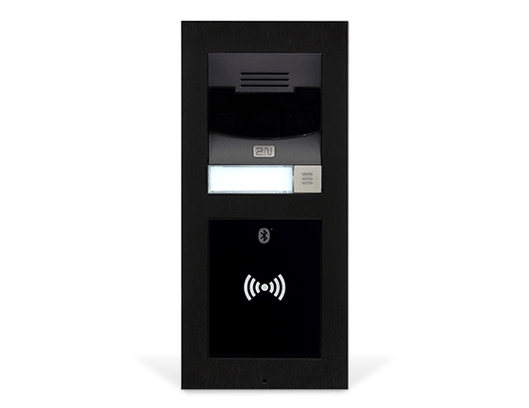
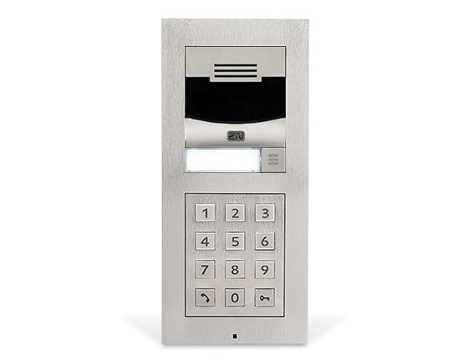
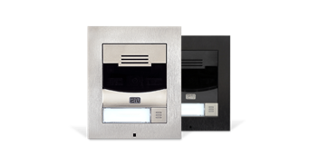
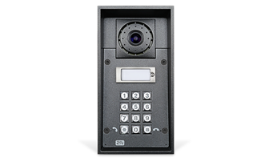
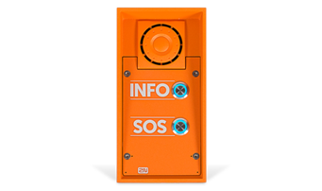
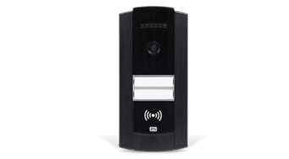
Best camera
Modularity
No cabling
Home automation
2N® IP Style
2N® IP Verso
2N® LTE Verso
2N® IP Solo
Durability
Emergency
Compactness
2N® IP Force
2N® IP Safety
2N® IP Base

Slide 38
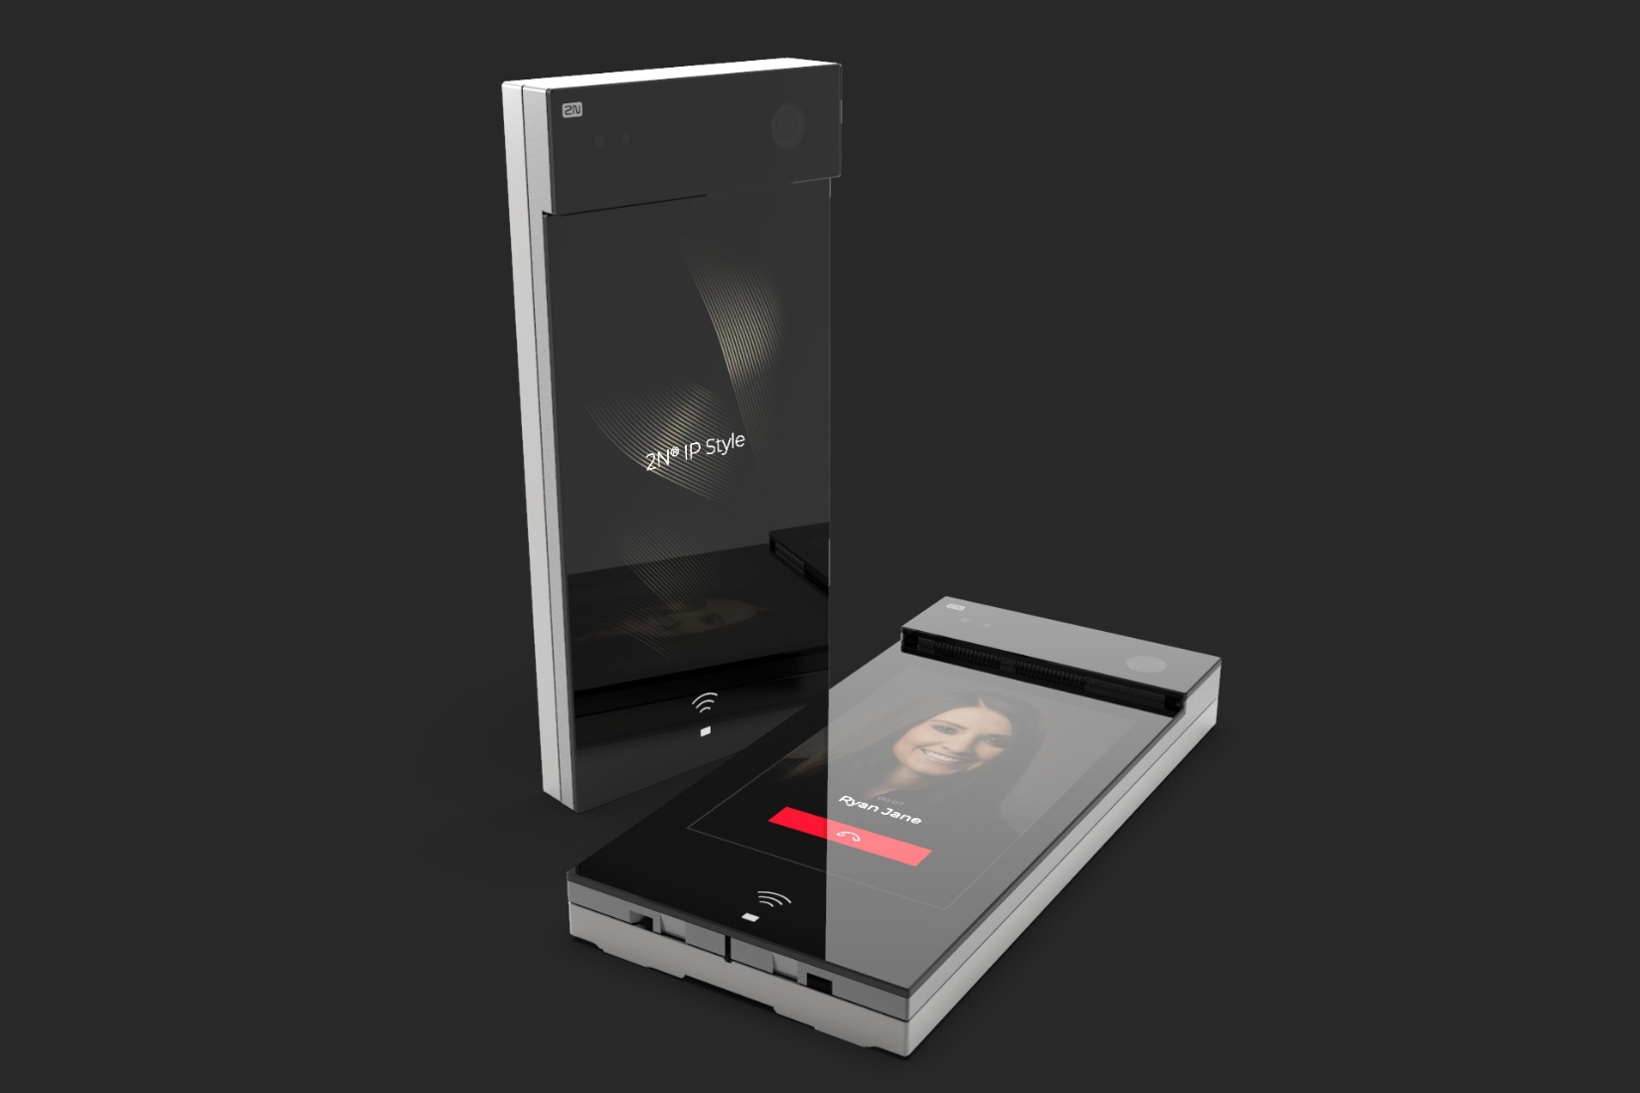
2N® IP Style
Top-of-the-line audio quality
Full HD camera (5MPx) with WDR
Powerful ARTPEC 7 processor
10.1” touch screen with unrivaled graphical UI
Multi-technology Access Control
(RFID, Bluetooth, virtual keypad)
Bidirectional video calls
IK08
IP65
Notes:
2N IP Style will be 10 inches IP intercom with fully touch based display without any mechanical buttons. The display has full HD resolution with brilliant colour reproduction and is protected and covered by reall 4mm thick glass which is scratch resistant, visible on direct sun with adaptive backlight
In the heart of the intercom is ARTPEC 7 processor. Thanks to it the intercom will provide an ultimate, excellent video quality.
Full HD camera is wide angle one with all previously described features such as WDR technology and automatic adaptive IR night vision. This will be a first intercom that makes wide-angle video call to Indoor View and IDT 2.0
Crystal clear speech quality and ultimate speech intelligibility in any situation is ensured by two speakers and two mics with echo and noise canceller.
Next feature worth to mention is inbuilt Access Control with virtual keypad, RFID and Bluetooth.
.This intercom brings elegant design combined with adjustable graphical user interface (display) with intuitive navigationthat is unrivaled on the market; customizable for both, residential and office building
Bidirectional video calls – a feature that allows to see the face of called person on the display of 2N® IP Style; typically used for reception (not for MDU because of privacy issues)
IP65 and IK07 outdoor rating makes the intercom durable and weather resistant

Slide 39
IP based products without any limitations
Easy integration thanks to open standards with a possibility for a vendor specific integrations
Saves your time and money
Makes your customer satisfied
Reliable and secure cloud services enabling calls to smartphone and remote configuration
Intercoms for any vertical with a possibility to choose even single modules
High quality products in terms of materials and reliable functionality

Slide 40
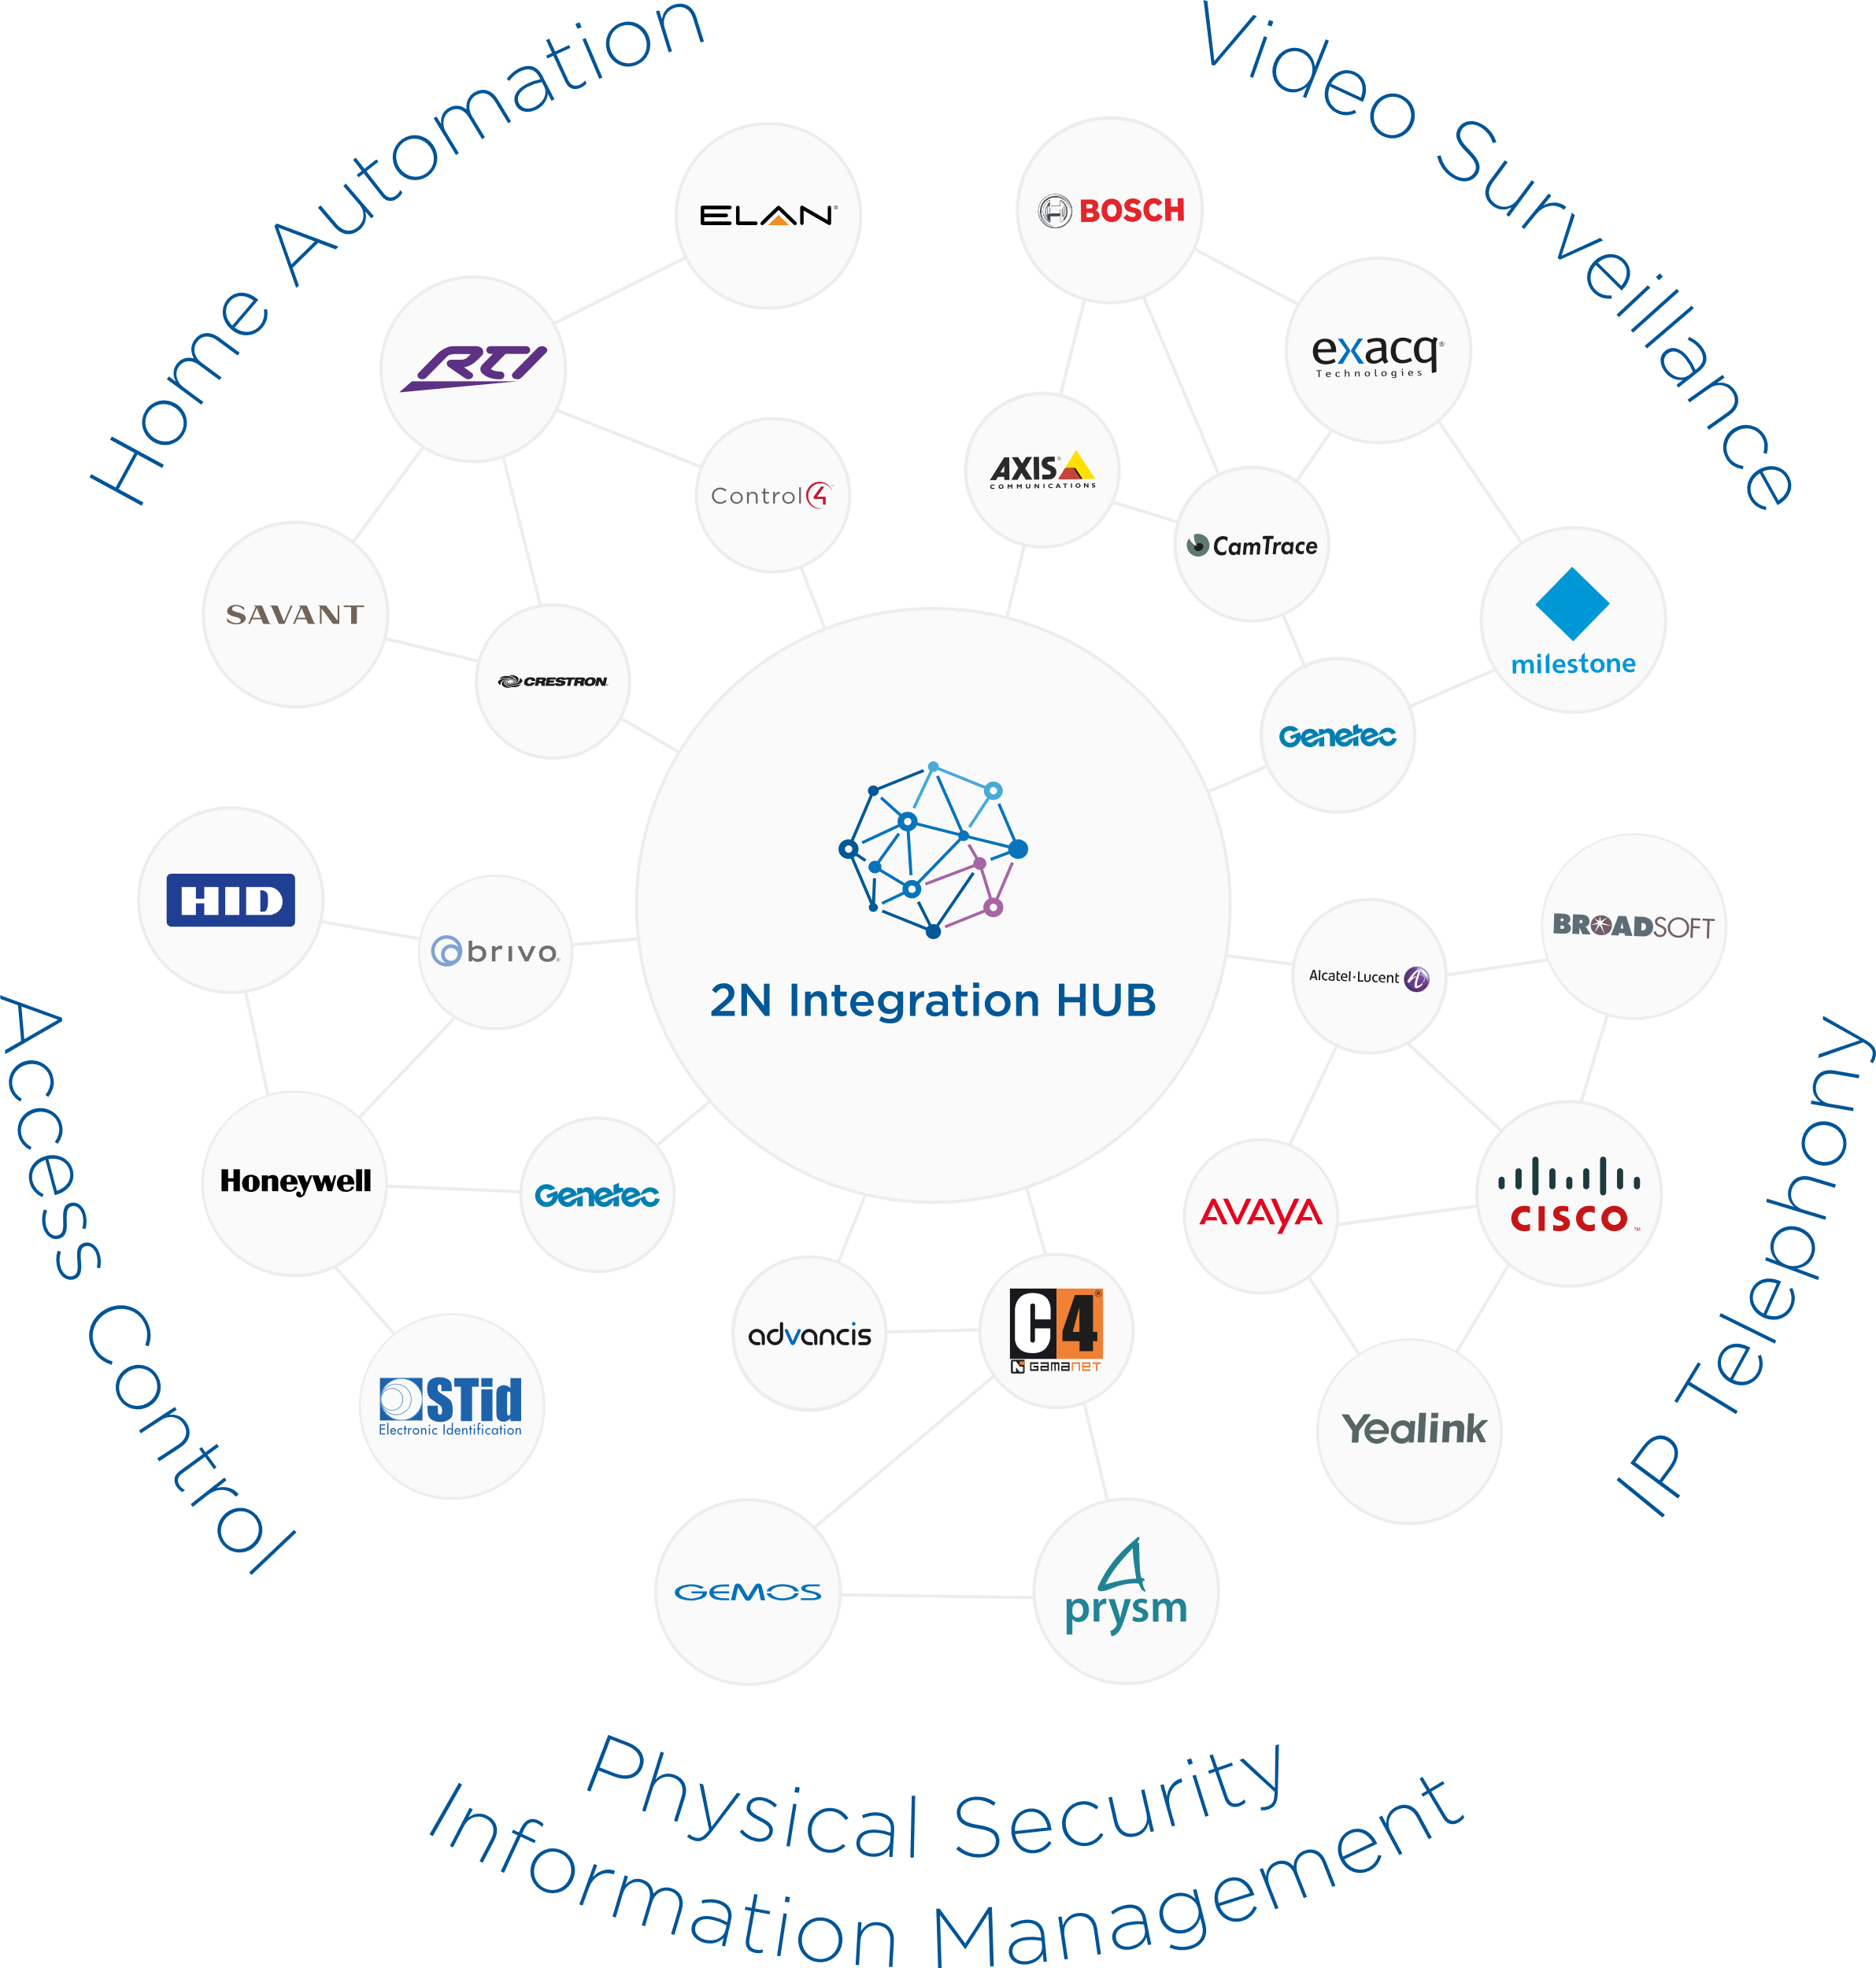
We embrace the power of integrations with 3rd party solutions
Extensive, fully documented API (HTTP API, REST API, 2N® Partner API)
Open standards and proprietary protocols ONVIF, RTSP/ RTP, SIP
Compatible with more than 200 solutions

Slide 41
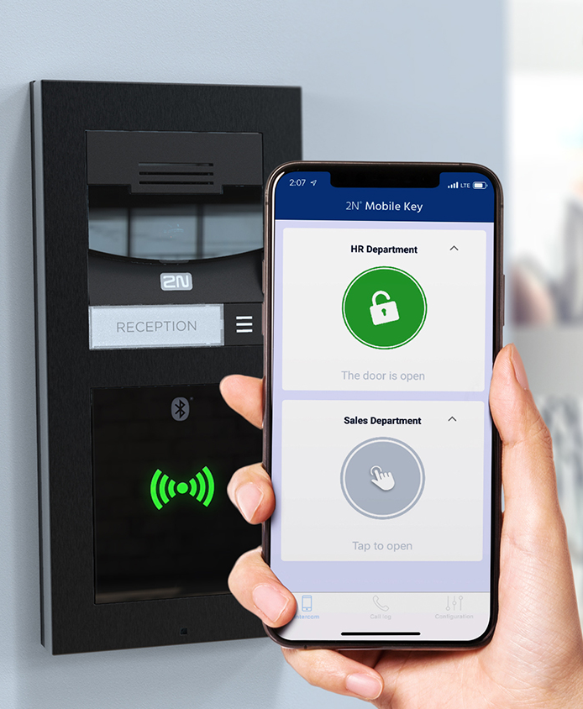
WaveKey – the pass you trust!
Best-in-class reliability
The fastest on the market
Unwanted door opening solved
Bulletproof security
Frictionless distribution
We don’t charge for credentials

Slide 42
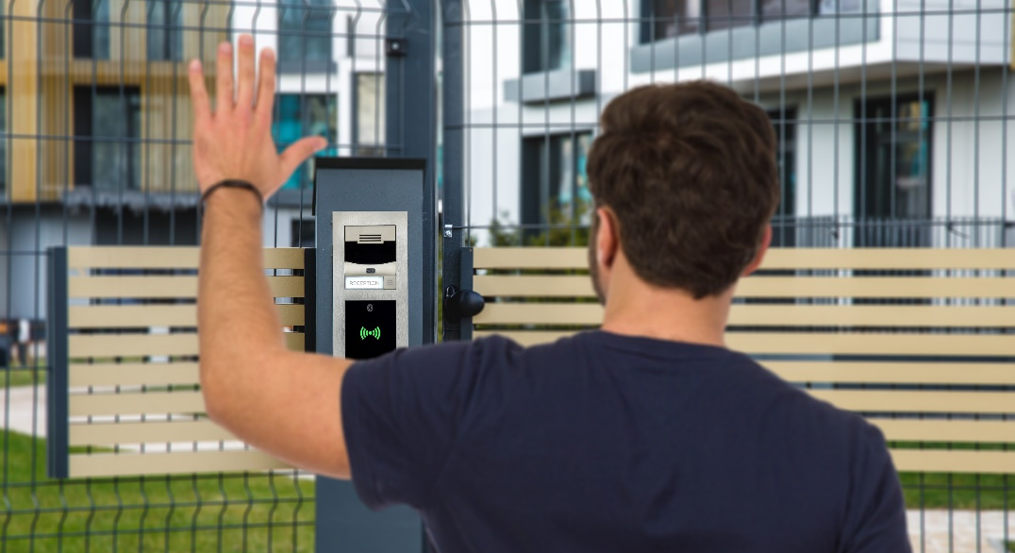
Tap in app
Touch
Card
Motion
Notes:
Description by Marketing:
To change the images, select the original one and hit the keyboard „Backspace“. This will remove the original image.

Slide 43
Door control from mobile app
Video intercom on your smartphone
2N® Mobile Video – the most reliable cloud service on the market
Application brings the security of your property to the next level allowing you:
unlock the door to visitors or package deliveries even when you are not at home
be reachable for visitors anywhere you are
be aware what is happening outside your property
Notes:
Intuitive and absolutely reliable mobile application 2N® Mobile Video brings the security of your property to the next level. The app provides you with a live video from your intercom and allows you to open the door only to person you really know.

Slide 44
INTEGRATION WITH 3RD PARTY SYSTEMS
Cisco
Avaya
Genetec
Alcatel Lucent
Yealink
Wildix
InnerRange
Genetec
Advancis
Prysm
Siemens
Milestone
Genetec
Axis
Digifort
Axxonsoft
Cognify
Control4
Savant
Crestron
RTI
Fibaro
TELEPHONY
SECURITY SYSTEMS
VIDEO MANAGEMENT SYSTEMS
HOME AUTOMATION
Notes:
Integrations and openess make us different!!

Slide 45
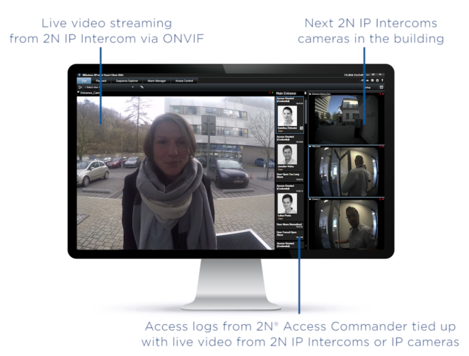
Milestone XProtect integration
Via ONVIF profile S
2N IP intercoms & XPortect VMS
live video streaming
both way audio communication
door and I/O control
Via special plugin
2N® Access Commander & XProtect® Access
Access logs and events tied up with live video
shared user details with XProtect®
Device control through the interactive maps
Notes:
XProtect® Access is an add-on product to Milestone XProtect VMS that enables the integration of 2N Access Commander with all connected readers (Access Units and IP intercoms) to Xprotect solution. Thanks to that you can then control both your IP cameras and access control system from one centralized interface. Such solution works in installations of all sizes.
Events that are reported in Milestone:
- door forced open, door open too long, tamper alarm, door open, door closed, card rejected
Shared user details (from ACom to Xprotect Access):
- user name, photo, company name, email, phone number, credential ID
Combining video with access control events offers several advantages. You will get:
Better decision making from your operators, who visually verify the identity of individuals requesting access
More efficient work processes, as operators can manage video surveillance and access control from one interface
More thorough, straightforward post-incident investigations, as you have video information linked to each entry/exit event

Slide 46
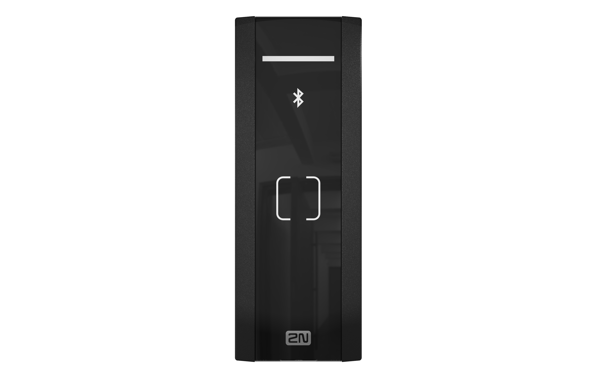
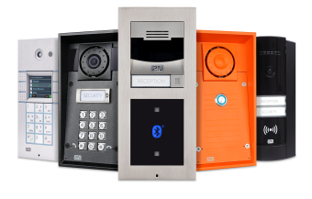
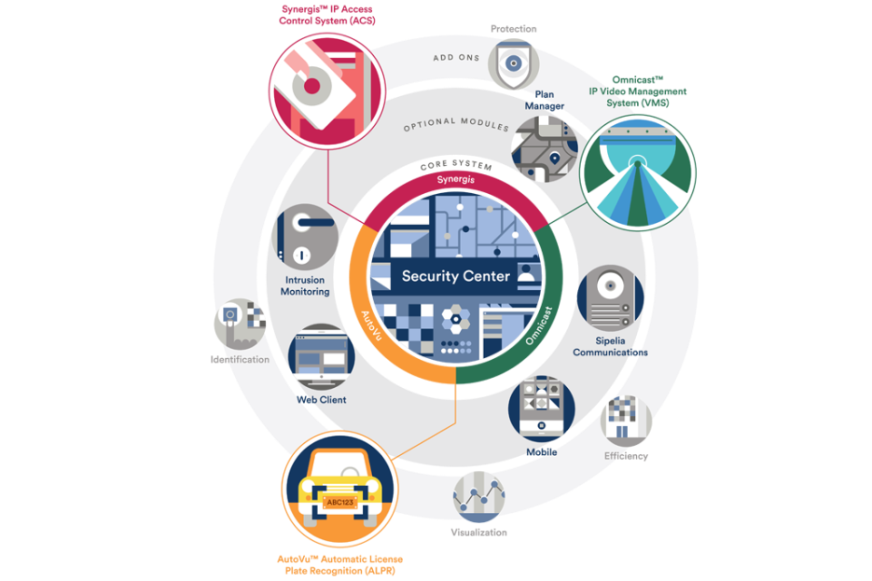
Genetec Security Center integration
SipeliaTM (Communications Management)
SIP communication between 2N IP intercoms and operators / stations in the security center
OmnicastTM (IP Video Management)
integration of 2N IP intercoms to Genetec VMS based on the ONVIF S and RTSP streaming
SynergisTM (IP Access Control)
direct integration of all 2N access control devices to the Security Center via RIO protocol
Notes:
Typical scenario: The employee has lost his access card – Sipelia’s intercom integration allows operators to respond to incoming request, ie. answer the incoming call, identify callers identity through live video and allow access through doors based on his access rights from the same user application (single powerful interface)
Sipelia™ Communications Management is the module of Security Center that enables SIP-based communications between operators and intercom devices deployed throughout your organization. Intuitive management of incoming calls, call forwarding to other operators or call stations, call logfing. When unified in Security Center, intercom communications become tightly linked with your security applications, greatly improving your security team’s awareness and facilitating collaboration.
Omnicast is IP Video Management System that is open, flexible and scalable. It supports the cameras of your choice and operates seamlessly over your network. With an uninterrupted view of camera feeds and security alarms, Omnicast allows operators to rapidly assess and respond to situations. It allows you to see the live video from one camera as well as from many of them, zoom in, switch between cameras, etc.
Synergis is an access control system that lets you manage the flow of people coming into your buildings. It secures your organization, simplifies your operations, and ensures you are not locked into a proprietary solution. Benefit from complete visibility of all activity to confidently protect your people and assets. And equip your team to react to threats at a moment’s notice – restricting access or locking down an entire building.

Slide 47
Our unique features help you to win your projects!

