Slide 1


2N Answering Units
Stylish indoor communicators for any apartment
www.2n.com

Slide 2
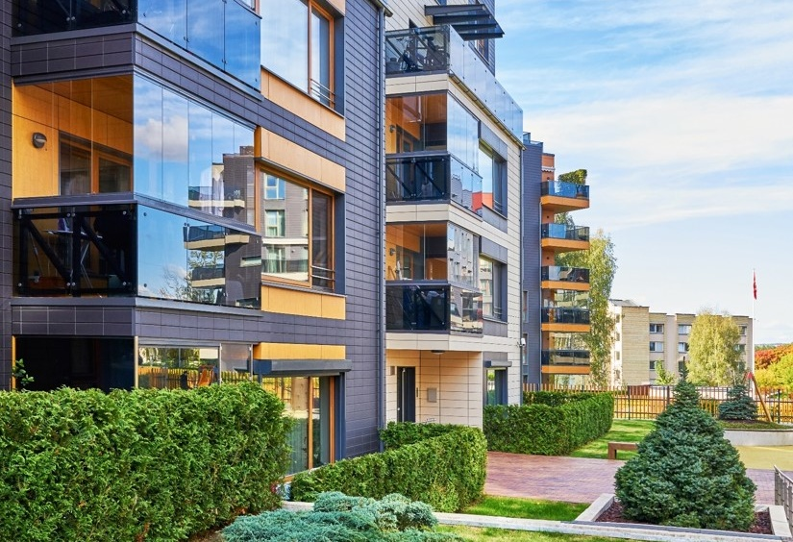
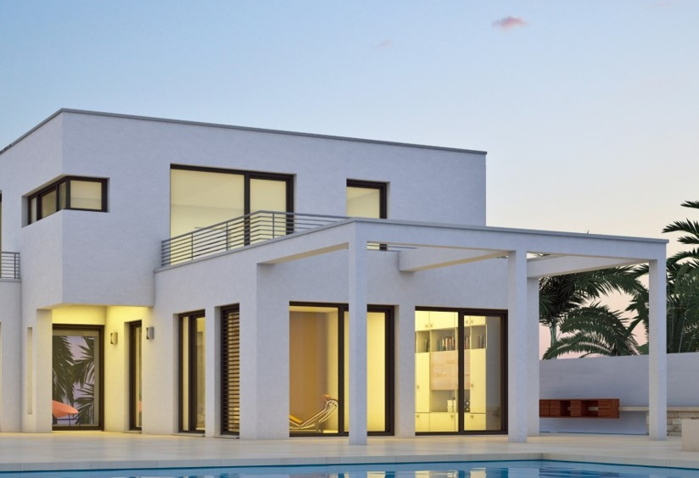

Verticals
Residential
Apartment
building
Residential
Single
house
Office
Office
building

Slide 3
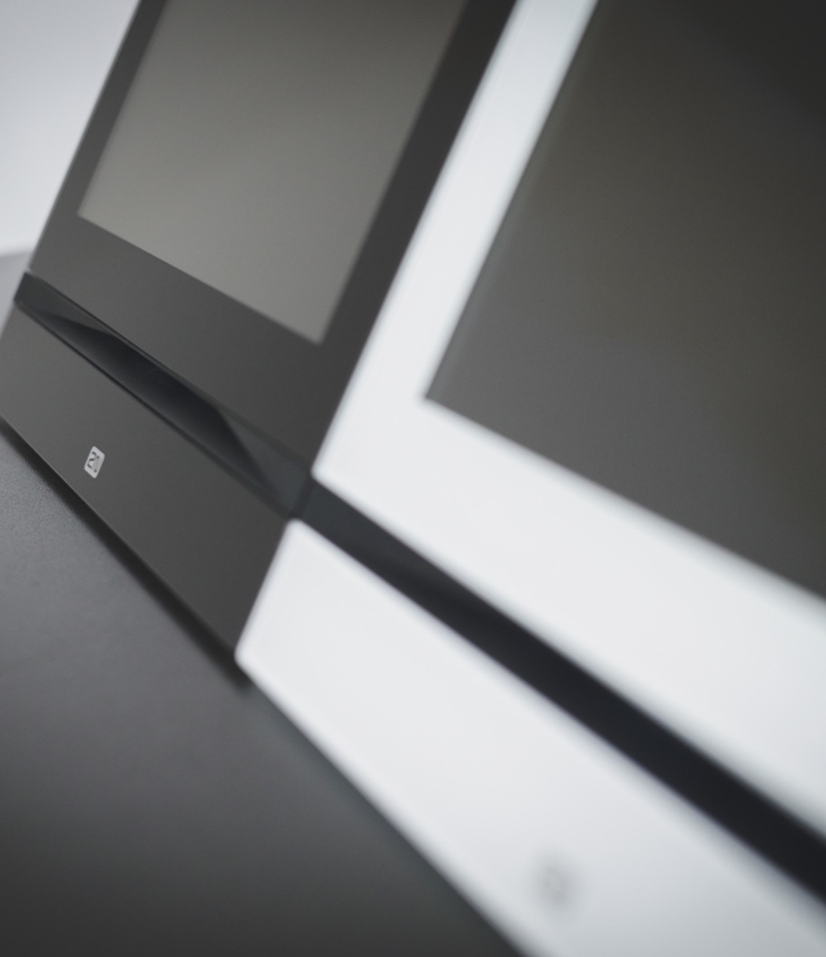
General Overview
Award-winning design
Red Dot and iF Design awards set a high bar
in terms of design
Choose your OS
Units with the 2N OS won’t let you down. For advanced integrations, choose Android
Cybersecure
Prevent cyberattacks and give preference to European products

Slide 4
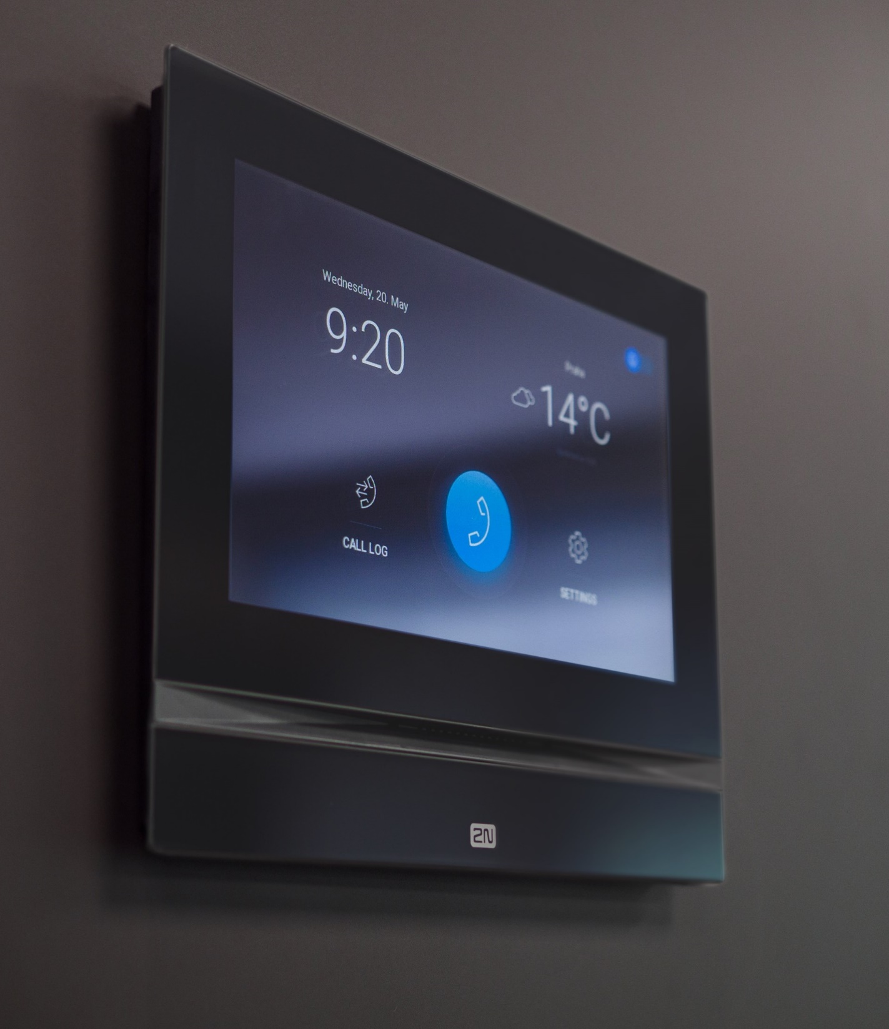
General Overview
Go for IP
It offers easy connection, configuration and
power over ethernet
In-wall, on-wall or on a table
Find the right type of installation you need for your project, every time
Retrofit ready
No wiring? Make free calls over the internet
and discover the other benefits of My2N cloud

Slide 5
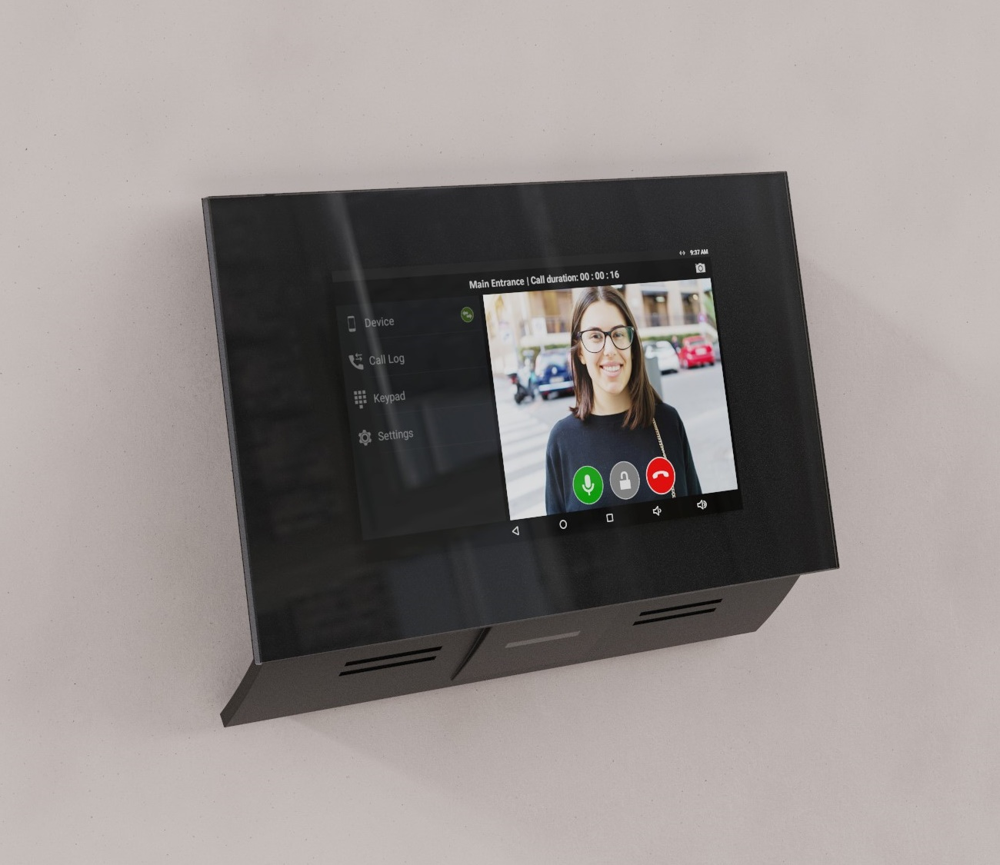

2N® Indoor Touch 2.0
Multifunctional panel with Android OS
Integration with home automation systems
Video recording for playing back missed calls
Durable 7“ HD touch screen

Slide 6
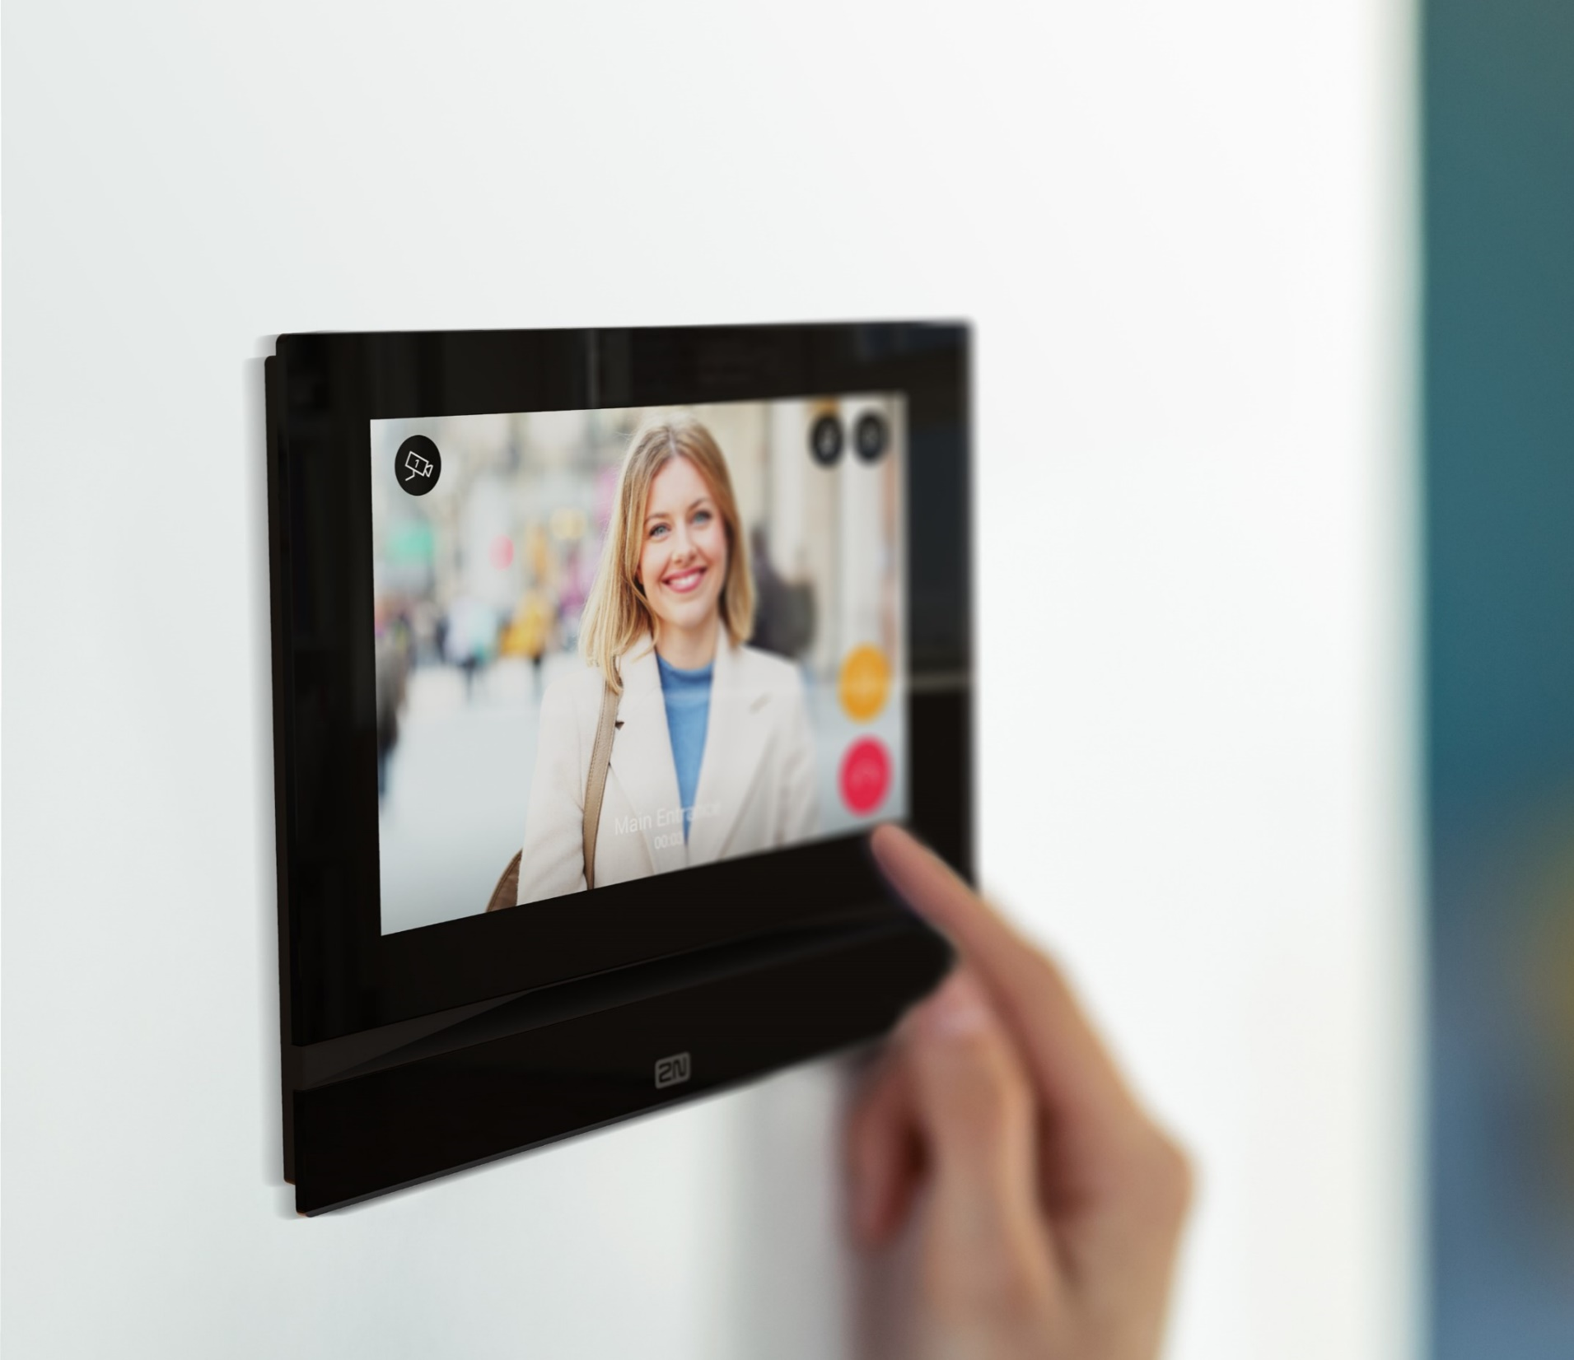
2N® Indoor View
Sleek answering unit with 7" touch display
Support of HD video calls
Video surveillance
Smart home integration

Slide 7
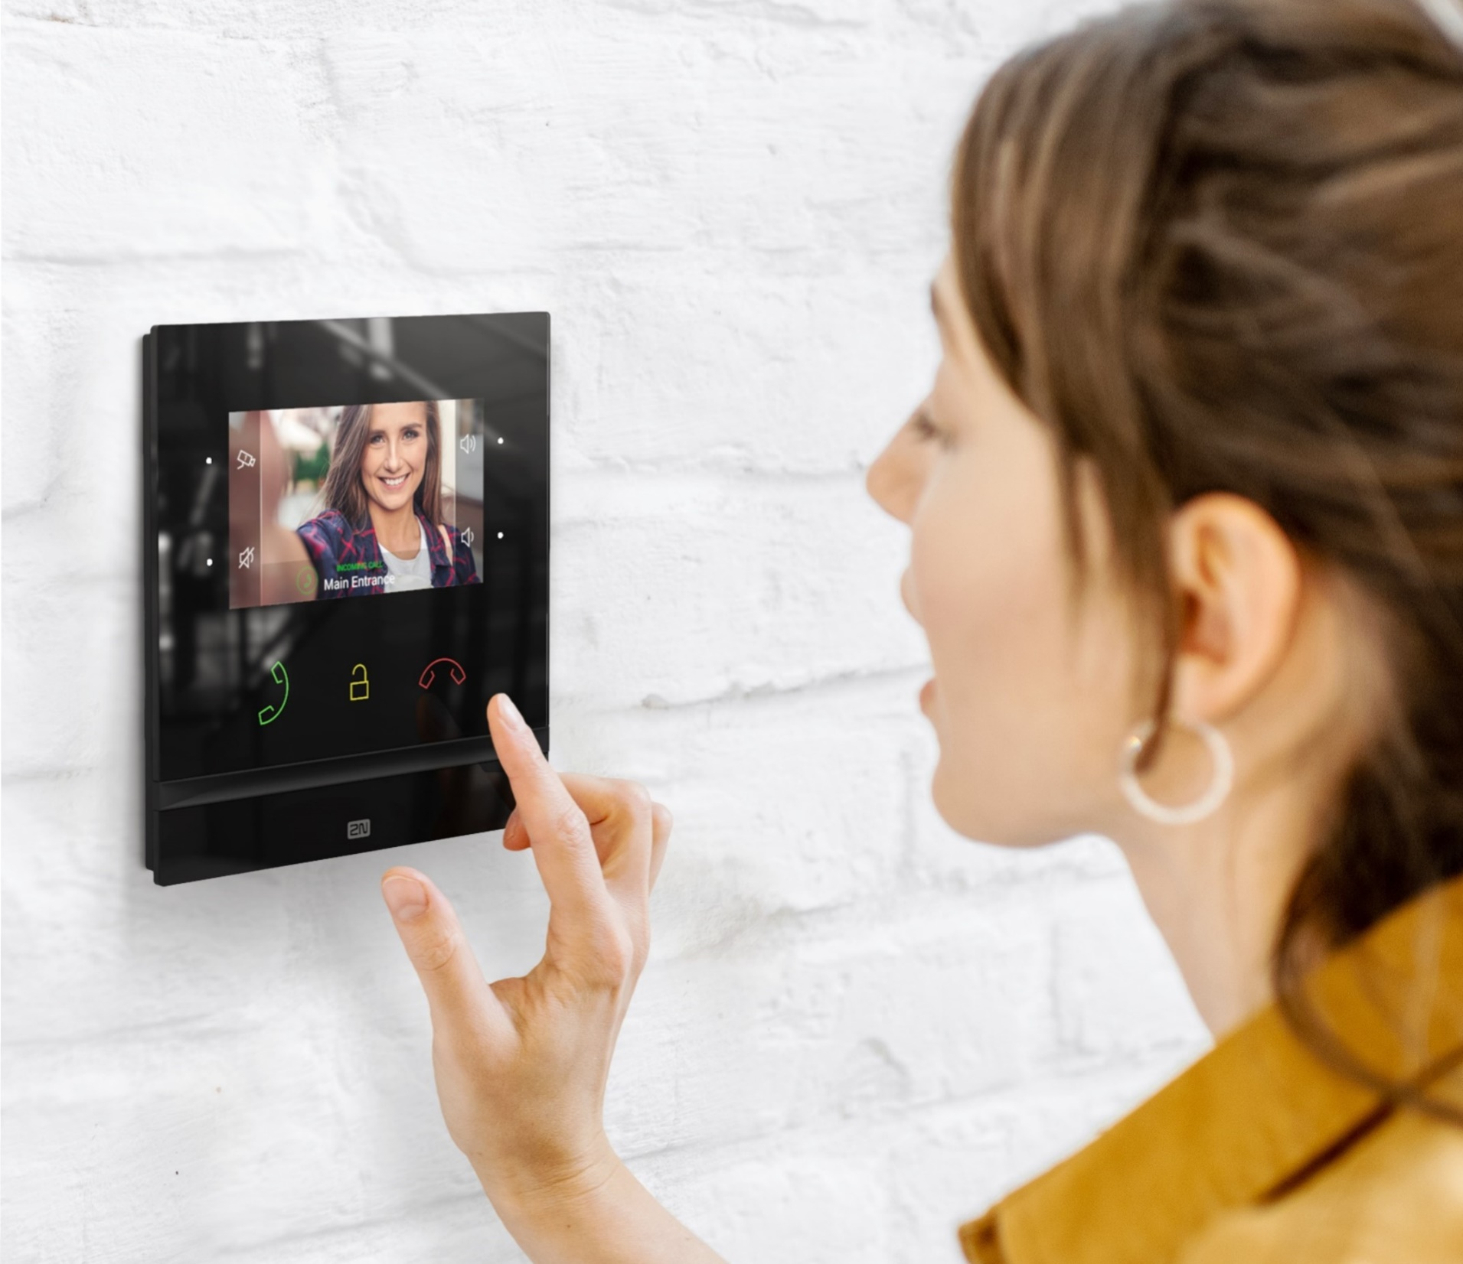
2N® Indoor Compact
Midsized video answering unit
Durable 4.3” display
Backlit touch buttons
Smart home integration

Slide 8

2N® Clip
Indoor station for
mid-priced projects
4.3” display
Touch buttons
Quick installation

Slide 9
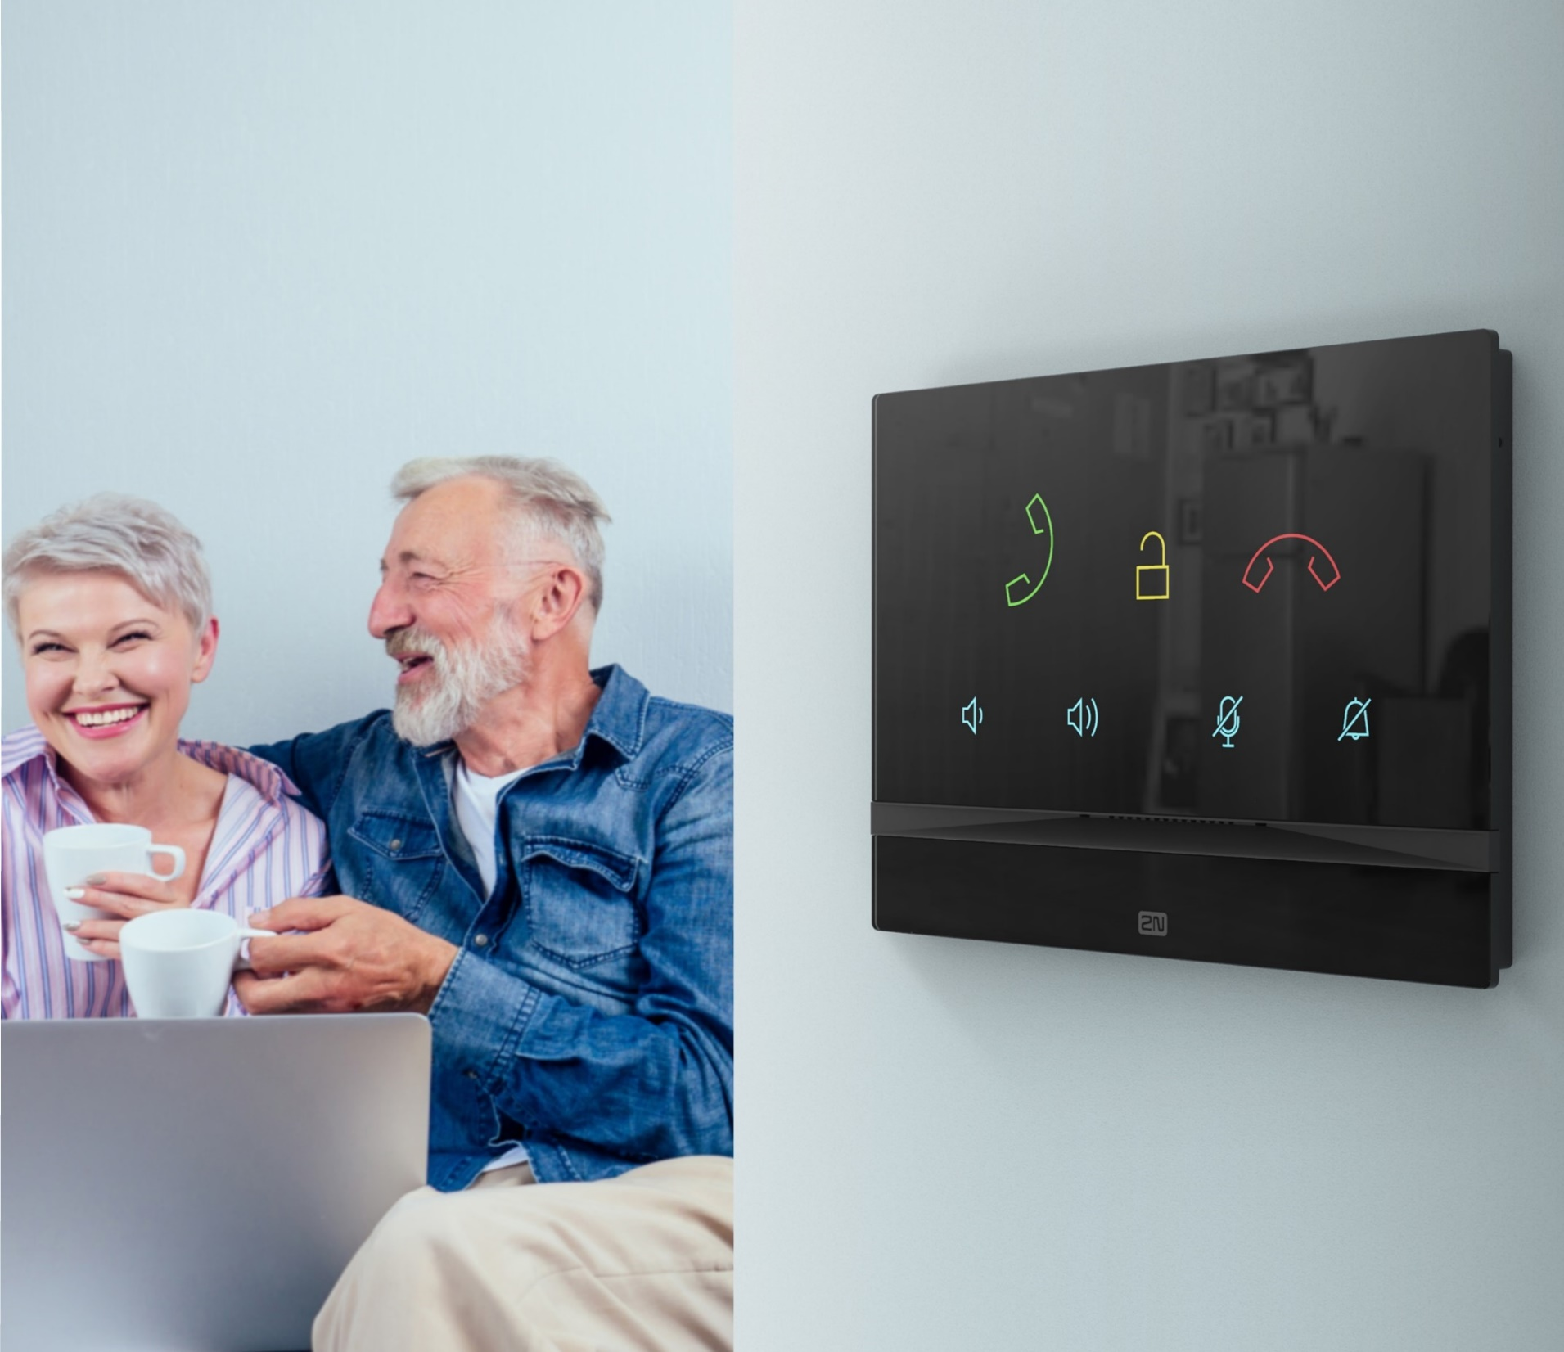

2N® Indoor Talk
More than just an audio answering unit
Crystal clear sound
Large backlit icons for easy control
3mm thick glass with an anti-scratch finish

Slide 10
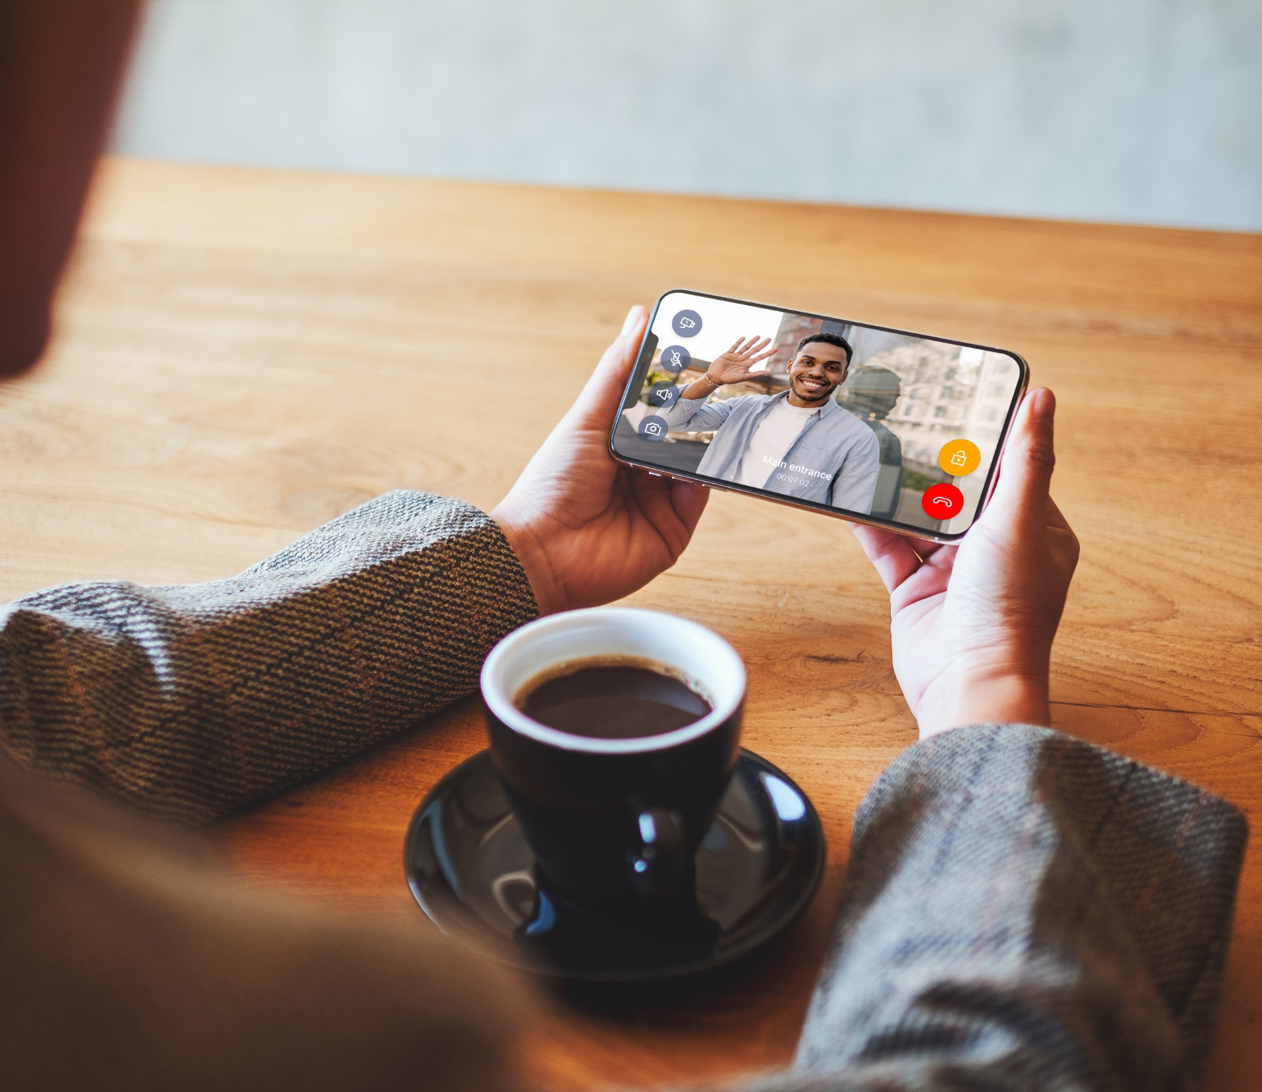
My2N App
Receive calls from intercoms via mobile
99.98% reliability rate
Round the clock home surveillance
Answer doors from anywhere

Slide 11
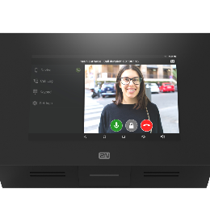
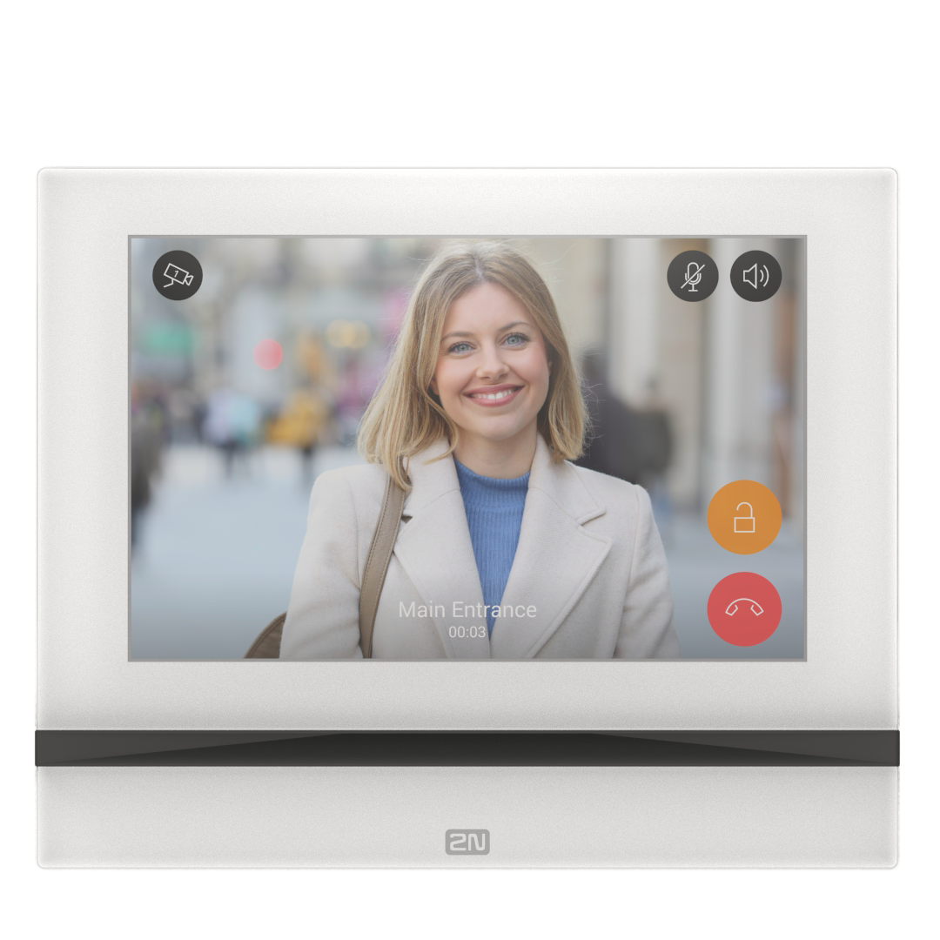
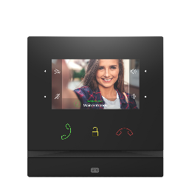
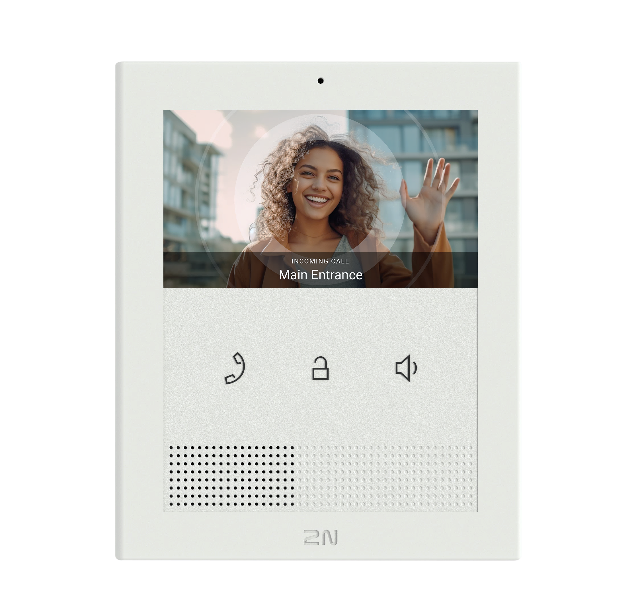
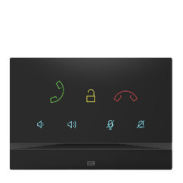

Answering unit portfolio
Home Automation
High-end
7” full screen
High-end
4” video
Cost effective video
Premium audio only
Mobile

Slide 12
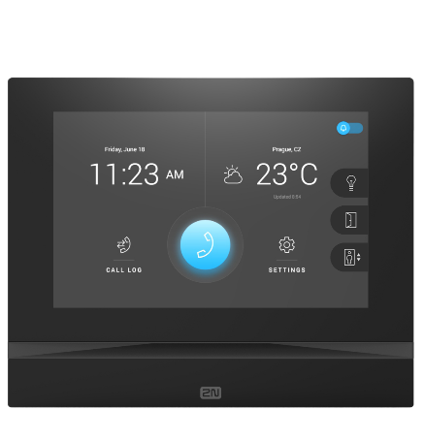
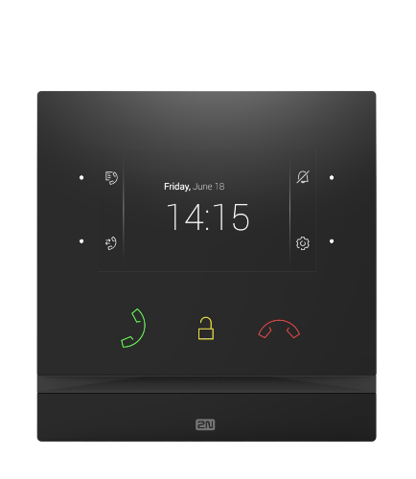
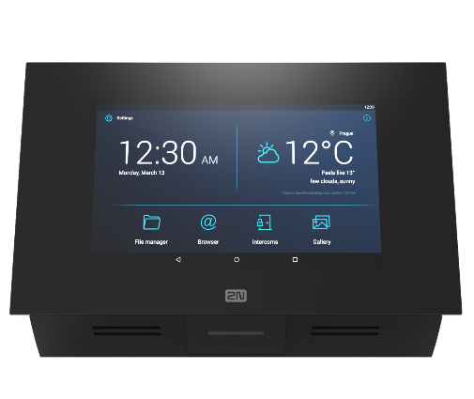
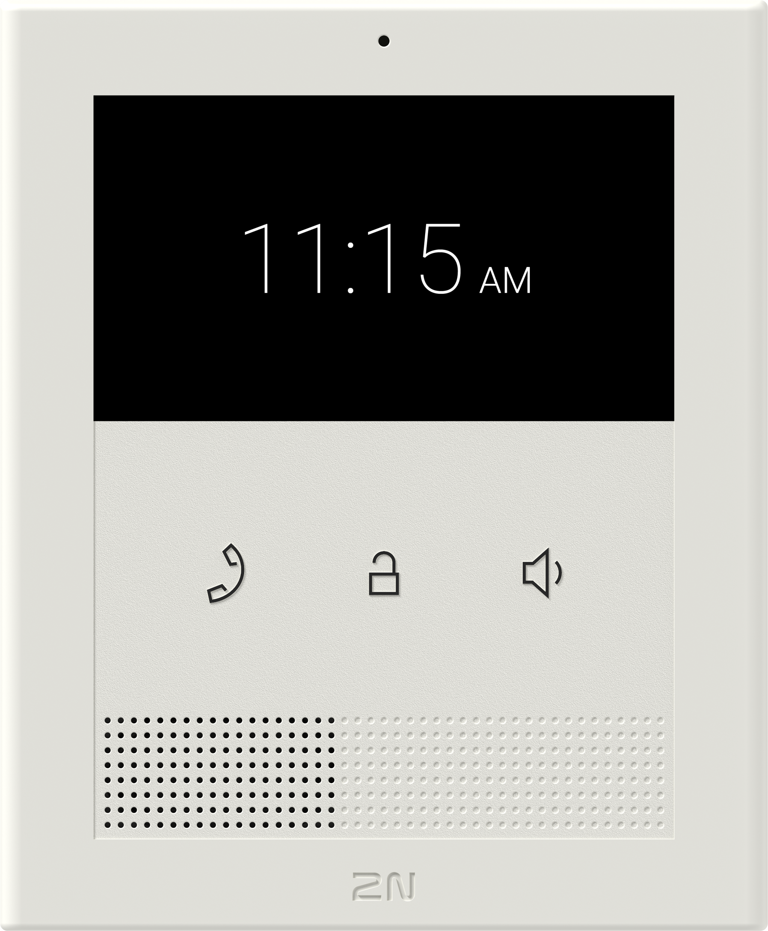
Order Numbers
2N® Indoor Touch 2.0
2N® Indoor View
2N® Indoor Compact
2N® Clip
01668-001
(black)
01669-001
(white)
02087-001
(black)
02088-001
(white)
01935-001
(black)
01936-001
(white)
02892-001
(ethernet)
02893-001
(ethernet, induction loop)

Slide 13
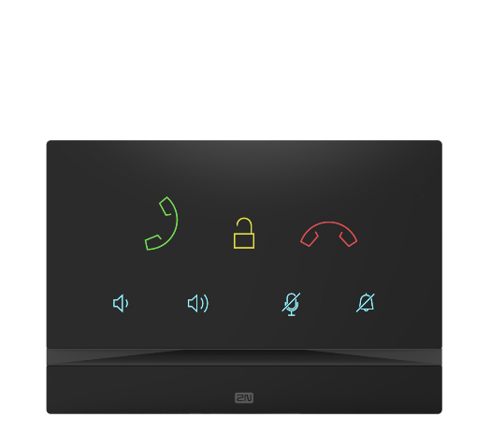
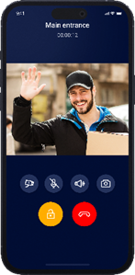
Order Numbers
2N® Indoor Talk
My2N App
01698-001
(black)
01699-001
(white)
02682-001
(annual device subscription)
02683-001
(annual apartment subscription)

Slide 14
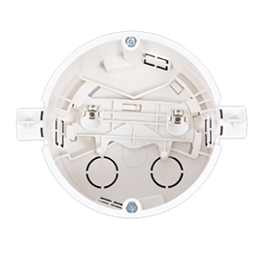
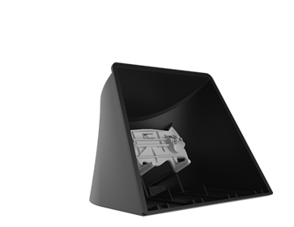
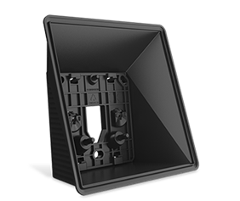
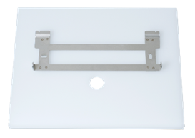
Order Numbers
2N Indoor Flush Box
(for 2N® Indoor View, Compact, Talk)
2N Indoor Surface Box
(for 2N® Indoor View, Compact)
2N Indoor Desk Stand
(for 2N® Indoor View, Compact, Talk)
Stand for
2N® Indoor Touch 2.0
01700-001
(mandatory accessory
for flush installation)
02320-001
(mandatory accessory
for surface installation)
02039-001
(mandatory accessory
for desk installation)
01425-001
(black)
01426-001
(white)

Slide 15

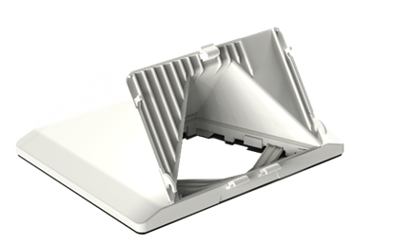

Order Numbers
Flush mounted
power supply
(for 2N® Indoor Touch 2.0)
2N Clip Desk Stand
2N Clip Single-Gang Box installation plate
01423-001
02905-001
(mandatory accessory
for desk installation)
02906-001

Slide 16
Rely on the high standards of European products
www.2n.com

