Slide 1
One family. One home. One smart intercom.
2N IP One

Slide 2
IP intercom for family homes
It’s not just large apartment buildings that need clever access control – even families want more than a simple video doorbell! The 2N IP One allows them to:
Increase security
Keep track of what's going on
Answer the door remotely

Slide 4
Clean, minimalist design
Slim frame, rounded edges, and three luxury finishes - the 2N IP One is designed to impress. The eye-catching backlit button has customizable colour that indicate the intercom’s current status (stand-by, ringing, in-call, door open).

Slide 5
Exceptional durability
With the IP66 & IK08 certifications, the 2N IP One is truly durable. The body is made of high-quality anodized aluminum, which ensures exceptional resistance to vandals, water, and dust.
This also applies to both the button and the camera!
Notes:
This is not an ordinary plastic doorbell.

Slide 6
Front door under control
Unlike regular video doorbells, you can connect the door strike directly to the 2N IP One. Residents can then answer the door from a 2N indoor station or the My2N app – and let visitors enter using a QR code on a mobile phone. They can also open the door for themselves using the My2N app.

Slide 7
Full HD, non-stop surveillance
Enhance home security! If motion is detected by the Full HD intercom camera, or the mic picks up increased noise, the 2N IP One will notify residents and start recording what is happening outside the home.

Slide 8
Connects with home automation devices
Based on open protocols and supporting multiple plug-ins, you can integrate the 2N IP One with leading home automation and also office building systems.

Slide 9
Superb sound quality
With exceptional clarity and perfect intelligibility – that’s how residents will communicate with every visitor, even in noisy environments. All thanks to the sensitive microphone and powerful speaker.

Slide 10
Unthinkable for some, standard for us
5-year warranty
Secure by design
Made in the EU
Reflects the confidence we have in all our products and guarantees you are secure and supported at no extra cost.
Being an ISO 27001 certified company, cybersecurity is at the forefront of our minds. We designed 2N IP One based on proven security models such as Axis' ASDM.
The 2N IP One was proudly manufactured within the European Union, using components only from trusted and NDAA compliant suppliers.

Slide 11
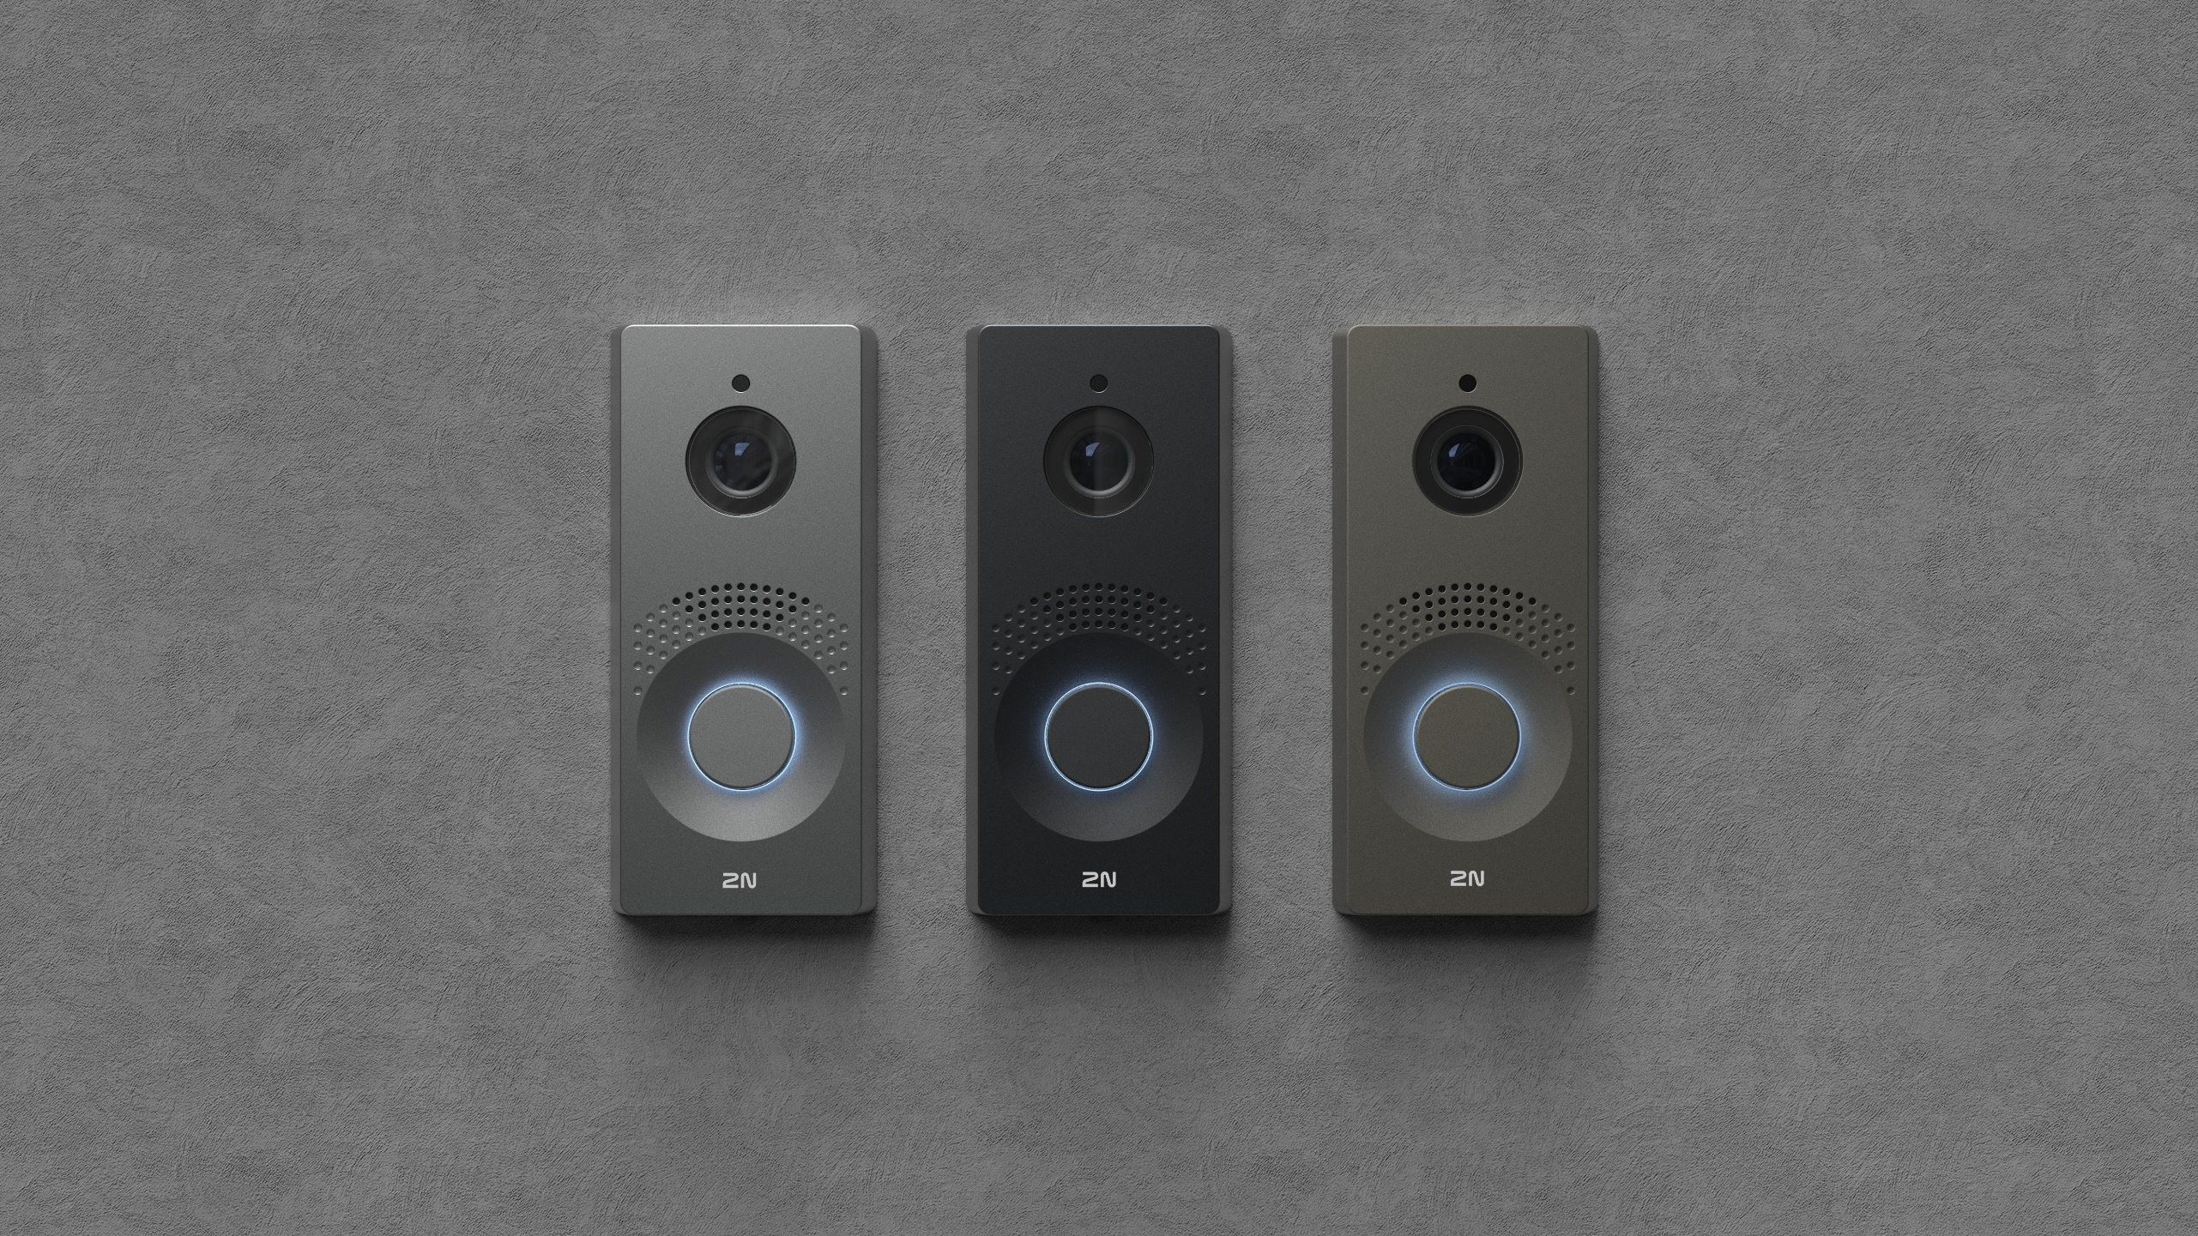
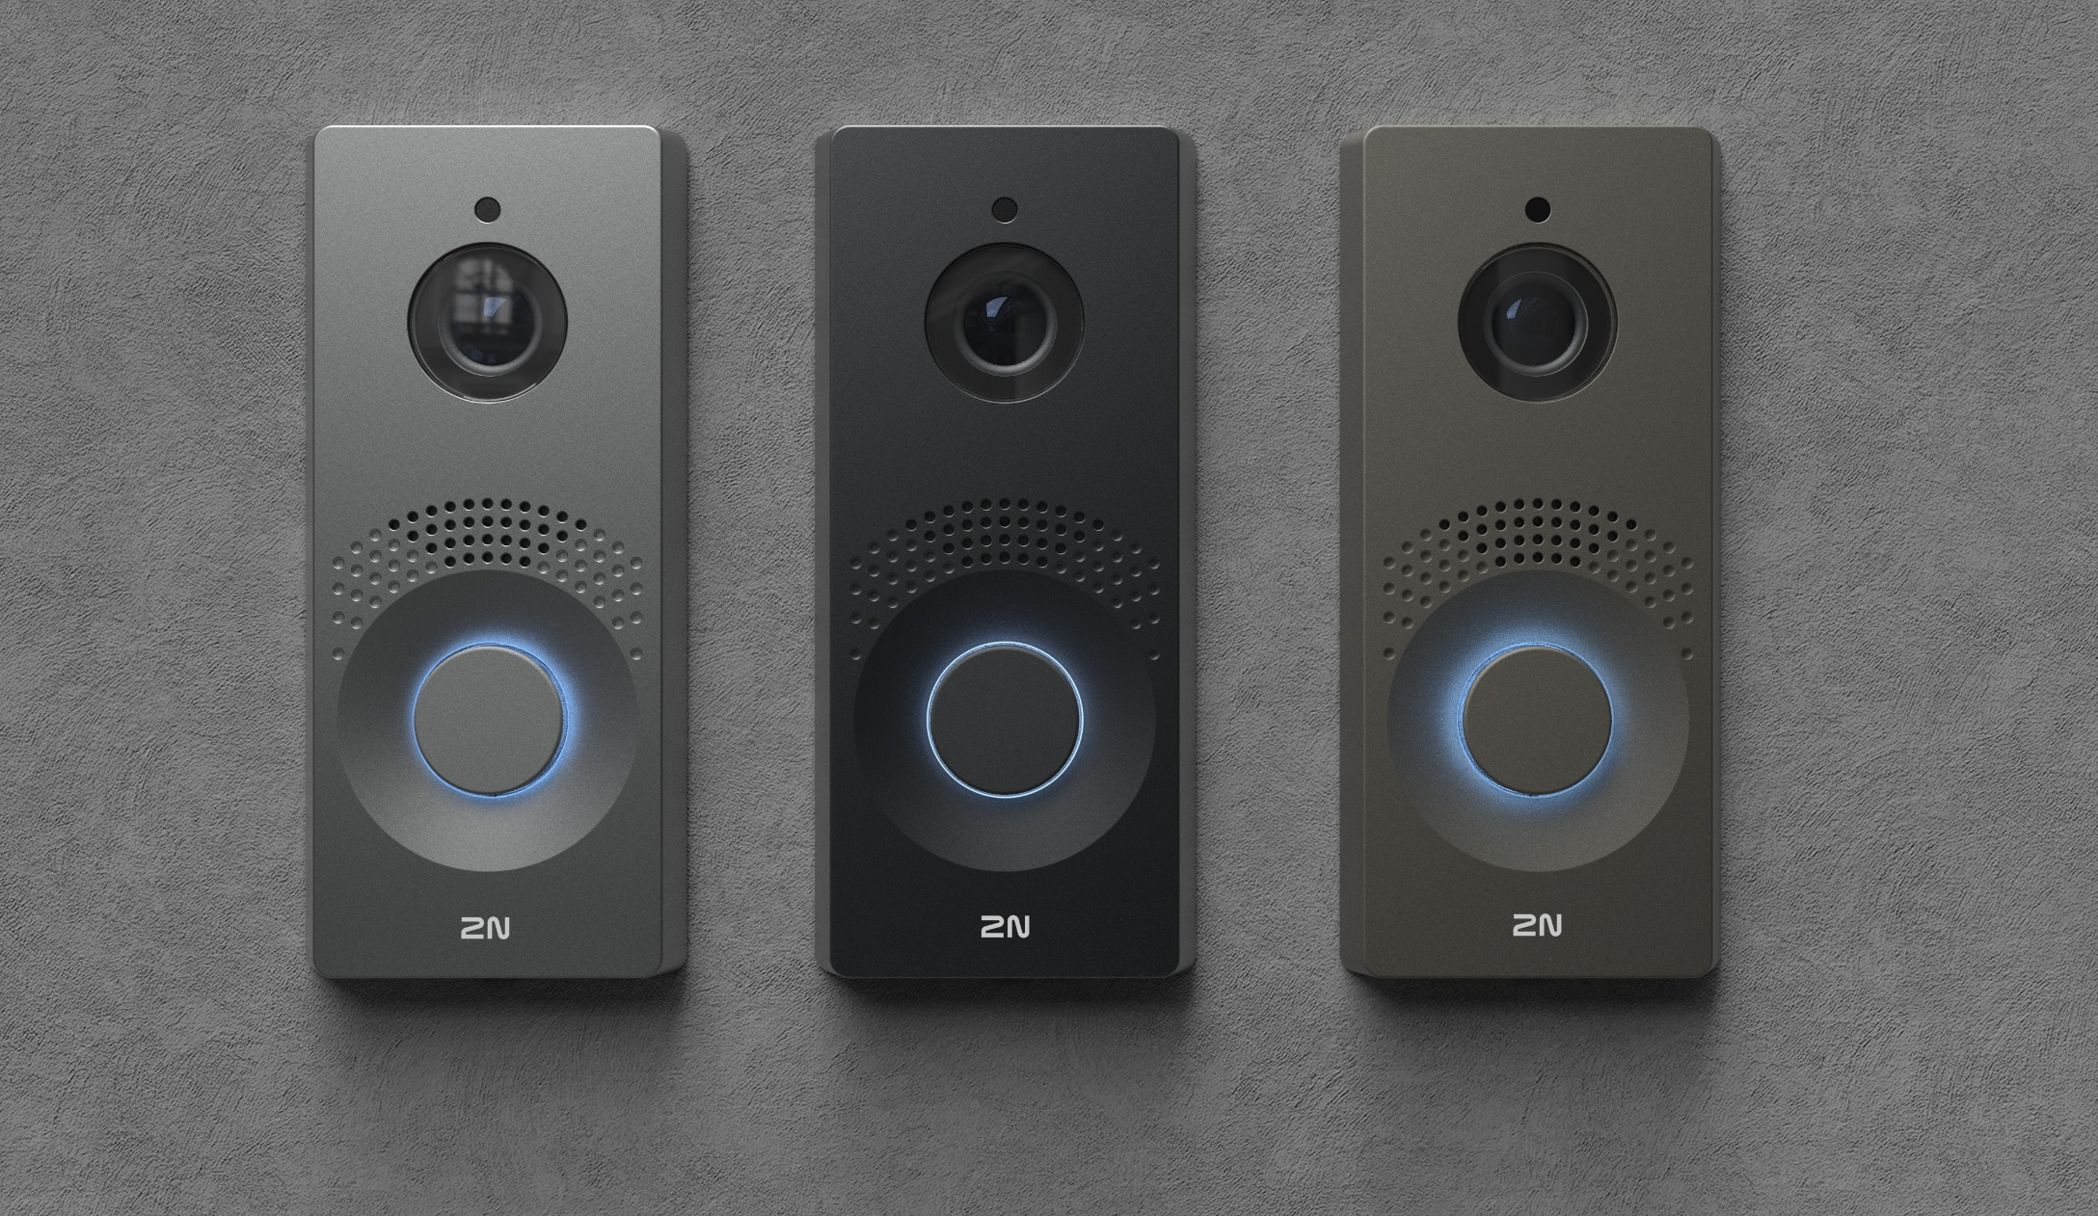
A technological masterpiece
1080p resolution, (WDR, Face Zooming)
IR illumination
QR code access
Uniquely designed speaker
Certified durability IK08 & IP66
Microphone in a special sealing
Customisable backlight colour
Made of anodized aluminium
Notes:
I have already used the word unique and our own development several times...for myself I have to say that this product is a true cutting edge and shows the technological maturity of our company.
With exceptional clarity and perfect intelligibility – that’s how residents will communicate with every visitor, even in noisy environments. All thanks to the sensitive microphone and intelligently developed speaker.

Slide 12
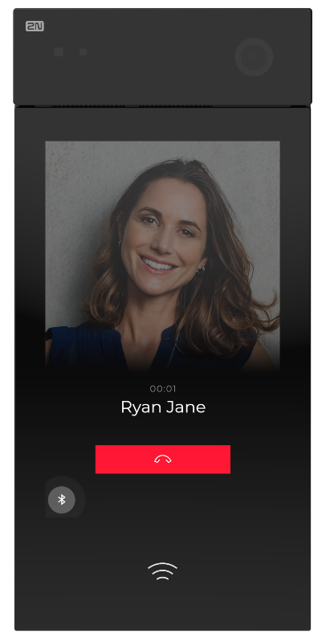
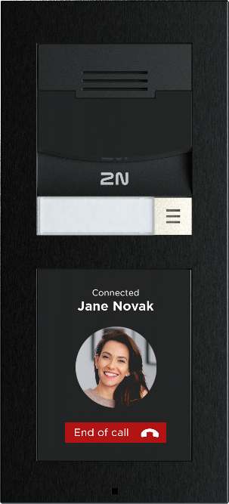
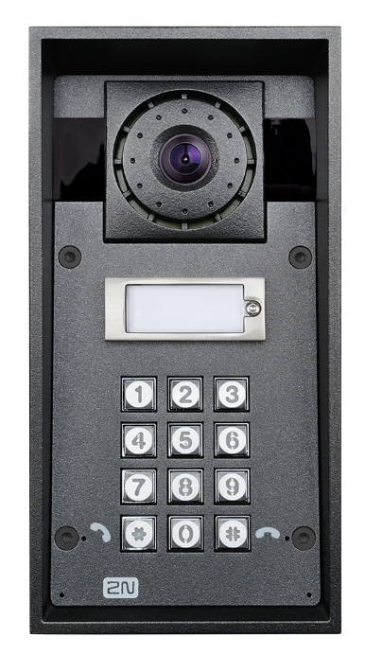
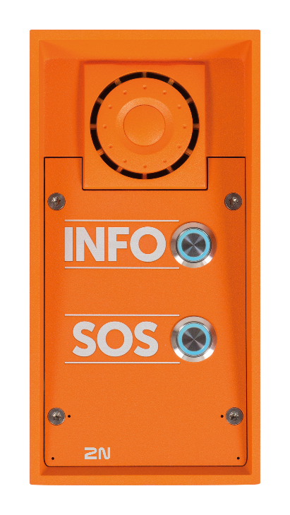
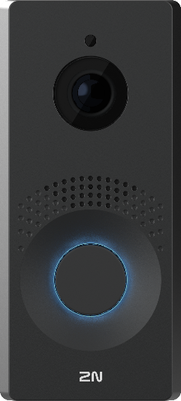
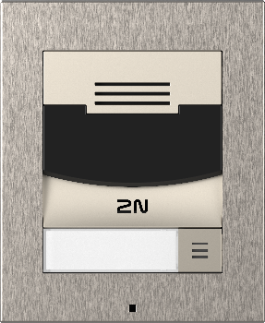
Part of the 2N IP intercom family
RECEPTION
SECURITY
WILLIAMS
2N IP Style
2N IP Verso 2.0
2N IP Force
2N IP Safety
2N IP One
2N IP Solo
These intercoms are particularly suitable for office buildings and apartment complexes (display, various access control options, Full HD camera).
The most durable intercoms on the market designed for demanding installations (noisy emergency environments, extreme temperatures, vandalism).
One-button intercoms designed primarily for single-family homes (can also be integrated with office building systems).
Notes:
Our best selling intercom… customers love the modularity, but the only limitation in some installation is the quality of the camera.
We know from our research and studies that 50% of office projects require an intercom with a FullHD camera.
Therefore, we are ready to launch the next generation of our best-seller which is harder, better, faster, stronger.
These are the adjectives that characterize IP Verso 2.0 and on which we will build our marketing communications.

Slide 13
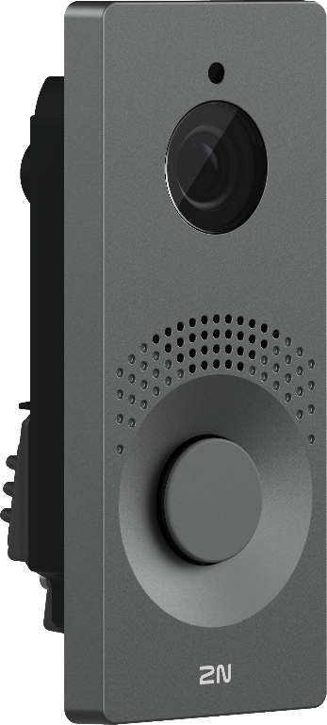
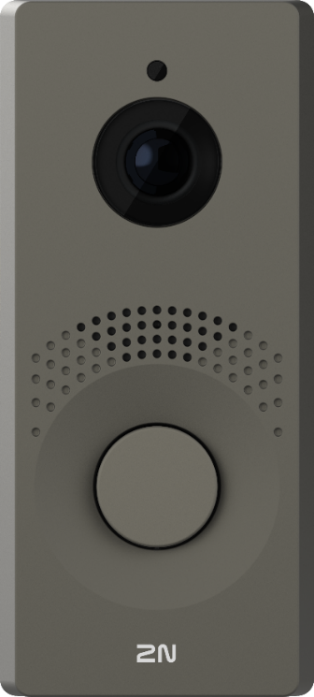
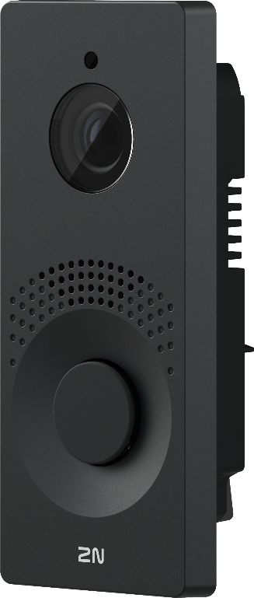
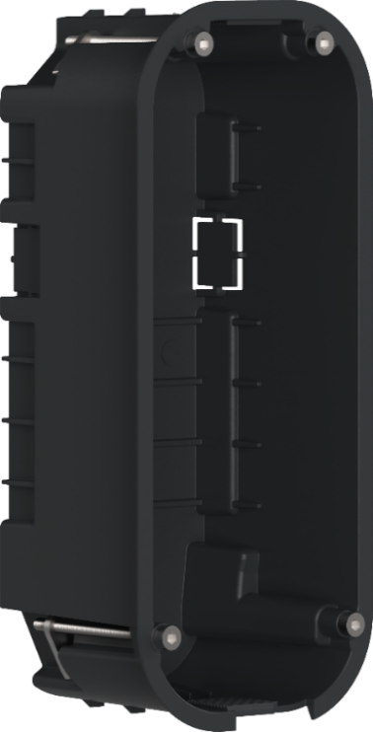
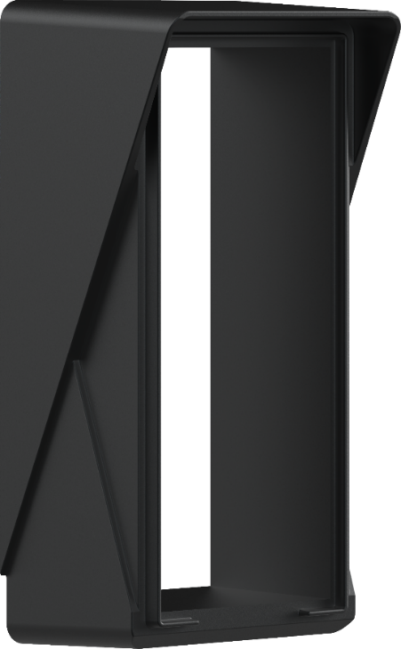
Product variants & mounting accessories
9158104 9158105 9158106 9158001
Grey Bronze Black Flush mount box
Coming Q4, 2024
Surface mount box
Note: 2N IP One is currently available only for flush mounting. Wall-mount box will come by the end of 2024.
Notes:
Mention that it will be in the temporary pricelist by mid March

Slide 14
Comparison table
 | 2N IP One | 2N IP Solo | 2N IP Verso 2.0
Power supply | PoE or 12V / 2A DC | PoE; or 12V / 2A DC | PoE; or 12V / 2A DC
Camera resolution (in call) | 1920 x 1440 px (4:3) | 640 x 480 px | 1920 x 1080 px (Full HD)
Max. viewing angle | 156°(H), 116°(V) | 128° (H), 95° (V) | 138° (H), 105° (V)
WDR support | ✓ |  | ✓
IR illumination | ✓ | ✓ | ✓
Zipstream (video compression) | ✓ |  | ✓
PIN, RFID, mobile access |  |  | ✓
QR code access | ✓ |  | ✓
ARTPEC-7 processor | ✓ |  | ✓
Face Zooming | ✓ |  | ✓
Chassis | Anodized aluminum | Hardened plastic | Anodized aluminum
IN/OUT | 1x IN, 1x OUT, 1x NO/NC Relay | 1x IN, 1x OUT, 1x NO/NC Relay | 1x IN, 1x OUT, 1x NO/NC Relay
Line OUT |  | ✓ | ✓
IP & IK rating | IP66, IK08 | IP54, IK08 | IP54, IK08

Slide 15
Technical parameters
Power supply
Type | PoE (802.3af) and/or 12 V / 2 A DC
Interfaces
LAN | 10/100BASE-TX with Auto-MDIX, RJ-45 jack
Recommended cabling | Cat-5e or better
Active switch output | 12 V DC, max 600 mA
Passive switch | NO contacts, 20 V AC or 30 V DC, 1 A
Inputs | 1 input - in passive/active mode (-30 V to +30 V DC)
Tamper switch | yes, mechanical
Audio
Microphone | 1 integrated microphone
Amplifier: | 5 W RMS (Class D)
Speaker | integrated, 3 W
Volume control | adjustable with automatic adaptive mode
Full duplex | Yes (AEC)
Protocols | RTP/RTSP/SRTP
Codecs | G.711, G.729, G.722, L16/16kHz
Camera & video
Sensor | 1/2.7'' colour CMOS
Focal lenght | 1.93 mm
View angle "peephole" | 156° (H), 116° (V)
IR, WDR | yes, yes
Minimal illumination | 0,3 lux without IR illumination
Protocols | RTP/RTSP/RTCP/HTTP, ONVIF v2.4 profile S
Codecs | H.264, MJPEG, Zipstream
Resolution H.264, MJPEG | max. 1920 x 1440 (4:3)
Frame rate | max. 30 fps
Dimensions
Device (above the wall) | 78 (W) x 172 (H) x 10 (D) mm
Flush mounting box | 67 (W) x 167 (H) x 56 (D) mm
Mechanical Properties
Front cover | aluminium casting, three colors
Button | 1, backlighted
Operating temperature | -40°C to +60°C
Storage temperature | -40°C to +70°C
Operating relative humidity | 10%-95% (non-condensing)
Weight | 355 g
Cover rating | IP66 and IK08
Warranty
 | 5-years warranty see https://www.2n.com/en_GB/support/warranty-and-repairs
Datasheets link

Slide 16
2N IP One
One family. One home. One smart intercom

